Slide 1

UC Managed Migration
Allie Markantonis
(Housing Quality Network & Brett Grellier Psychology Services)
alison@bgpsych.com
alisonm13@sky.com

Slide 2
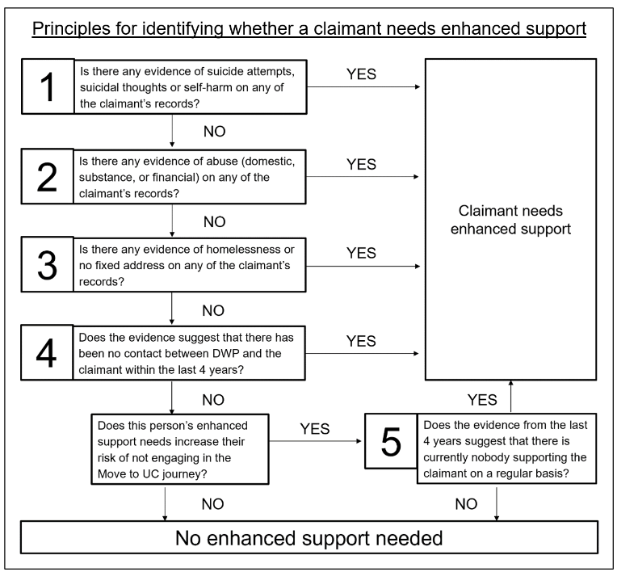
Enhanced Support Journey
https://www.whatdotheyknow.com/request/guidance_for_teams_working_on_ma/response/2479653/attach/4/Identifying%20enhanced%20support%20needs%20for%20Move%20to%20Universal%20Credit.pdf?cookie_passthrough=1

Slide 3
Enhanced Support Journey
If a claimant hasn’t made a claim by week 12 of the Migration Notice, they will receive a text saying that DWP will be contacting them, and from what number. They will attempt to call 3 times on different days
If an ESA(ir) claimant does not respond, they will receive a letter arranging a home visit
If a home visit is not successful in contacting the client, further escalations are considered
Deadline extensions will be automatically granted to allow them to make a claim before the Deadline Day
If they do make contact, the DWP will check again before Deadline Day if no claim has been made

Slide 4
Barriers for service users
Understanding a complex system involving a variety of online processes – Digital Literacy
Involving a 3rd party in helping to manage their claim
Communicating with Jobcentre Plus
Impact on health & wellbeing
Providing identification
Accessing a bank account
Setting up and managing claims online
Ongoing management of claims
Managing finances

Slide 5
Challenges for service users
Perception of UC
Fear – lose money, 5 week wait, cost of living crisis
Support – applying, right elements, Transitional Protection
Move across at the right time
Migration Notice – when to take action
Deductions / financial hardship

Slide 6
Challenges to support staff
Timing & service user reliance at letting us know
How to fill gaps in benefit
Where to signpost
  Benefits Advice
Delays
Deductions & sanctions
Supporting service users' mental health & wellbeing
We know very little about how DWP are using their powers to cancel Migration Notices

Slide 7
Useful links
https://www.gov.uk/government/publications/universal-credit-and-homeless-people/universal-credit-and-homeless-people-guide-for-supporting-organisations#appendix-1
https://www.turn2us.org.uk/get-support/information-for-your-situation/universal-credit-migration-notice/migration-notices
DWP Migration Notice Helpline
  Telephone: 0800 169 0328 (calls are free from mobiles and landlines)
  Open Monday to Friday, 8am to 6pm
Citizen Advice Help to Claim Service
  www.citizensadvice.org.uk/about-us/contact-us/contact-us/help-to-claim/
DWP Universal Credit Helpline
  Telephone: 0800 328 5644 (calls are free from mobiles and landlines)
  Textphone: 0800 328 1344
  Welsh language: 0800 328 1744
  Open Monday to Friday, 8am to 6pm

