Slide 1

Universal Credit: Managed Migration and beyond

Slide 2
Timetable
Migration Notices will be sent by benefit type to:-
Income Support (& HB) claimants - from April to June (110,000)
ESA(IR) and Child Tax Credit (& HB) claimants - from July to September (90,000)
JSA(IB) (& HB) claimants - in September (20,000)
Tax Credit and HB claimants - from April (120,000)
Housing Benefit-only claimants - after Tax Credit & HB claimants (100,000)
During 2024/25 - All other Income-Related ESA cases (brought forward from 2028/29) – from September 2024.
Note: Migration Notices will be sent out on a national level rather than geographical. There will be no geographical pattern to the issue of the notices – the timetable will be according to which combination of benefits the claimant is in receipt of.

Slide 3
UC Managed Migration
Allie Markantonis
(Housing Quality Network & Brett Grellier Psychology Services)
alison@bgpsych.com
alisonm13@sky.com

Slide 4

Poll

Slide 5
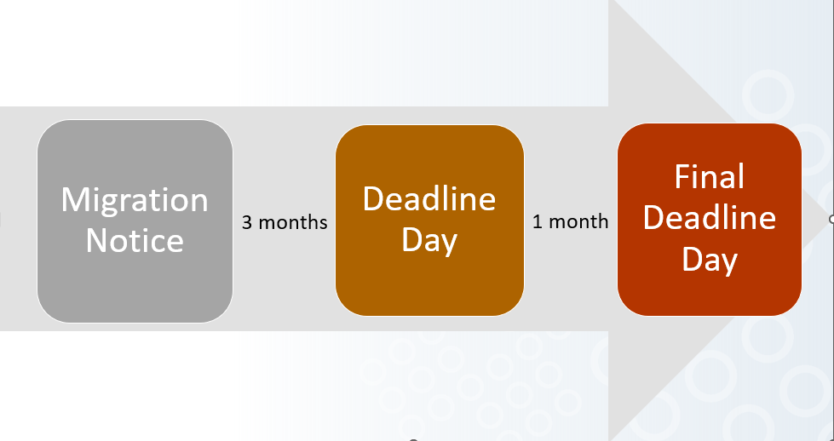
Managed Migration process

Slide 6
Summary
If this situation:-
Missed Deadline Day
Missed Final Deadline Day
Service user has known difficulty managing claim by Deadline Day
Refused an extension/cancellation of Migration Notice
Do this:-
Claim by Final Deadline to retain Transitional Protection (TP)
Make a new claim, but no Transitional Protection
Request an extension at least one week before Deadline Day, by phoning Managed Migration Helpline on 0800 169 0328. **You can only get an extension before your Deadline Day
Make a claim or try using one of CPAG template letters challenging the refusal. Discretionary decision so no right of appeal – Use complaints process https://www.gov.uk/government/organisations/department-for-work-pensions/about/complaints-procedure

Slide 7
Summary
If this:-
Think award is incorrect. Check UC statement if only getting standard allowance and think they should be getting more.
Do this:-
Request more information from DWP on Journal
* The DWP does not provide claimants with information about how their entitlement to transitional protection has been calculated in their UC statement. This means that claimants cannot check that the right information has been used to calculate their transitional element and many claimants will simply assume it is correct. If it is incorrect, claimants will be out-of-pocket, or accrue large overpayments which the DWP has the right to claim back even if the claimant is not at fault.

Slide 8
What's in place for vulnerable people?
UC Migration Notice helpline: 0800 169 0328
The line is open 8am to 6pm and calls are free
Help to Claim Service, Citizens Advice
Offline Claims
Guidance for help if you have accessibility needs
For those with additional needs a suite of additional products will be developed as part of the campaign and included in the toolkit and ‘Move to UC’ website.
  ‘Products include: explainer content, step by step guides on the application process, and wider accessible formats such as BSL videos, Easy Read guidance (also in Welsh), and translated materials where appropriate.’
At this stage, it looks as though those who cannot use a computer are being advised to phone the Move to UC helpline.

Slide 9
What's in place for vulnerable people?
DWP are recognising that claimants need advice and have developed the Enhanced Support Journey.
  It involves different interventions, ranging from outbound calls, system checks, home visits and contact with the local community. If all these options have been exhausted, a case conference will happen
In many cases, additional help is likely to be provided by those who support these claimants: families, landlords, advice and support services.

Slide 10
Julie Casson, Partnership Manager
Coastal Jobcentres; Blackpool, St Annes and Fleetwood

Slide 11
Enhanced Support Journey
Outbound Telephone Calls
  From week 12 after the Migration Notice being sent out (so following the second reminder, for those still to claim), the DWP will attempt contacting claimants by phone if they are considered may need extra support.
Home Visit
  Where no contact is made by telephone, then the DWP will refer all Income-Related ESA cases for a home visit. If a home visit is appropriate, then the claimant will be sent a letter explaining that the DWP are due to visit and when. And their Deadline Day will be extended.
Further Escalations
  If the DWP is unable to make contact (even after attempting a home visit), then further escalations will be considered on a case- by case basis. Where all these options had been exhausted, a case conference may be arranged.

Slide 12
Links DWP resources
Blackpool Escalation Doc February 2024
Easement document
Help to Claim

Slide 13
The Administrative Earning Threshold (AET)
The AET was designed to ensure UC claimants on low incomes are provided with regular work coach support to help them grow their earnings, becoming more financially resilient.
Between 2015 and 2022, the threshold had not kept pace with the increases of national minimum wage and national living wage.
As a result, regulations came into force on the 26th Sept 2022 to bring the AET back to levels commensurate with the 2015 levels (12 hours single /19 hours couple ) followed in April 2023, with an increase to 15/24 hours per week.
From 13th May 2024 the AET will increase further to 18/29 hours a week

Slide 14
What does this mean ?
For new claims made on and after the 13th May 2024, the service automatically calculates and applies the new AET threshold of 18 hours per week for a single person £892 or 29 hours per week for a couple £1437.
Existing claimants in the light touch regime, at the time the new regulations come into force, will only be impacted by this change after their first full assessment period, effectively from 13th June 2024.
In total, an estimated 186,000 claimants will be impacted by this increase, of which 113,000 will be existing claimants moving from Light Touch to IWS.
Conditionality in Light Touch will continue as at present.

Slide 15
Transitional protection payments
Transitional protection payments are an additional amount to help with your move to Universal Credit. The payment will make up the difference if your Universal Credit entitlement is less than your previous tax credits or benefits.
Example
Jane is entitled to £800 on her existing tax credits or benefits. Her Universal Credit entitlement is £600. This means Jane’s transitional protection amount will be £200.
Her total Universal Credit entitlement is now £800.

Slide 16
How long your transitional protection payments last
Transitional protection payments are not permanent. They can decrease or end if your Universal Credit entitlement increases.
If you’re eligible, your transitional protection payments will continue until:
Your Universal Credit entitlement is the same or more than your previous tax credits or benefits
You have a significant change of circumstances

Slide 17
Changes that can decrease your transitional protection payments
Your transitional protection payments can decrease over time following a change in your circumstances. Changes can include:
Having a child
Starting to care for a child or disabled person
An increase in housing costs (rent)
A worsening health condition
Changes to government benefit rates
This is because these changes are likely to increase your Universal Credit amount.

Slide 18
Example
Jane’s current Universal Credit payment is £800, which includes a transitional protection amount of £200.
Jane has a second child added to her claim. This increases her Universal Credit amount by £50.
This means Jane’s transitional protection amount will decrease by £50.
However, her total Universal Credit payment is still £800.

Slide 19
How your Universal Credit entitlement affects your transitional protection payments
If your Universal Credit entitlement increases, your transitional protection payment will decrease by the same amount. Childcare costs are the only exception.
Further increases to your Universal Credit amount can eventually end your transitional protection payments. This will only happen if your entitlement is the same or more on Universal Credit.

Slide 20
Changes that end transitional protection
Significant changes to your circumstances will end your transitional protection. The following are considered as significant changes:
A partner moving into your household
A different partner moving into your household
A partner leaving your household
Your earnings drop below an agreed amount for 3 months in a row
Your Universal Credit claim ends

Slide 21
Universal Credit: Managed Migration and beyond

