Slide 1
Homelessness Presentations
BELFAST CITY COUNCIL
8,452
2,447
7.5
Between October 2023 and March 2024, just over 8,400 households presented as homeless to the Housing Executive
2,447 of these
households were
families
The Belfast Council area had the highest rate of presentations at 7.5 per 1000
Source: DfC Homelessness Bulletin October 2023 to March 2024

Slide 2
Homelesness Acceptances
5,698
1,935
3,544
In Oct 2023 to March 2024, just under 5,700 households were accepted as homeless by the Housing Executive
Over 1,900 families were accepted as homeless
Over 3,500 children were accepted as homeless as part of households
Source: DfC Homelessness Bulletin October 2023 to March 2024

Slide 3
Temporary Accommodation
4,784
5,106
0.5%
On March 31 2024, 4,784 households were
living in temporary accommodation in NI. This is an increase of 132% compared to Jan 2019
This includes over
5,100 children. This figure has increased by 110% compared
with Jan 2019.
4,784 households is around 0.5% of households in NI: one out of every 200 households
Source: DfC Homelessness Bulletin October 2023 to March 2024

Slide 4
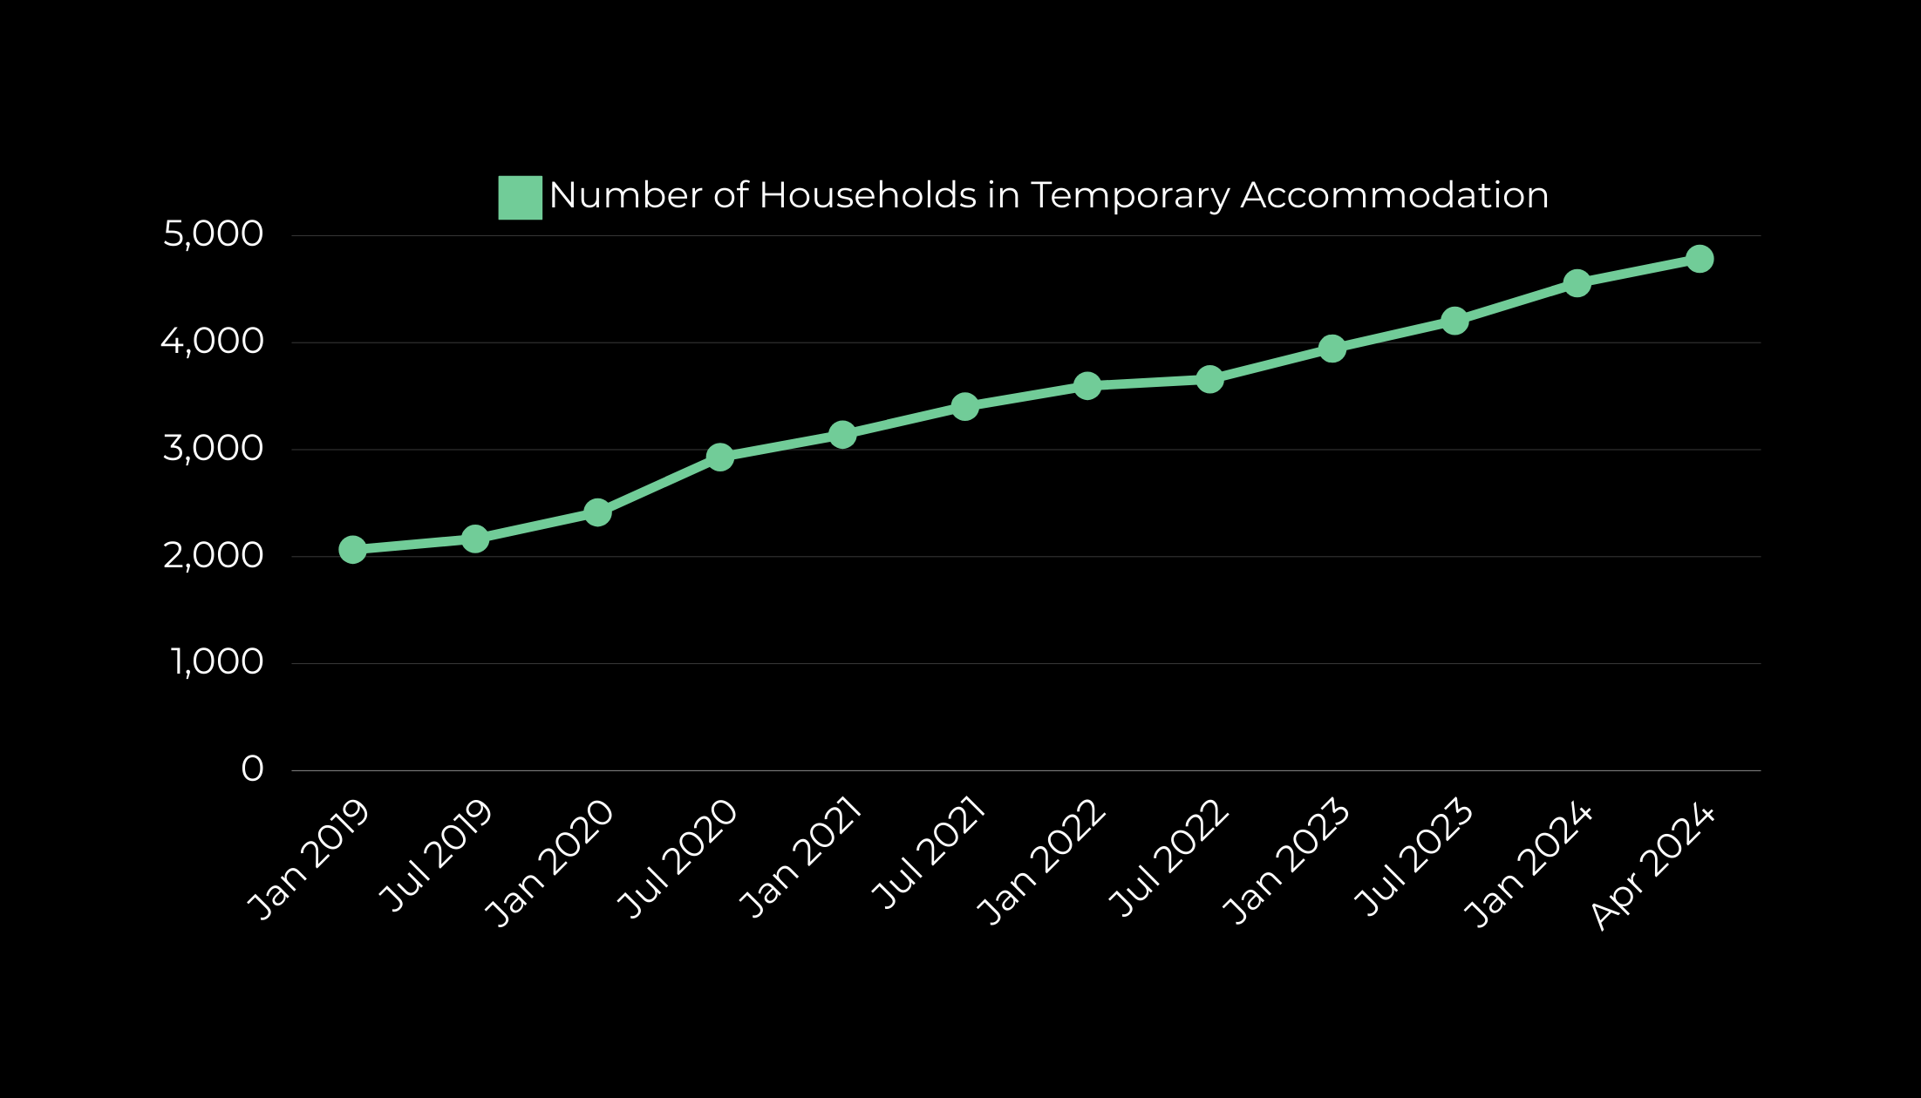
Temporary Accommodation
Increase of 132% between
Jan 2019 and Apr 2024
Source: DfC Homelessness Bulletin October 2023 to March 2024

Slide 5
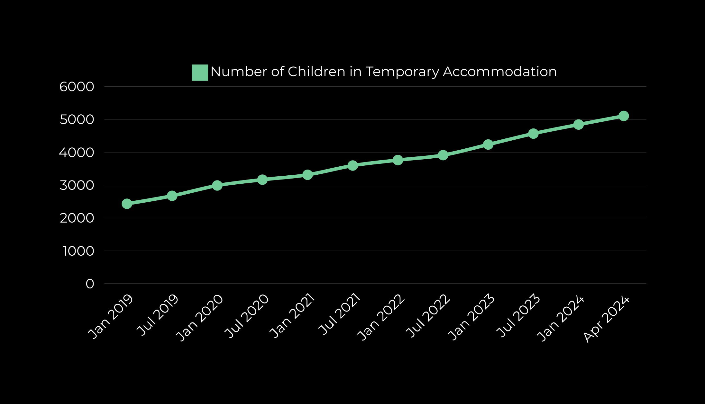
Temporary Accommodation
Increase of 110% between
Jan 2019 and Apr 2024
Source: DfC Homelessness Bulletin October 2023 to March 2024

Slide 6
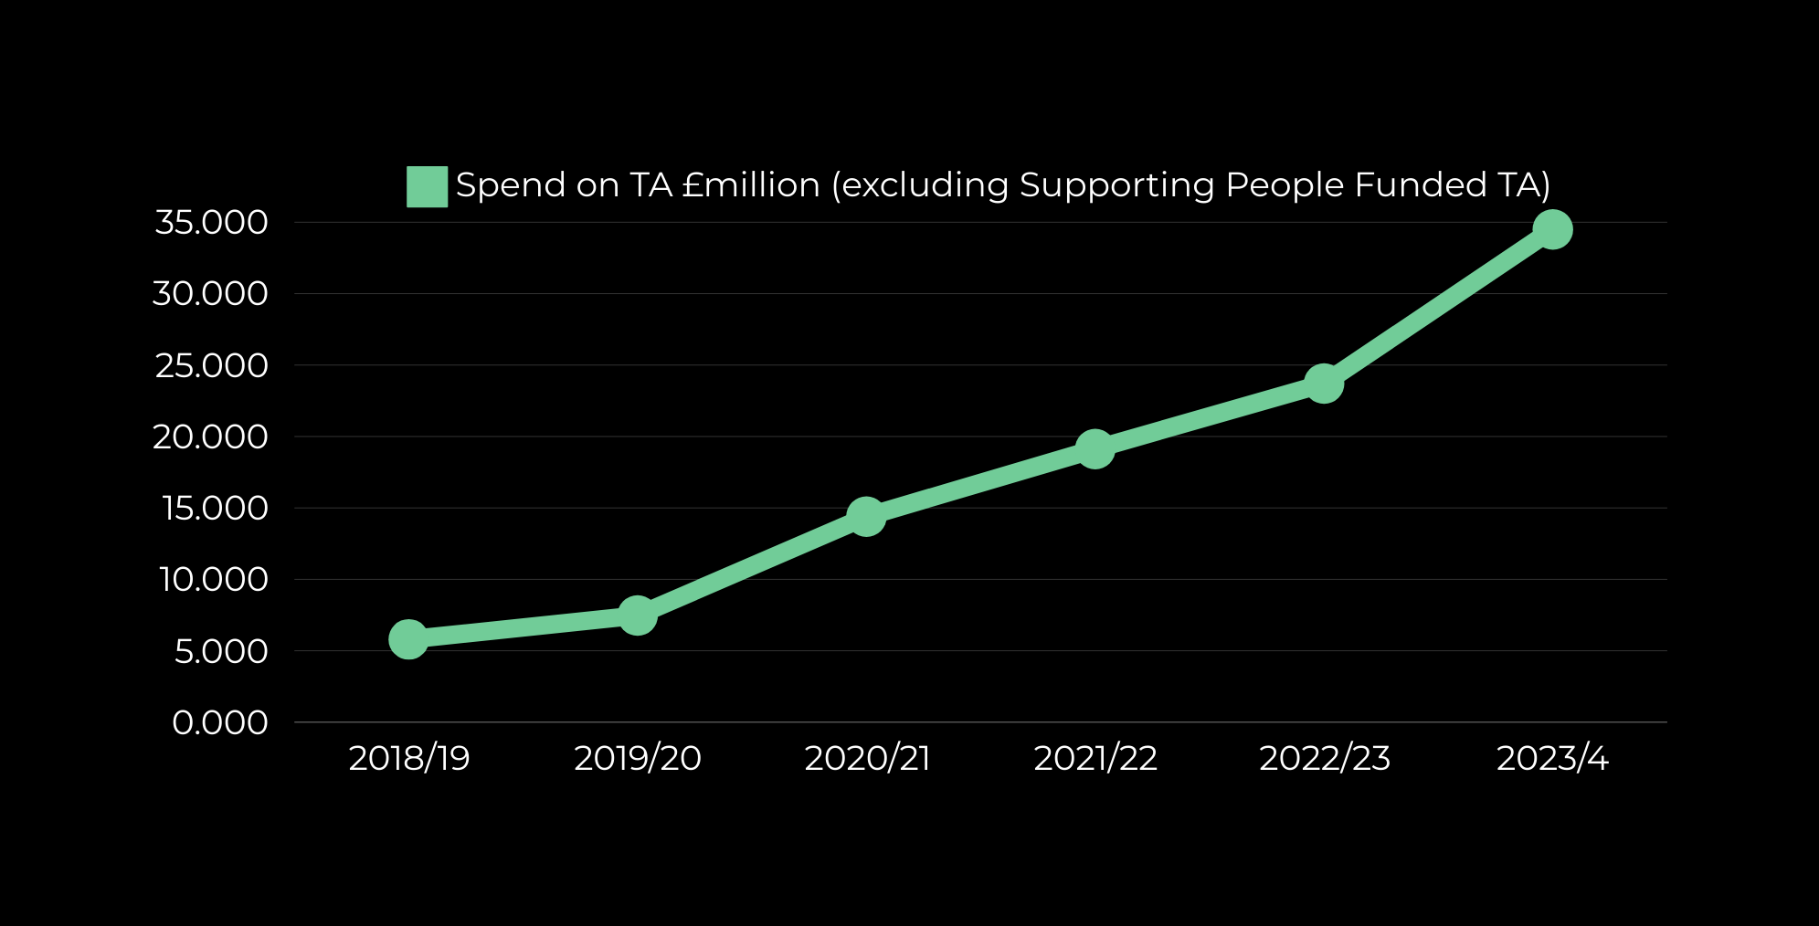
Spend on Temporary Accommodation (Non-SP)
Increase of 495% between
2018/9 and 2023/4
Sources: NIHE FOI 22/3 072 and AQW 12681/22-27

Slide 7
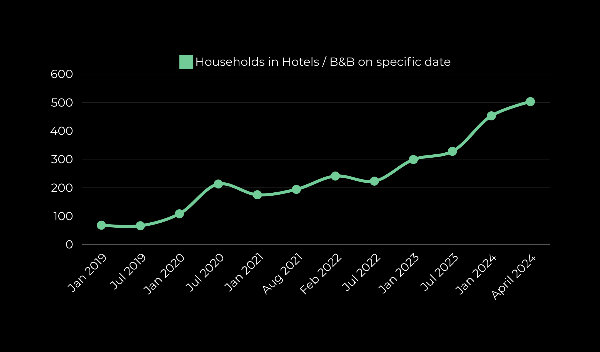
Use of non-standard Temporary Accommodation
Source: DfC Homelessness Bulletin Oct 2023 to Mar 2024

Slide 8
47,312
18.4%
35,464
On 31 March 2024, 47,312 households were on the social housing waiting list.
This is an increase of 18.4% since 2014.
Over 35,000
households on the
list were classed as
being in housing stress
on 31 March
Source: DfC Housing Bulletin January to March 2024

Slide 9
28,614
133.1%
55,589
On 31 Dec 2023, 28,614 households on the Social Housing Waiting List had homelessness status.
This is an increase of 133.1% since 2014.
55,589 people make up the 28,614 households with homelessness status. This is around 2.9% of the NI population
Source: NIHE FOI 276 2024 and AQW 286/22-27

Slide 10
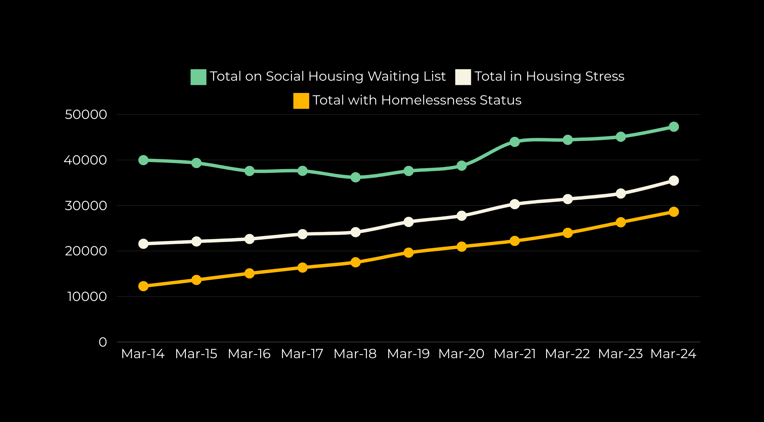
Social Housing Waiting List
Source: DfC Homelessness Bulletin Oct 23 to Mar 24 and AQW 286/22-27

Slide 11
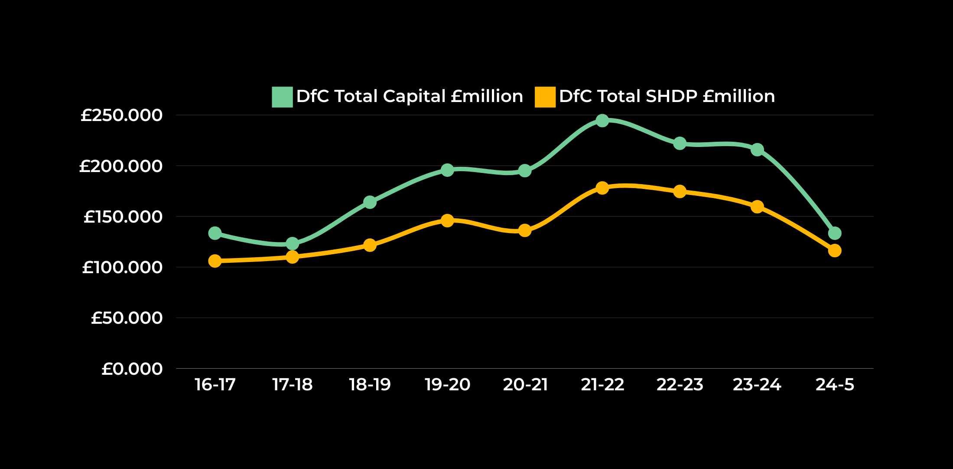
DfC Capital and SHDP Budget
Fall in Capital Budget of 38.2% and in SHDP of 27.1% between 2023/4 and 2024/5
Source: AQW 11103/22-27 and AQW 12677/22-27

Slide 12
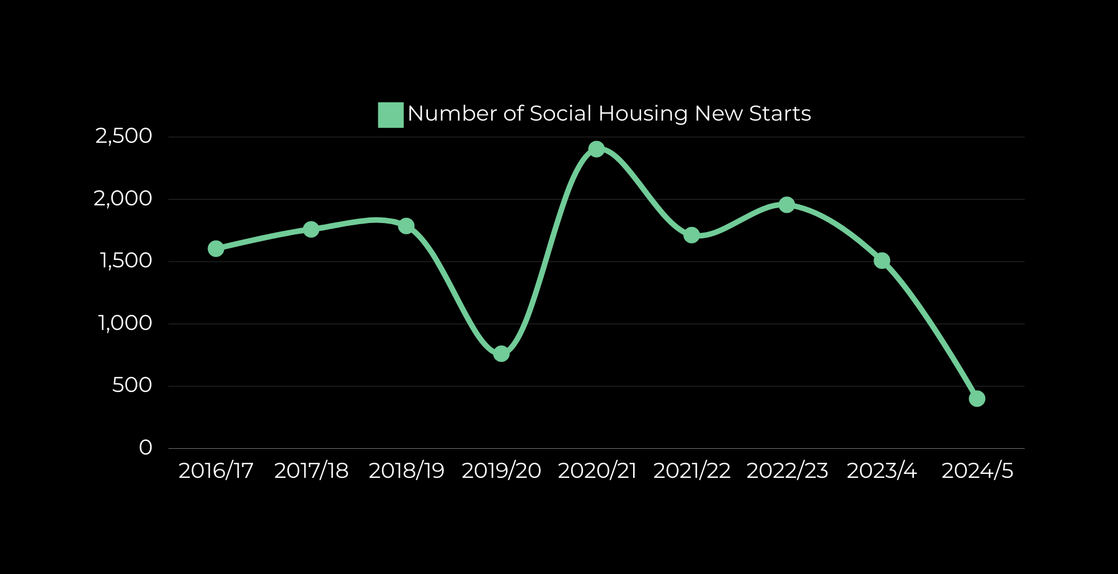
Social Housing New Starts
Source: Housing Bulletin July to December 2023, DfC EQIA on Budget Allocations 24/25

Slide 13
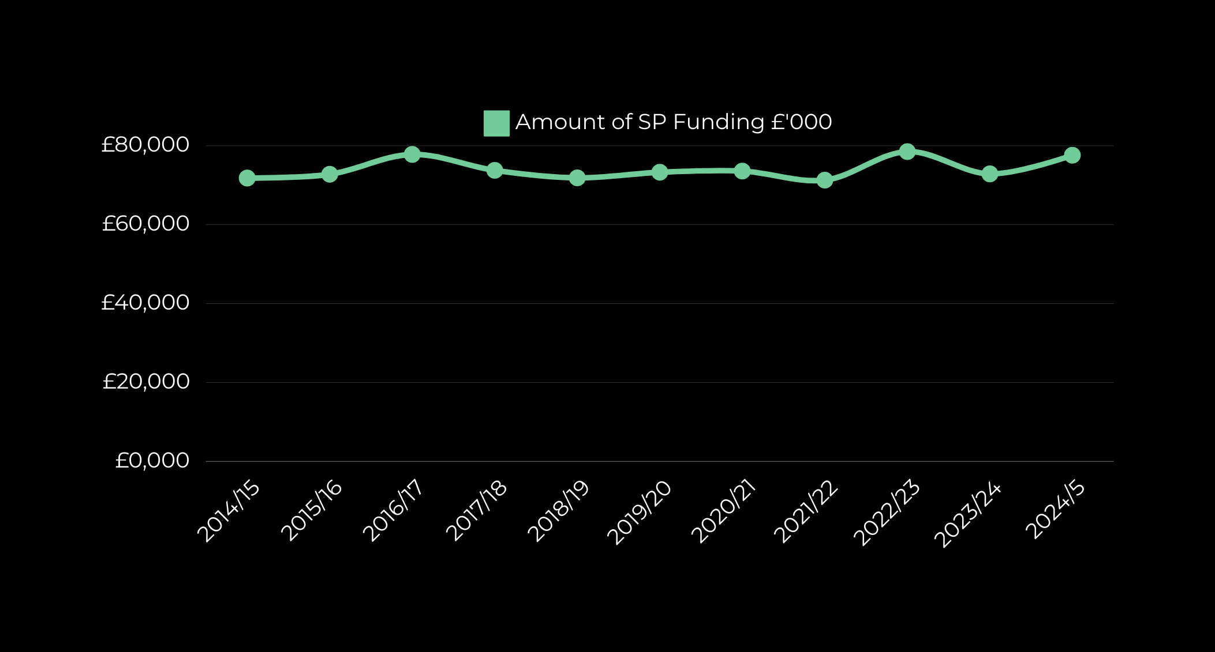
Supporting People Budget
Source: AQW 11103/22-27 and DfC EQIA on Budget Allcoations 24/25

