Slide 1
Exploring Systems Leadership Changing the narrative to ‘troubled system’
Making Every Adult Matter (MEAM)

Slide 2
This session…
Introductions Making Every Adult Matter (MEAM)
MEAM’s view of Systems
Case study 1: Client X
Case study 2: Pam
Q&A
Close

Slide 3
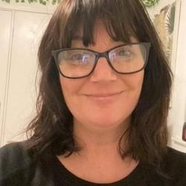
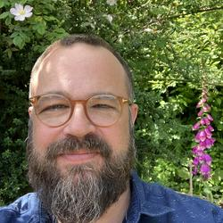
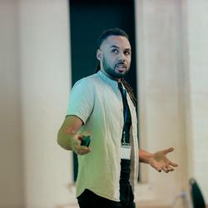
Princess Okwuonu
Medway MEAM Coordinator, Medway Multiple Disadvantage Network (MMDN)
MEAM Coordinator and Team Manager, Nottinghamshire County Council
Partnerships Development Manager, MEAM
Systems Practice Manager, MEAM

Slide 4
The Making Every Adult Matter Coalition
A coalition of national charities: Mind, Collective Voice, Homeless Link and Clinks.
Formed around 2009 as a response to the siloed commissioning, working and policy development apparent in the public and charity sector for people experiencing multiple disadvantage.
We work with place-based partnerships to help them focus on systems for people experiencing multiple disadvantage and use our shared knowledge and practical experience from this work to influence policy at a national and local level.
We strongly value coproduction with people with lived experience of multiple disadvantage and we are increasingly focussed on naming and addressing structural inequalities in our local work with areas.

Slide 5
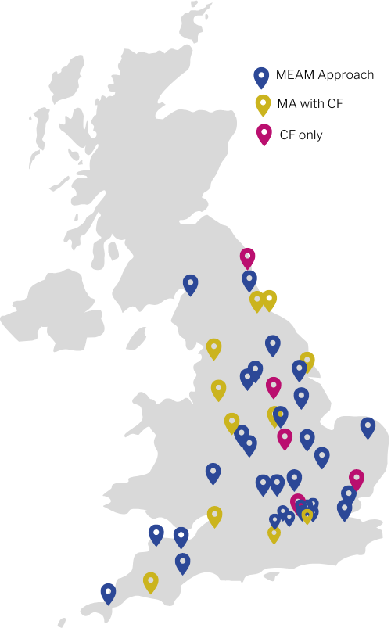
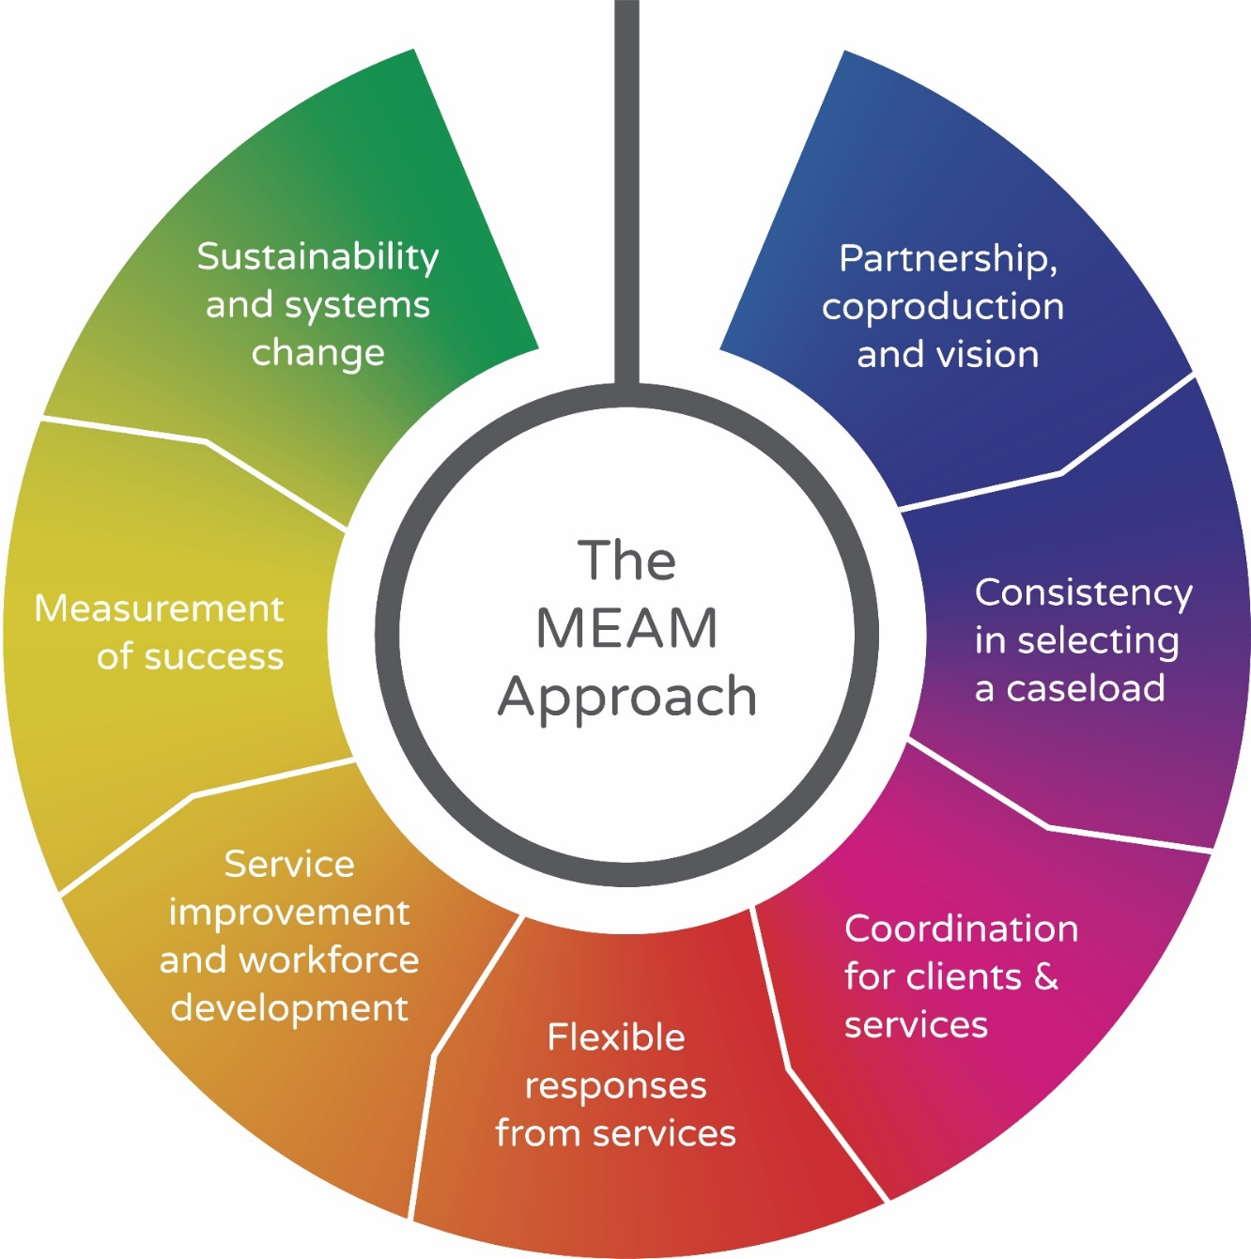
The MEAM Approach network
Basingstoke and Deane
Birmingham
Bristol*
Buckinghamshire
Calderdale
Cambridgeshire
Camden
Cornwall
Cumbria
Durham
Exeter
Greater Manchester*
Hackney
Haringey
Herefordshire
Hertfordshire
Hull*
Lancashire*
Lincoln
Medway
Middlesbrough*
Newham
North Devon
North Lincolnshire
Norwich
Nottingham*
Nottinghamshire
Oxfordshire
Peterborough
Plymouth*
Reading
Redbridge
Redcar & Cleveland*
Somerset
Southend-on-Sea
Stafford
Stoke-on-Trent*
Surrey*
Sussex*
West Yorkshire
Windsor & Maidenhead
York

Slide 6
Our vision
Our vision is that everyone experiencing
multiple disadvantage can reach
their potential and contribute fully
to their communities

Slide 7
MEAM’s definition of multiple disadvantage
People facing multiple disadvantage experience a combination of problems. For many, their current circumstances are shaped by long-term experiences of poverty, deprivation, trauma, abuse and neglect. Many also face racism, sexism and homophobia.
Multiple disadvantage is a systemic, not an individual issue… people are failed by services and systems that focus on singular issues, making it harder for individuals to address their problems.
(MEAM Strategy 2021– 2025)

Slide 8
MEAM’s view of systems
Services designed, commissioned and delivered in silos
Often built around the needs of the service, not the individual
Focus on deficits rather than strengths
Lack a person-centred and trauma-informed approach
As a result, can often add to people’s problems

Slide 9
Systems Leadership is a practice, not a product, defined as “the collaborative leadership of many people at different places in a system, in order to achieve a shared purpose
Systems Leadership - University of Birmingham
Notes:
Typicall used in wicked issues, complex situations, many disagreeing stakeholders / points of view, - SCIO has a good thing on this intro slides

Slide 10
MEAM Systems Intervention Approach

Slide 11
“It’s not troubled individuals, it’s a troubled system”

Slide 12
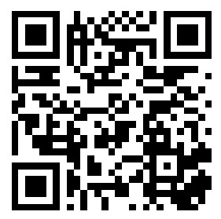
Question?
Join at Slido.com
use code 8423 093
Log on to Slido and answer the following question:
As a frontline practitioner, to what extent do you feel able to shape and influence local practice?

Slide 13
Please download and install the Slido app on all computers you use
As a frontline practitioner, to what extent do you feel able to shape and influence local practice?
ⓘ Start presenting to display the poll results on this slide.

Slide 14
“……. THE PROBLEM NOT THE PERSON”
IN THE EYES OF A MEAM COORDINATOR

Slide 15
BEHIND THE BARS

Slide 16
CLIENT X
BACKGROUND HISTORY
Involved in the Criminal Justice System.
Learning difficulties (Family History)
Over 32 convictions since age 18
System not working

Slide 18
BARRIERS
Having being supported in custody for LD, mental health this has been a challenge in the community to obtain a diagnosis for LD nor a referral for MH.
Early prison release, as much as this was salvaged at the last minute it would have caused a huge setback on the progress of the support in the community. (current issue 70 days).
Services working in silos.
Systems not working for clients with multiple disadvantages.
the tag issue & how this triggers his conflict & self Harm
the carers inconsistency & times allocated seemingly to suit the carers not the client.
LD not been recognised eg Gillingham Football Club
A previous social worker not prepared to lead & formulate a working approach/strategy

Slide 19
WHAT WENT RIGHT

Slide 20
What went right
Good relationship with the prison establishment, PO was empathetic and provided access to “Client 1” giving the opportunity to build a good relationship and enable Client 1 to be involved in his support.
Professionals getting together sharing advice
A social worker who was prepared to lead the network & build a relationship with the client
Getting Specialists around the table eg LD Lead for Kent
The flexible nature of the housing provider
Primary Care on release, GP Liaison worker attended meetings & helped with registration & dosset box to address previously known triggers for the client
Weekly MDT meetings to clarify working approach & feedback
Social Worker managed to get a CJS Communication Passport devised by a specialist CJLDS Speech & Language Therapist for the client to show people to help identify his needs. Eg, the police, it can help to inform them of his needs as sometimes they would suspect he is drunk when he isn’t & at 6 foot 3 & 25 stone has caused him problems as being identified as the aggressor when not.
Social Worker formulated a strategy that all who were working with client had to read, acknowledge & sign up to avoid creating conflict for the client which triggers behaviours such as reoffending, drinking & Self Harm

Slide 21
PAM

Slide 22
Pam: A story of difference
Pam is a woman in her late twenties. She was facing significant difficulties in her relationship with her partner. There is a history of serious domestic abuse, both emotionally and physically in the relationship which was relatively new. Pam has also experienced abusive relationships in the past, been badly beaten and featured chronic addictions. Not unlike her parent’s experience. And sadly two children removed. The trauma was significant throughout her life, sexual abuse, self-harm, bullying, suicide attempts. Pam was diagnosed with EUPD. After finally leaving her husband, her mum tragically drank herself to death in her flat and Pam and her sister found her several days later.
When contact was made with Pam to join the MEAM cohort she was heavily pregnant and had retracted all reports she had made regarding abuse by her partner instead professing the complete opposite - that Ken was loyal and loved her and would do anything for her. Although she has had previous alcohol issues Ken introduced Pam to crack cocaine and they described themselves as chronically addicted. This further complicated their relationship and their ability to make positive choices for themselves and their unborn child. The fact that they were homeless added another layer of instability and insecurity to their situation. These challenges made it incredibly difficult for Pam to maintain a healthy and safe relationship with her partner. However, Pam reported feeling strongly that Ken kept her safe from harm during their homelessness and rough sleeping something he constantly told her.
On referral the MEAM social worker (I) developed a relationship with Pam and worked alongside the unborn baby’s Children’s Social Care worker to advocate for Pam. The work was challenging and at times the MEAM social worker felt overwhelmed by the risks that were being managed - including the high suicide risk due to Pam’s Emotionally Unstable Personality Disorder/Trauma and two very serious previous attempts on her life.

Slide 23
System map

Slide 24
Pam: A story of difference
Persevering together Pam and the team identified her strengths. Working closely with Pam the team were able to move quickly when a time limited opportunity presented itself. Ken was remanded in custody for several serious crimes including robbery. Until Ken was removed from the situation Pam did not really engage consistently with anyone but the team were able to use the time apart to help Pam to identify what was happening and what she wanted. Whilst Ken was in custody the team moved to make a time critical intervention and used MEAM funding to place her in hotel accommodation out of Nottinghamshire. Probation were able to flex their approach to keep Ken in custody whilst accommodation plans were made to keep Pam and the baby safe.
The out of area housing authority accepted their duty towards her as someone fleeing domestic abuse but she was placed back in Nottinghamshire in a hotel in a room opposite a chaotic man who was a poly drug user, and she was in a very vulnerable situation. Pam had the baby early at 36 weeks whilst in this accommodation. At the last-minute Pam was offered a mother and baby placement which she moved to following the birth.
Pam has now said her ties with Ken are severed as she sees her future success depending on her parenting baby as a single mum. Pam has been supported to reunite with her sister which is a massive strength to build on. She has agreed to work with CGL too and fully engaged in learning pportuities at Mother and baby
Childrens services have fed back that the MEAM support has made a real impact on Pam’s chances of moving forwards. Without MEAM support colleagues fed back that it would likely have ended with child removal – as Pam has had 2 previous children removed in the past. Pam says she feels incredibly lucky to have the support and the co-ordination that has been provided, keeping her informed and encouraging her to forgive herself and move forwards.

Slide 25
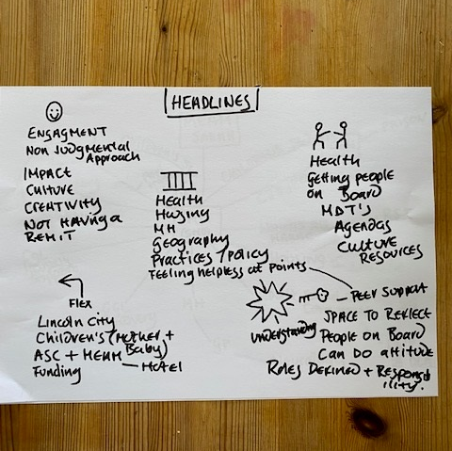
What went well
Barriers
Challenges
Flex
Opportinities

Slide 26
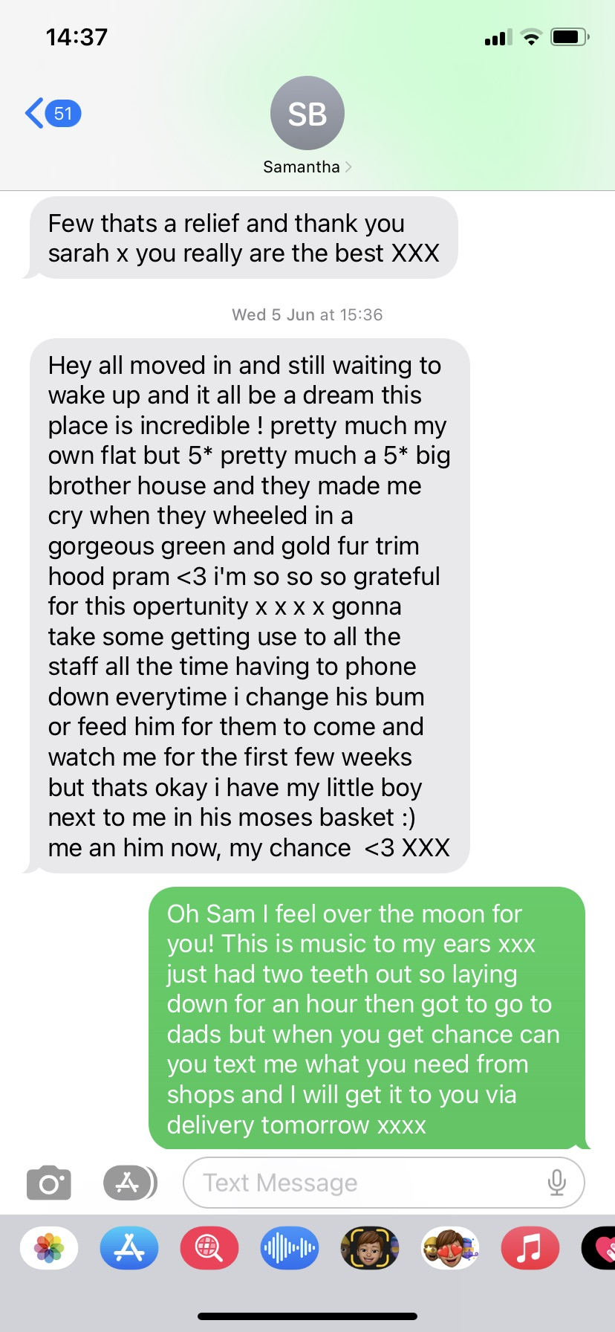
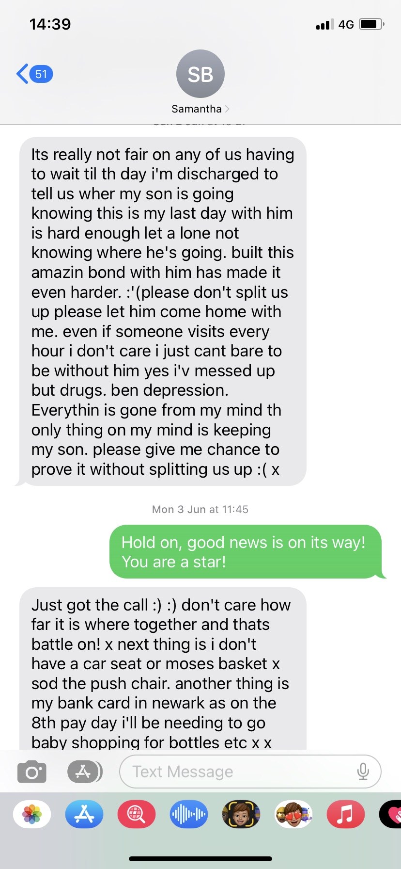
TEXTS

Slide 27
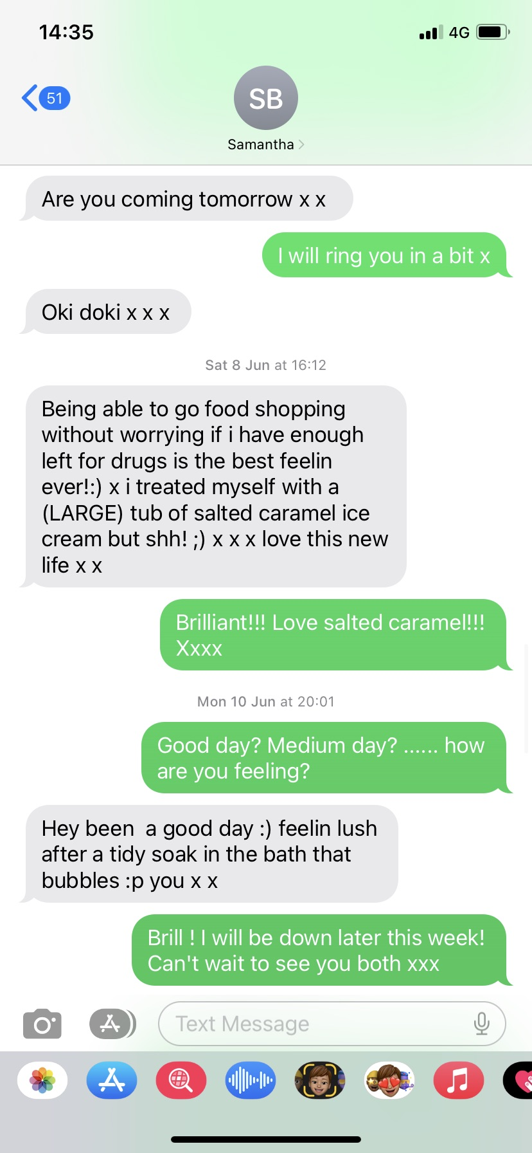
Text messages

Slide 28
Feedback from Childrens social worker
Hi Sarah,
I just wanted to thank you and the MEAM for the impact you have had by working with Pam.
I have been a children’s social worker for 10 years and in all those years I have removed many babies and met many mothers like Pam. What I assumed from my working experience when I met Pam and knew the situation, she was in, is that I was going to be removing that baby when it arrived.
Pam initially hated me as she has a fear of professionals, and ongoing trauma from her previous children being removed and adopted so it has been hard for me to build that trusting relationship ( we wont ever be fully there and I understand why with all my parents, but today I did get her saying she hated me at first, but is now going to miss me and asked me to keep in touch) I thank you for being an integral part of this transformation.
Without you working alongside me and being on Pams shoulder lifting her up, and supporting her to push through her past traumas and the prejudging thoughts of professionals you have helped transform a “lost cause, clear cut removal” to give Pam the opportunity to parent her baby.
Without the help of the rough sleeper co-ordinator helping push the council she would be homeless; I have many cases like Pam now and will in the future without the flex approach she would not be given housing. Without James funding the hotel we would have had a homeless pregnant woman who would have disengaged and probably been subject to more violence, more drug use and the outcome for the baby and her was bleak.
However, you all worked your magic and with some push back from Newark and Sherwood in particular(hmm less said ha) we got her where she needed to be.
She has given birth to a healthy baby boy and she is moving to a mother and baby unit to be given an opportunity to start a new life and evidence she can be a good parent. I have all my fingers crossed and I know she is in good hands when she comes out with you guys behind her.
You have given Pam a chance at life she wouldn’t have had if I had been working alone with her, children’s services don’t fund for parents accommodation etc and that I feel has been pivotal in helping her reduce her usage, clear her head and learn to trust. The emotional support combined with this practical support has worked wonders and she is now in a positive place where she wouldn’t have been.
There is much work to be done with her, but she has a support network that she is so lucky to have and you have given her the Baby to transform her life and build a future without abuse, self-loathing, self-medicating and homelessness which was her future before you got on board.
You Sarah are the most amazing social worker and SUPER advocate and I’ve loved watching you challenge “systems” in meetings and being a part of real change and that has been lovely to be part of.
I hope the project expands and is successful as working alongside children’s services its been invaluable for better outcomes Pam and all vulnerable adults and thus positive impacting their children too.
Neither you or I could have done more and now this is wholly up to Pam, and how she reacts to the opportunity given to her to parent Baby and change her life.
Many Thanks Annon SW

Slide 29
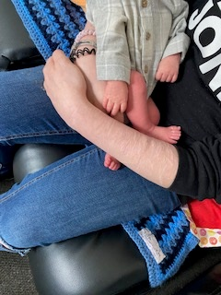
A Chance
Pam and baby , both together,
We need to be sure support doesn’t fall away too early
We need to continue to provide the cnsistancy and keep those with a relationship with her involved despite the boundary issues.
We will be communicating with the MEAM approaches in her new area so they can keep working with her if necessary and possible.

Slide 30
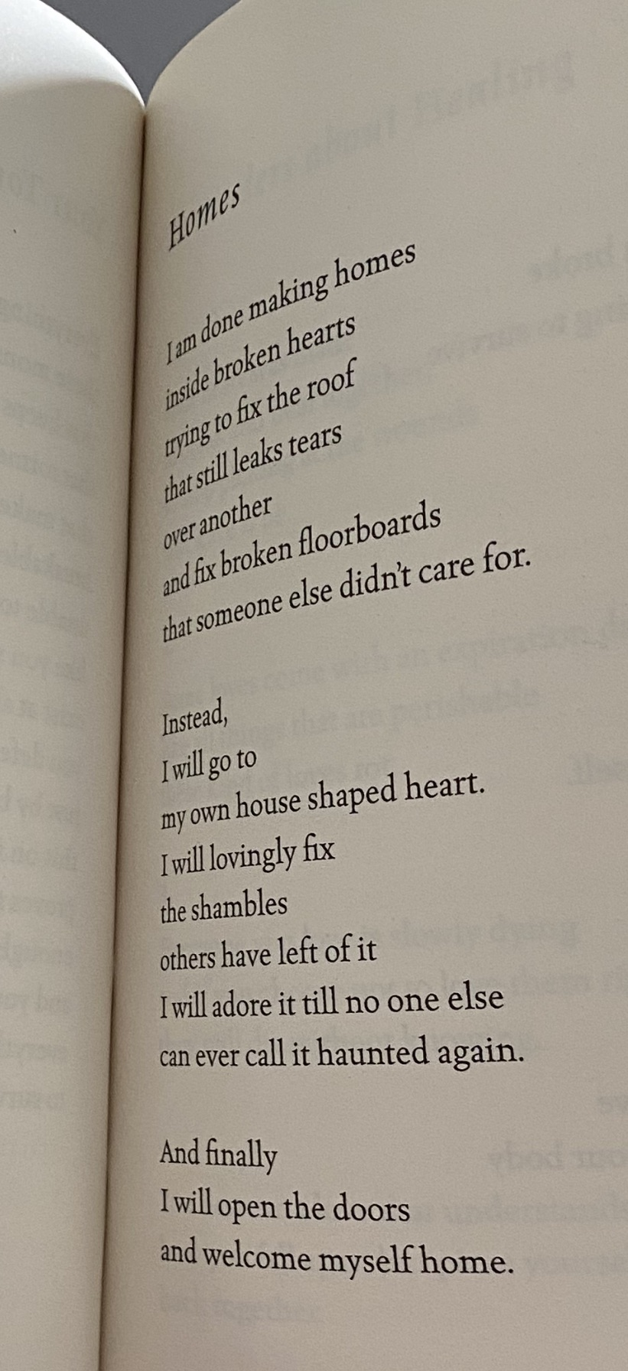
A Book Called “Wild Embers”

Slide 31
Q&A

Slide 32
Top tips
“If you’re not having fun you’re not doing it right” - Checkland
It’s called practice for a reason
Keep to purpose
Uncertainty is ok – get used to it
There is no wrong and right – it’s all grey
Therefore, have you done enough is a more helpful question…
Listen, really listen, to the system

Slide 33
Working With Us…
Specialist Systems Consultancy
Systems leadership Development Programme
Co-production and Inclusion
Partnership Development
In-Depth Training
Chat to us at: Info@meam.org.uk

Slide 34
Further Reading
Systems Convening
Thinking in systems
Grammar of systems
The art of hosting / Facilitator’s pocketbook
Fish in water (explanation of systems)
Feedback loops – positive and negative
Cognitive Bias Codex

Slide 35
Thank you
Greg Headley Greg.Headley@meam.org.uk
Carl Brown Carl.Brown@meam.org.uk

