Slide 1
Understanding Hoarding
Jack Moore FCIH, Hannah Scott, Fraser MacKinnon

Slide 2
Hoarding or Extreme Clutter?

Slide 3
Hoarding or Extreme Clutter, as a result of, or resulting in…
Depression
Anxiety
Obsessive-compulsive disorder
Hoarding disorder
Phobias
Psychosis
Bipolar disorder
Schizophrenia
Eating disorders
Dementia
Neurodiversity
ADD/ADHD
Dyscalculia
Dyslexia
Dyspraxia Developmental co-ordination disorder (DCD
Tourette’s Syndrome
Autism / Autistic Spectrum
Asperger’s Syndrome

Slide 4
The five diagnostic criteria used to identify a case of hoarding disorder
Persistent difficulty discarding or parting with possessions, regardless of their monetary value
This difficulty is due to a perceived need to save the items and distress associated with discarding them
The difficulty discarding possessions results in the accumulation of possessions that congest and clutter active living areas
The hoarding causes clinically significant distress or impairment in social, occupational, or other important areas of functioning
The hoarding is not attributable to another medical condition or mental disorder

Slide 5
Hoarding can also result from other problems
Physical illness – can lead to tiredness and disorganisation.
Dementia – memory problems can interfere with someone’s ability to organise themselves and their belongings.
Depression – can make you lose interest in your normal activities, make it hard to concentrate and make it hard to make decisions.
Alcohol and drug misuse – can affect your ability to look after yourself.
Schizophrenia – unusual beliefs and a lack of organisation can lead to hoarding.
Bipolar disorder – can make you shop too much (highs), and will interfere with your organisation (lows).
Learning disability or acquired brain injury – can lead to problems with thinking and memory.

Slide 6
Hoarding can also result from other problems (cont’d)
Autism and related disorders – collecting things can be a source of comfort. (clear communication / step by step actions / bite-sized interventions)
Obsessive Compulsive Disorder (OCD) – you don't feel attached to your hoarded items, but you do fear what will happen if you throw them away, or fear of contamination results in inability to tackle post or throw rotten food away. About 1 in 20 people with OCD have a problem with hoarding. (NB Other research 20-30%)
(Royal College of Psychiatrists)
Attention deficit (and hyperactive) disorder – trouble staying focused on one task, flit from one area of interest to another
PTSD or Victim of Crime – creates barrier or buffer against further disaster
Struggling to cope with a stressful life event, such as bereavement or redundancy
Excessive guilt about waste

Slide 7
Risk factors – Increased risk of…
Fire
Accumulation of combustible materials such as newspapers, clothing and rubbish (stats; 1 in 4 and 90%/40%)
Structural Damage
Structural damage threatens the occupants, public safety personnel and adjacent buildings
Disease, Injury and Infestation
Storage of hoarded items makes cleaning nearly impossible, which can lead to unsanitary living conditions and increases the risk of disease
Avalanche

Slide 8
Our dehoarding service
Referral
Initial visit
Quote
Visits commence
Working sheets
Progress meeting
Ongoing support / monitoring

Slide 9
Our
Empathy and understanding
Work in pairs
Hands-on service
Tipper / van if or when required
Typical case 3 hours per week for 3 months
85% success rate (in achieving goal)
PLUS
Hospital Discharge Service
Regional Hoarding Support Groups

Slide 10
P3’s Hoarding Support Services

Slide 11
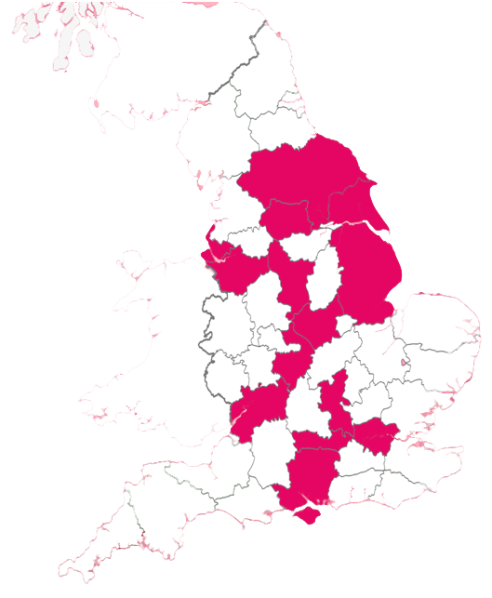
Services in 17 Counties
53 local district and boroughs
Currently we run hoarding services in Derbyshire, Warwickshire, Buckinghamshire and Redditch
P3 have provided housing-related support services since 1972
We deliver support to 9000 individuals at any-onetime and over 33,000 people annually.
Notes:
So, who are P3 well just a quick overview. We are a housing charity here in England who have been providing housing related support since 1972. We provide support in communities all across England withWe work with 33,000 people annually and around 9,000 people at any one time.
P3 itself stands for people, potential and possibilities and that’s the ethos we have throughout all of the work that we do. We are people lead, putting people first to create a lasting difference.
housing, Homelessness, mental health, social exclusion and more.

Slide 12
P3 Hoarding services
in-home practical support
Emotional/Psychological Support
Notes:
So its this person centred approach that lead to the development of our hoarding services.
The Warwickshire service was set up in consultation with adult social care to support ten people for the year using a gradual approach that combines the in-home practical support (Moving, disposing, donating, reorganising) with emotional and psychological support.
It centres around building a working relationship with someone. building that trust to support them in a holistic way that can provide us with a complete picture of their circumstances. Some issues may be apparent immediately and others that will open themselves up to us over time.
When this happens that relationship we have built up has been essential to help the people we support leave their comfort zone and build there network with other organisations.

Slide 13
Collaborative Approach: Working Together
Understand that building trust takes time
On average we will work with someone for just under 1 year
Building support into weekly routine
Move at a pace that works
Motivational techniques
Notes:
Working Together
Helping someone address their hoard is a difficult process. They might not feel ready, they might not recognise any problem at all. This is where we put a strong focus on building a good relationship with the people we support.
On average we will work with someone for just under a year. This gives our hoarding coach the time to get to know individuals, get to know how they work and what works well for them. We like to keep consistency, booking in a regular time once a week to build our support into their routine. It’s important that support is not brought in as dramatic change but one that goes at their pace and is respectful of peoples limitations and goal.

Slide 14
Collaborative Approach: Working Together
Motivational techniques
Set Small goals that help break down large barriers
Discuss the different ways to assign value
Help to find systems that work for the life someone wants to live
Address buying habits and meaningful use of time
Notes:
Our hoarding coaches use motivational techniques,
set small goals that break down large barriers, into a smaller, manageable wins. Discussing different ways to look at and value objects and find systems that work for the life that someone wants to live.

Slide 15
Q&A
Opportunity now for you to put your hoarding related questions and observations to Jack, Hannah and Fraser

