Slide 1


Bridging the Gap Conference
The relationship between mental health and housing: Understanding and intervention
Copyright
Presentation co-produced by: Jess Bain, Khalid Gumus, Jake Lake, Nineb Nersy and Tess Saunders
Presented by Jake Lake and Jess Bain
Notes:
Structure:
30 mins presenting
20 mins discussing
20 mins feedback
Actions
*Jake to slide on pitfalls of diagnosis/psychology/psychiatry
Problems with the medicalisation of distress (e.g. OPD, BPD)
*Jess to add visual map for levels
*All to add references

Slide 2
Hopes for Today
Copyright
Understanding
To introduce MAC-UK and our contextual approach to understanding mental health.
To introduce a public health approach and explore the intersections between mental health and housing
Intervention: When and where to intervene
To explore how co-production can be used to support mental health
To examine how working at multiple levels of the system can be supportive of mental health
Anything else you hope to gain from today?
Notes:
Share Structure:
30 mins presenting
20 mins discussing
20 mins feedback

Slide 3

An Introduction to MAC-UK
Copyright
MAC-UK story
Youth Work
Community Psychology
Public Health
Co-Production
Notes:
Brief MAC-UK story
Briefly touch on youth work, community psychology
Co-production and public health will be discussed throughout.
At MAC-UK we hold co-production as a key tenet of everything we do. In order to produce something that we believe will be as meaningful as possible we work alongside young people to develop services that they determine work best for them.
This in itself can be a public health intervention, and we will think about how later.
We are also a learning organisation, and believe it is important to understand the context from which young people are coming. And so, while the following ideas have not necessarily come directly from young people in this instance, they represent some of the contextual understanding that we have gained over the years of working with this community.

Slide 4
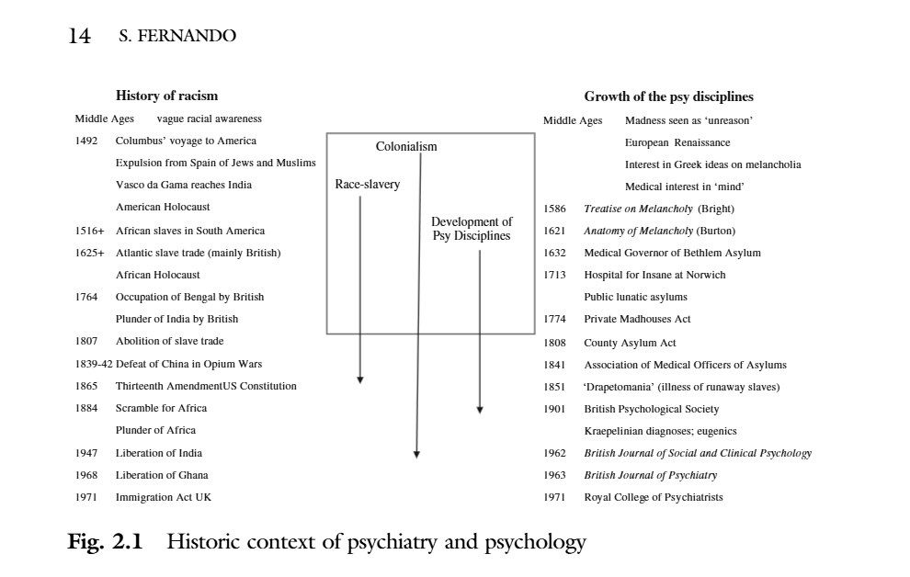
Western Psychology - problem
Copyright
Fernando, S. (2017).
Notes:
Fernando, S. (2017). How ‘Race’ Began, and the Emergence of Psychiatry and Clinical Psychology. Institutional Racism in Psychiatry and Clinical Psychology, 11–37. https://doi.org/10.1007/978-3-319-62728-1_2

Slide 5
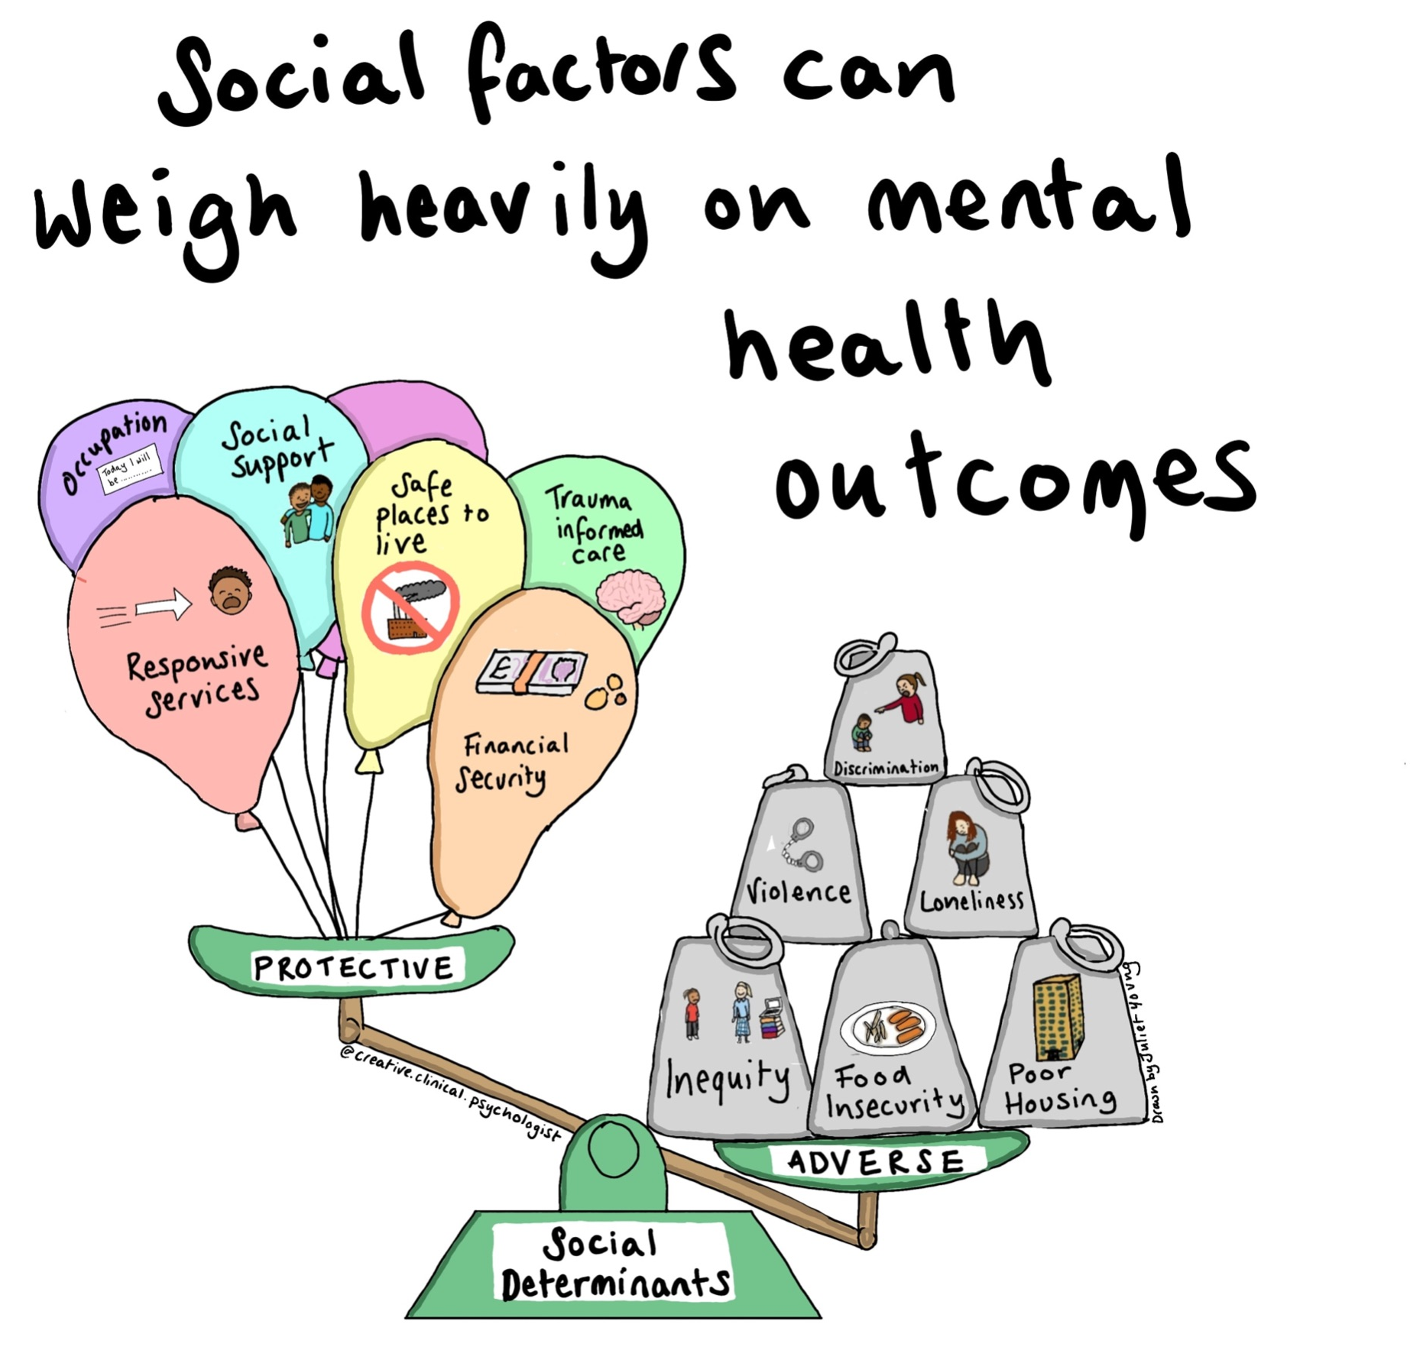
A Contextual Understanding of Mental Health
Copyright
Notes:
Rather than positioning the difficulties in the individual, a contextual approach understand the difficulties to be positioned in the context around a person.

Slide 6
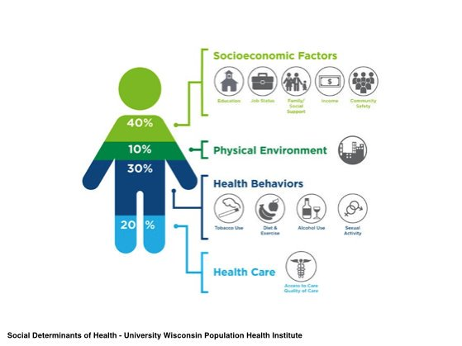
A Public Health Approach to Mental Health
Copyright
Public Health - the study of population level health outcomes.
Social determinants - the social and contextual factors that impact health.
A public health lens allows us to view the determining factors of poor mental health, as located in society rather than the individual. This has consequences for how we might support individuals and the systems around them.
Notes:
At MAC-UK we view health outcomes as being a consequence of people’s experiences within the societies and networks within which they exist.
Public health is the study of population level health outcomes. It looks at the contextual factors that impact health - these are called social determinants of health. The public Health approach aims to is to understand how poor health outcomes develop, and what can be done to combat them.
In order to work with people who experience poor mental health outcomes it is essential to look at the population level information on not simply who has access to services, but where poor mental health proliferates.
Examples of social determinants:
Economic inequality
Austerity
Housing
***Name the limitations of the image - these levels are all interlinked and impact each other.

Slide 7
Social Determinants of Mental Health: Inequality
Copyright
The social determinants of health are thought to develop from unequal distribution of resources.
Therefore interventions that target social and economic policies and progammes can reduce these social determinants and their impact on mental health.
Notes:
Marmot M, Friel S, Bell R, Houweling TA, Taylor S, Health CoSDo. Closing the gap in a generation: health equity through action on the social determinants of health. The lancet 2008;372(9650):1661–9
https://www.thelancet.com/journals/lancet/article/PIIS0140-6736(08)61690-6/fulltext?cc=y%3D
Alegría, M., NeMoyer, A., Falgàs Bagué, I., Wang, Y., & Alvarez, K. (2018). Social determinants of mental health: where we are and where we need to go. Current psychiatry reports, 20, 1-13.
https://www.ncbi.nlm.nih.gov/pmc/articles/PMC6181118/

Slide 8
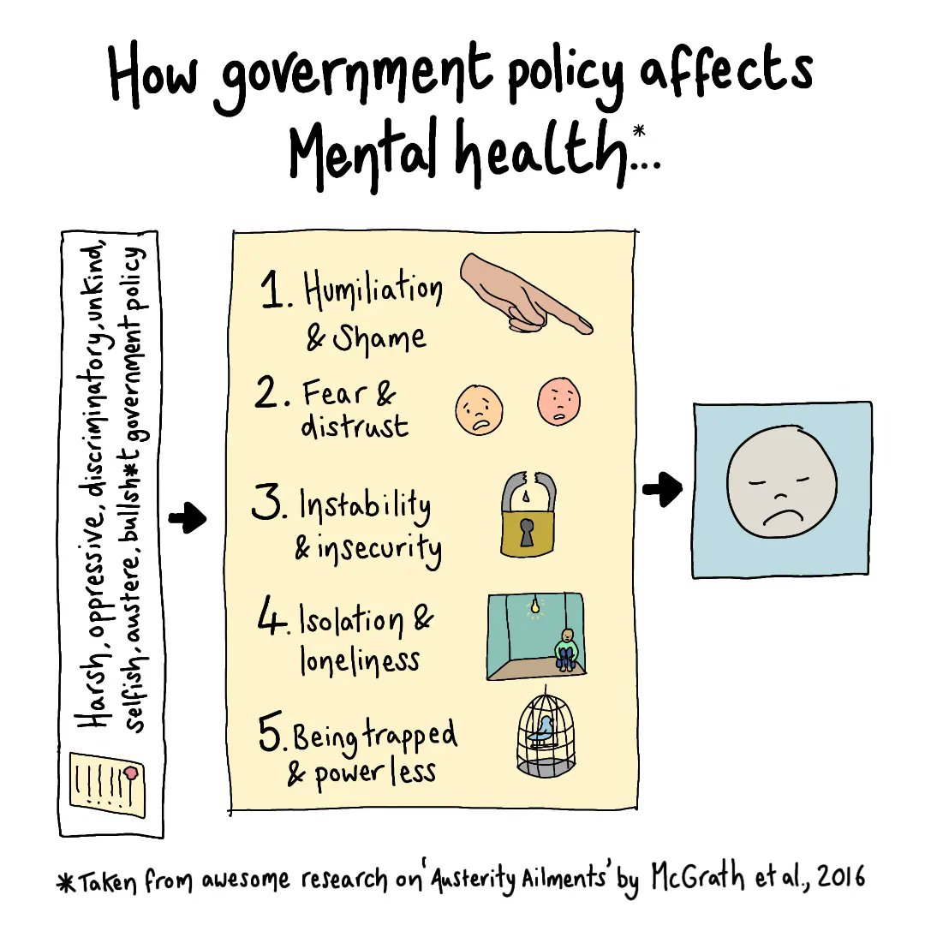
Social Determinants of Mental Health: Austerity
Copyright
The Psychological Impact of Austerity (2015):
Austerity policies have damaging psychological costs. Mental health problems are being created in the present, and further problems are being stored for the future.
Specific ways in which austerity policies impact on mental health:
Humiliation and shame
Fear and distrust
Instability and insecurity
Isolation and loneliness
Being trapped and powerless
Notes:
McGrath, L., Griffin, V., & Mundy, E. (2016). The psychological impact of austerity: a briefing paper. Educational Psychology Research and Practice, 2(2), 46-57.
https://www.psychchange.org/uploads/9/7/9/7/97971280/paa_briefing_paper.pdf

Slide 9
Social Determinants of Mental Health: Housing
Copyright
Mind Brick by Brick Report (2017):
There is broad agreement within the existing literature that a combination of physical and social factors drives the impact of housing on mental health, including:
physical condition of the property (Gibson et al., 2011)
local environment (Truong & Ma, 2006)
affordability of rent or mortgage (Bentley et
al., 2011)
physical security (Barnes et al., 2013)
social connections with neighbours (Oishi, 2010)
impact of housing on identity and self-esteem (Evans, Wells, & Moch, 2003)
Notes:
https://www.mind.org.uk/media/4432/20171115-brick-by-brick-final-low-res-pdf-plus-links.pdf

Slide 10
Social Determinants of Mental Health: Unemployment
Copyright
Unemployment, precarious employment, and employment conditions continue to be routinely linked to increased psychological distress (Reibling et al., 2017)
Notes:
Reibling, N., Beckfield, J., Huijts, T., Schmidt-Catran, A., Thomson, K. H., & Wendt, C. (2017). Depressed during the depression: has the economic crisis affected mental health inequalities in Europe? Findings from the European Social Survey (2014) special module on the determinants of health. The European Journal of Public Health, 27(suppl_1), 47-54.
https://academic.oup.com/eurpub/article/27/suppl_1/47/3045946

Slide 11
Social Determinants of Mental Health: Discrimination
Copyright
Discrimination, whether related to race/ethnicity, immigrant status, sexual orientation, and/or occupational status, has repeatedly been associated with negative mental health outcomes
(Khan et al., 2017; Wallace et al., 2016)
Notes:
Khan, M., Ilcisin, M., & Saxton, K. (2017). Multifactorial discrimination as a fundamental cause of mental health inequities. International Journal for Equity in Health, 16, 1-12.
https://academic.oup.com/eurpub/article/27/suppl_1/47/3045946
Wallace, S., Nazroo, J., & Bécares, L. (2016). Cumulative effect of racial discrimination on the mental health of ethnic minorities in the United Kingdom. American journal of public health, 106(7), 1294-1300.
https://ajph.aphapublications.org/doi/full/10.2105/AJPH.2016.303121?casa_token=26gB99FgIUsAAAAA%3AqB97dfz5nV2u3nRRZQEQWL6nhk-ew1bWjeaWJv2AkQ0GQiUGMmjQ86ORIYzGzxyrVbOxNrzONLFM

Slide 12
The Intersection Between Mental Health and Housing
Thoughts from a Youth Consultant
Copyright
Lots of moving, often short notice, not knowing when/where, no reassurance that we will be able to stay - scary - constantly played in my head, nothing I could do = anxiety + panic
Never felt comfortable/settled at home - not able to call it my own home
Changing schools - constant fear and feeling unsettled = impact on education, friendships
The not knowing - mentally makes it hard to focus/relax, anxiety, almost like panic attacks, jarring
Housing conditions: mould - I couldn’t breath, the mold was literally killing me, couldn’t sleep
Cheap material/falling apart/dangerous conditions, ceiling collapsed - no quality control - people are dying
Notes:
3-18yr
At least 9 moves
500,000 homeless people
900,000 empty houses

Slide 13
The Intersection Between Mental Health and Housing
Thoughts from a Youth Consultant
Copyright
Repairs take months
Some houses haunted - feeling unsafe
Too small/cramped - like caged animals
Separating families
No choice / power - people making decisions on your behalf e.g. service people visit unannounced, told to move with hardly any warning.
Council - tricking you, not listening, threatening, intimidating, fear mongering, racist, discrimination - feeling unsafe in own home, no trust in services
Long-lasting impact e.g. still not decorating my room (so used to not being able to)
Notes:
3-18yr
At least 9 moves
500,000 homeless people
900,000 empty houses

Slide 14
Housing That Has a Positive Impact on Mental Health
Thoughts From a Youth Consultant
Copyright
Housing shouldn’t be a luxury, its should be a right
Moved to permanent home - didn’t have to worry any more - big sigh of relief
A system that is there to genuinely help you - trust
To have ownership of the space, be able to make the important decisions (e.g. if you want to move, when you want to move, how you decorate, deciding when service people visit).
Good conditions/quality
Enough space
Safety
Community and support (especially cultural connection)
Choice and options

Slide 15

Intervention: When and Where to Intervene
How we Respond to Mental Health in Housing
Copyright
Notes:
A lot of you will know about the traditional ways of intervening e.g. NHS/1:1
We know these ways don’t work for everyone. We’re sharing a different approach today.

Slide 16
Co-Production as a
Mental Health Intervention
Copyright
How:
Creates services that best meets the needs of the communities they serve
Facilitates the rebuilding of autonomy for people who may have had this taken away from them throughout their lives, and most importantly by those exact service that claim to support them
Notes:
Co-production is a way of people leveraging power for themselves in order to take charge of their own care in a way that works for them. It can be slow, and requires investment, however it is extremely effective.
Through co-production young people can both develop skills that support their lives as well as an opportunity to have conversations about their lives that can be therapeutic and empowering.
***Researchers have found that well-being is a function of the control and power young people have in their schools and communities (Morsillo & Prilleltensky 2007; Prilleltensky & Prilleltensky 2006).

Slide 17
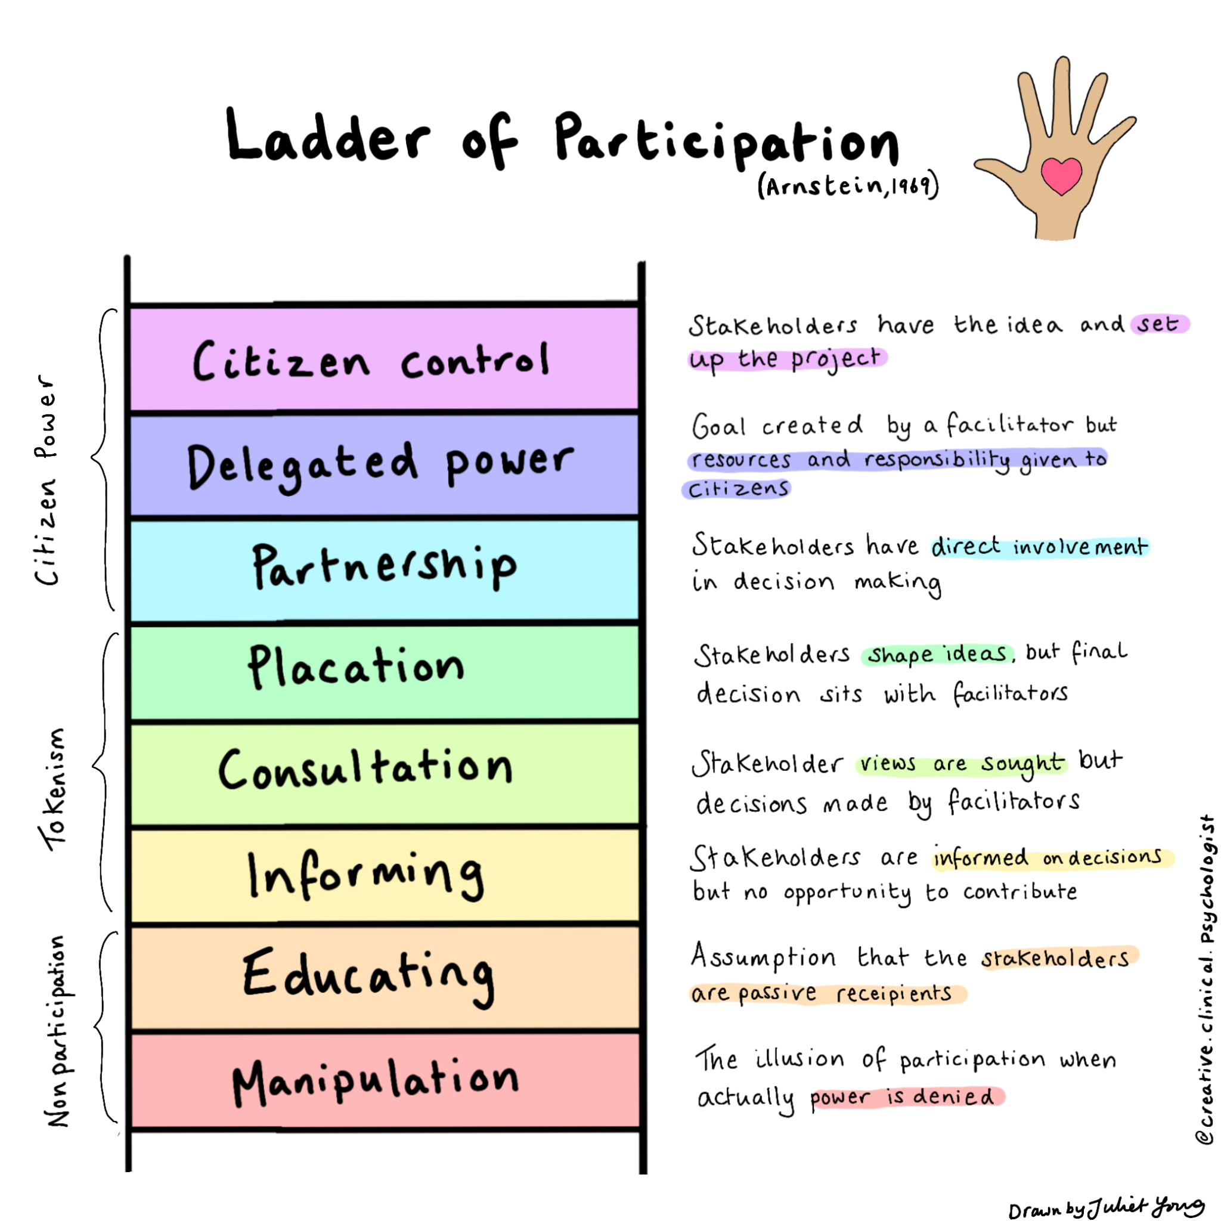
Co-Production as a Mental Health Intervention
Copyright
Notes:
Discuss the harms of doing co-production tokenistically and of not doing it at all.
*Not that sometimes the ladder has therapy on it
Arnstein’s Ladder maps out the different levels of service user participation.
There is not a consistent definition of ‘service user involvement’ or what is required of it in health care policy or in legislation, and so often ‘service user involvement’ in the NHS and clinical psychology stays in the bottom levels of the ladder, differing from community psychology’s approach of meaningful participation, through co-production, aiming for the top levels of the ladder.
As shown in Arnstein’s Ladder of Participation, involvement can sit across 8 levels. The lower down the ladder, the further clients are withheld power by professionals, and the more severely their human rights are breached.
Psychology can place itself as trying to help others. But to help someone, you are placing them as the ‘helped’, and ourselves as the ‘givers of help’, which can lead to the withholding of power from the client - meaning ‘service user involvement’ is often tokenistic. This thus breaches the client’s Right to Health. At the moment, clinical psychology often sits in the bottom rungs of the ladder, with either no service user participation of tokenistic service user participation.
Reaching the higher levels of the Ladder requires acknowledging that clients can hold solutions to the problems that they face, and can give significant contributions towards these, if given power and the tools to use it.
So moving towards partnership and delegated power in this service means how do young people have decision making powers in the service.

Slide 18
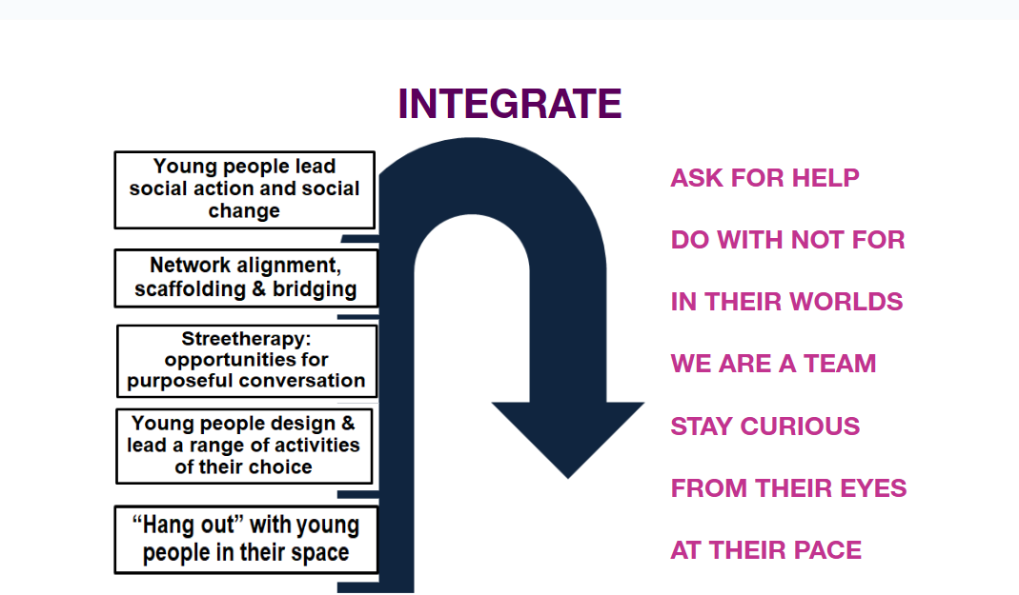
Meaningful Co-Production:
What Does This Look Like in Practice
Copyright
Notes:
Co-production amongst teams to develop structures that are flexible and responsive to the needs of young people and support the wellbeing and learning of the team
Time is prioritised in the service for teams to come together to slow down, think and connect
Relationship building is prioritised, and there is investment in activities that young people want to participate in
Time is spent between the staff and the young people in the service to understand what is needed to support their mental wellbeing
Investment in young people’s ideas is prioritised, supporting them materially by offering employment opportunities and pathways, and offering autonomy over decision making
Give examples from current work with Look Ahead

Slide 19
A Multi-Level Approach
Copyright
Societal
Social Action / Community campaigns
Research
Organisational
Teaching
Sharing of power with staff and young people - to allow for meaningful co-production of services
Ensuring staff have time and resource to do meaningful
co-production
Staff Teams
Paid youth
employment
Support/Reflective Spaces
Learning spaces:
Contextual
mental health
Co-production with young people
Young People
Building relationships, flexible support, youth-led activities, Youth employment, co-producing service design, bridging to community
Notes:
Young People
E.g. building relationships, flexible support, youth-led activities, youth employment, co-producing service design and solutions to problems, bridging to community.
Staff Teams
E.g learning spaces: contextual mental health, support/reflective spaces, co-production with staff and young people, co-producing service design and solutions to problems.
Organisational
E.g Facilitating the sharing of power and resources with young people and staff teams, developing paid youth employment pathways, involving youth consultants in organisational level work e.g. recruitment of staff, policy design, training and service evaluation development. Ensuring resource/time for staff to do co-production.
Is there an ability for this organisation to take steps to support people with better quality housing and what sacrifices are they making to do this.
Support them to interrogate - what is the turn over of their organisation and where is the money going.
Public health approach - re-distributing wealth = supports mental health
Unionise - to improve the housing conditions - ignite in them that they are able to leverage power. It’s not completely hopeless.
Societal
Engagement with campaigns/community actions to shape society - e.g. Acorn renters union. Teaching/presenting about our approach.

Slide 20
Group Discussion
Copyright
How are you already working in these ways?
How would you like to work more at these different to levels support the mental health of the people you work with?
What barriers might there be to working in this way? What resources would you need to navigate these?
Notes:
20 mins discussing
20 mins feedback
Groups of 3 - breakout rooms
*Don’t worry about having to answer them all.

Slide 21
Discussion feedback
Copyright
Societal
Organisational
Staff Teams
Young People
Notes:
Add responses from discussions.
MAC-UK to feedback on Qs 3:
Requires more resource than organisations realise or are willing to give
Its an investment in long-term impacts - which requires a bit of patience and faith (Renaisi model)
Resources: funding, commitment from commissioners/senior management to create system level change e.g. providing staff with additional resource/time to do this work
Language - translating/bridging
Flexibility - space for innovation
Evidencing the impact / using their language to show the value of the work
Change to pressures on staff to create more time e.g. streamlining paperwork

Slide 22
Any Questions
Copyright

Slide 23
Thank You
Copyright

Slide 24
References
Copyright
Brick by Brick Report: https://www.mind.org.uk/media/4432/20171115-brick-by-brick-final-low-res-pdf-plus-links.pdf
Fernando, S. (2017). How ‘Race’ Began, and the Emergence of Psychiatry and Clinical Psychology. Institutional Racism in Psychiatry and Clinical Psychology, 11–37. https://doi.org/10.1007/978-3-319-62728-1_2
Khan, M., Ilcisin, M., & Saxton, K. (2017). Multifactorial discrimination as a fundamental cause of mental health inequities. International Journal for Equity in Health, 16, 1-12.
https://academic.oup.com/eurpub/article/27/suppl_1/47/3045946
Marmot M, Friel S, Bell R, Houweling TA, Taylor S, Health CoSDo. Closing the gap in a generation: health equity through action on the social determinants of health. The lancet 2008;372(9650):1661–9
https://www.thelancet.com/journals/lancet/article/PIIS0140-6736(08)61690-6/fulltext?cc=y%3D

Slide 25
References
Copyright
McGrath, L., Griffin, V., & Mundy, E. (2016). The psychological impact of austerity: a briefing paper. Educational Psychology Research and Practice, 2(2), 46-57. https://www.psychchange.org/uploads/9/7/9/7/97971280/paa_briefing_paper.pdf
Reibling, N., Beckfield, J., Huijts, T., Schmidt-Catran, A., Thomson, K. H., & Wendt, C. (2017). Depressed during the depression: has the economic crisis affected mental health inequalities in Europe? Findings from the European Social Survey (2014) special module on the determinants of health. The European Journal of Public Health, 27(suppl_1), 47-54.
https://academic.oup.com/eurpub/article/27/suppl_1/47/3045946
Wallace, S., Nazroo, J., & Bécares, L. (2016). Cumulative effect of racial discrimination on the mental health of ethnic minorities in the United Kingdom. American journal of public health, 106(7), 1294-1300.
https://ajph.aphapublications.org/doi/full/10.2105/AJPH.2016.303121?casa_token=26gB99FgIUsAAAAA%3AqB97dfz5nV2u3nRRZQEQWL6nhk-ew1bWjeaWJv2AkQ0GQiUGMmjQ86ORIYzGzxyrVbOxNrzONLFM

Slide 26
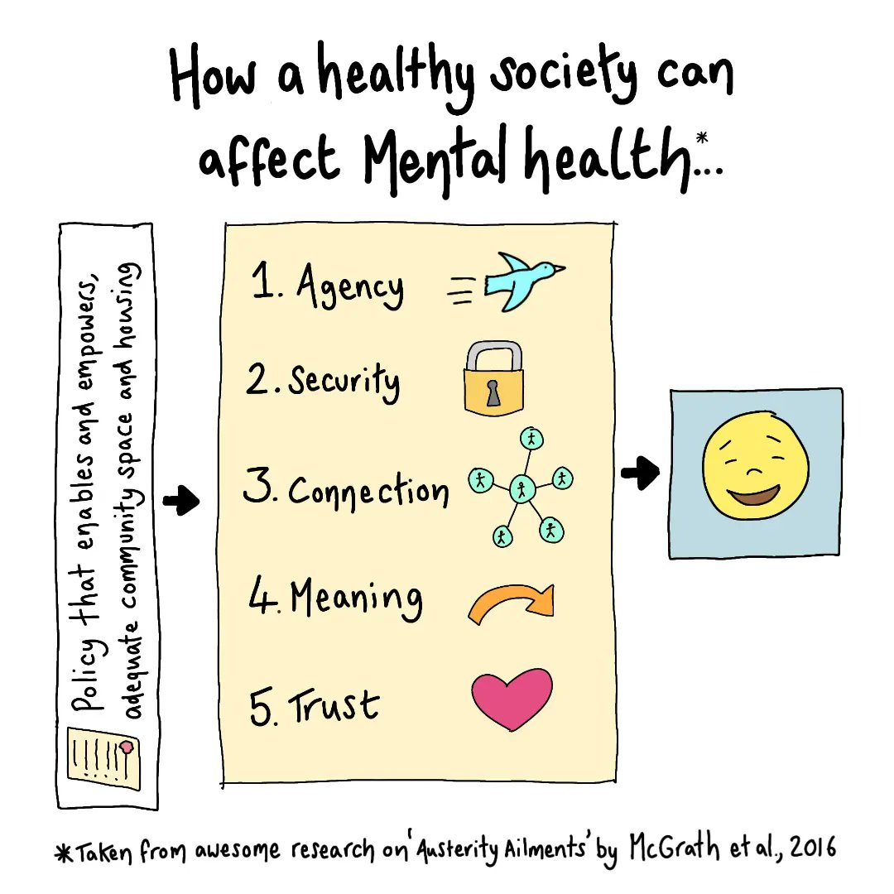
Reading / Resources
Copyright
Vickie Cooper & David Whyte - Introducing ‘The Violence of Austerity’
https://www.youtube.com/watch?v=81IKostVXZk
https://www.julietyoung.co.uk/ - Creative Clinical Psychologist images

