Slide 1


Brighton and Hove Common Ambition
Lived experience-led systems improvement project
Jules Grenville - Participation Lead & Brighton and Hove Frontline Network coordinator

Slide 2

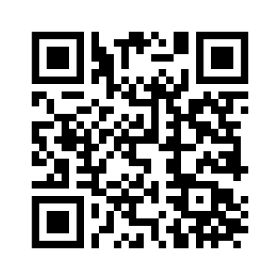
Brighton and Hove Common Ambition
Brighton and Hove Common Ambition aims to improve support systems in Brighton and Hove by working collaboratively and lifting the voices of people with lived experience.
It started as a three year partnership project, the partners were Arch Health CIC, Justlife, University of Brighton, BHCC Public Health Department and NHS Sussex. It was funded by The Health Foundation.
Initially its was aimed at improving homeless healthcare in the city.
https://www.bhcommonambition.org/

Slide 3
Challenges identified in year 1
Barriers to accessing care
Continuity of care along pathways
Facing stigma and judgement
Lack of mental health support
Capacity and training of staff
‘There is a lot of judgement and stigma in the system and services. People don’t feel listened to’
‘There isn’t enough care provided along pathways, particularly at the end of the housing pathway, or after finishing rehab, or leaving prison’
‘It is unclear what healthcare services are available and how to access them’

Slide 4
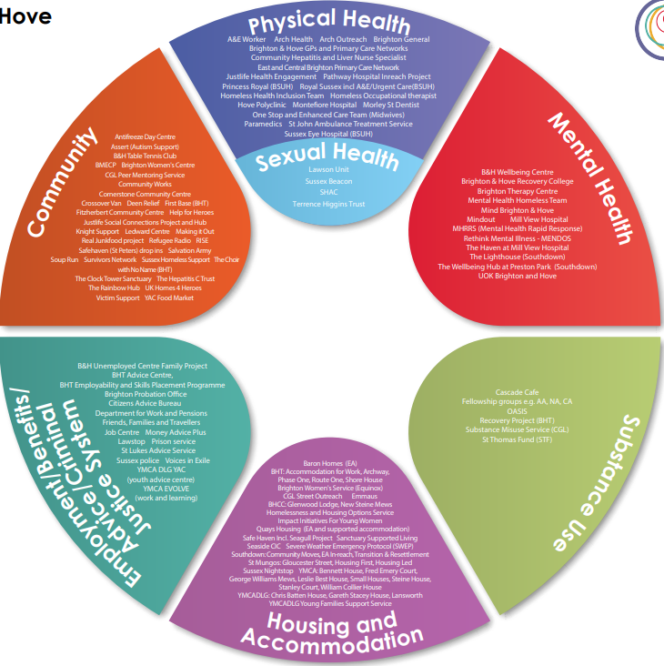
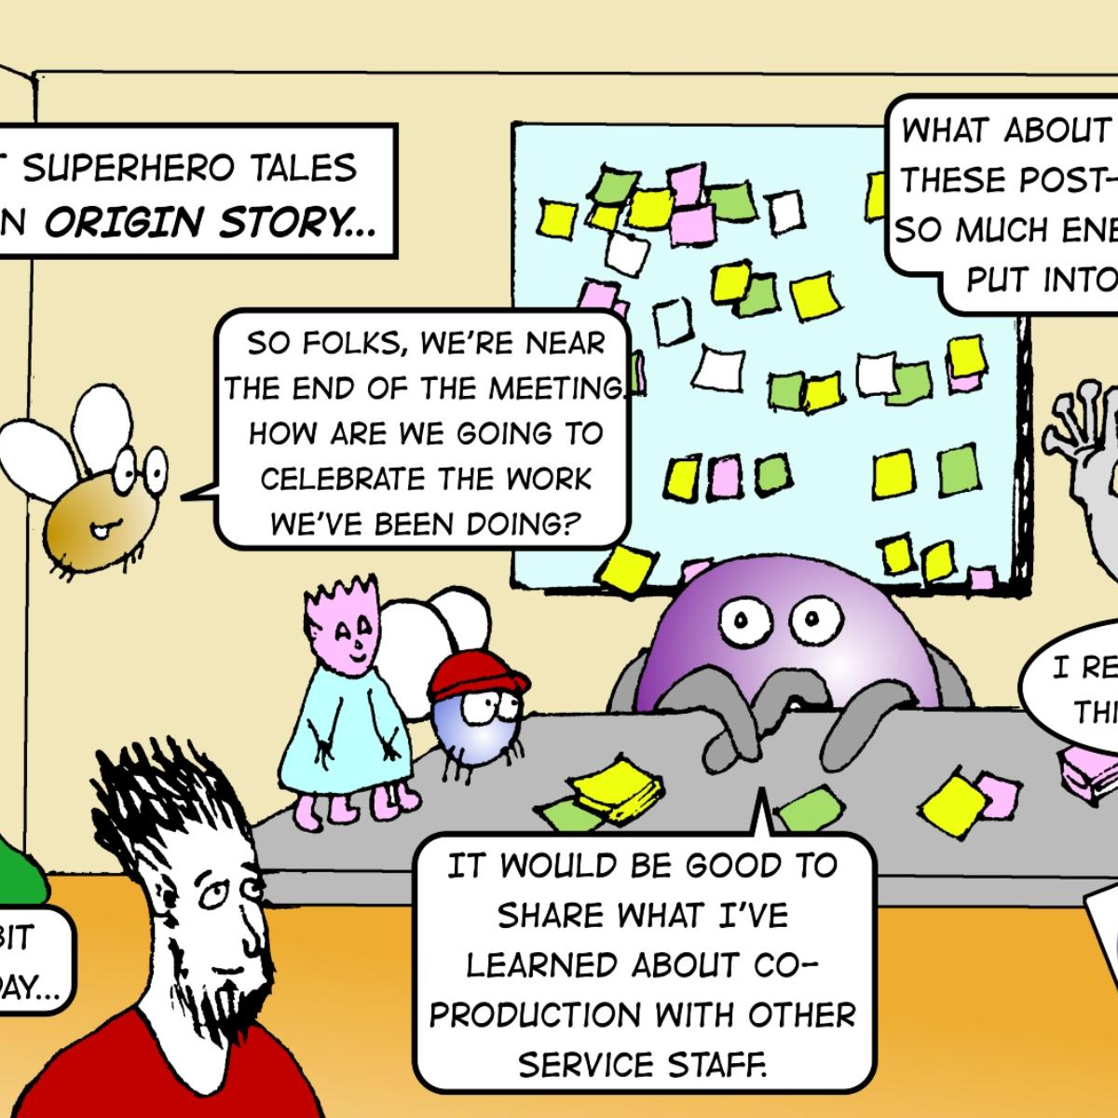
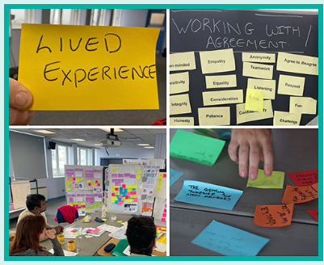
Common Ambition’s impact
Created voice for people with experience of homelessness
Developed a work and learning pathway for members with lived experience
Developed a unique trauma-informed approach
Mapped and identified barriers and challenges within the system and pathways
Co-produced processes, guidance, communications (including a website) and events
15 co-production design sprints, including consulting on service improvements, developing training for medical students, mapping the housing pathway, co-producing research, developing a homeless healthcare hub specification and co-producing a comic to raise awareness of the challenges people experiencing homelessness face

Slide 5
Co-producing medical training
Overview
Optional Homelessness and Health course for 2nd year medical students at Brighton and Sussex Medical School
Co-designed by Dr Kate Pitt and CA group in November 2022. Initial design delivered to students Jan 23
Feedback from students incorporated into 2nd design sprint and delivered again Oct 23
Now due to run every term
Key ways of working
Built trusted relationships
Made joint decisions
Co-developed processes
Created a safe space
Prepared clinicians or students who do not normally work in this setting
Ensured everyone understands trauma-informed working

Slide 6

Homeless healthcare hub
A safe space where people experiencing homelessness can come and access the support they need under one roof.
The homeless healthcare hub specification was shared with council members as part of a larger proposal.
Developing a homeless healthcare hub in the city has now been identified as a key priority by the council and we hope that the specification will be central to its development.

Slide 7
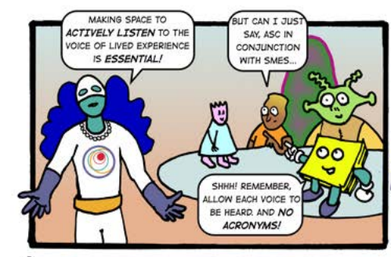
Top tips in co-production
Co-producing improvements, system change and research in inclusion health can break down barriers and misconceptions and will provide valuable insights and improvements - “you won’t be able to see what we can see”
Safety must come first
Take the time to build trusted relationships
Learn together to become experts in the area you are working in
Co-create processes to ensure accessibility
Support people to co-produce
Reciprocity is key

Slide 8
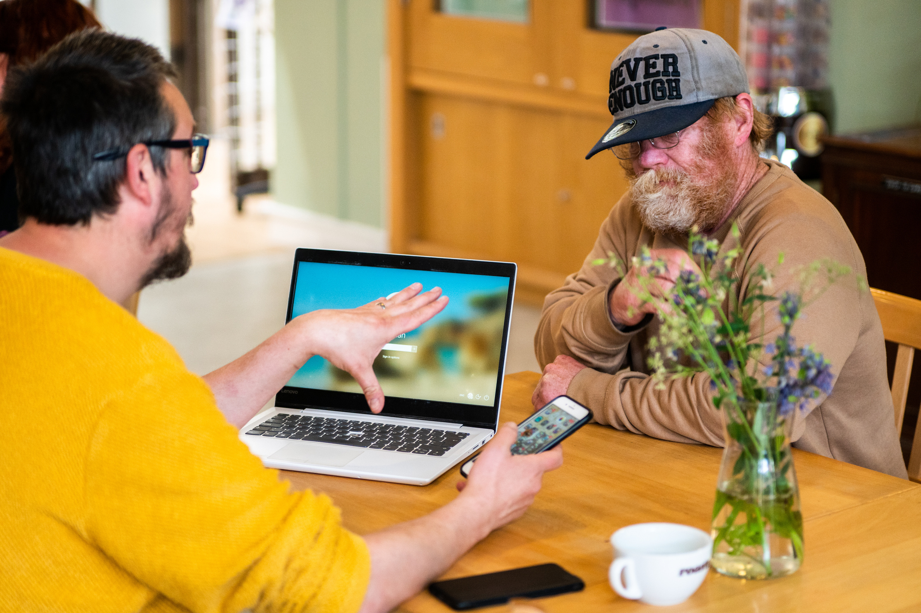

Justlife: Health Engagement
Health Engagement is an outreach team in Brighton working with people in Emergency and Temporary Accommodation presenting with complex and unmet health needs.
We aim to make people’s experience of EA/TA as short, safe and healthy as possible.

Slide 9
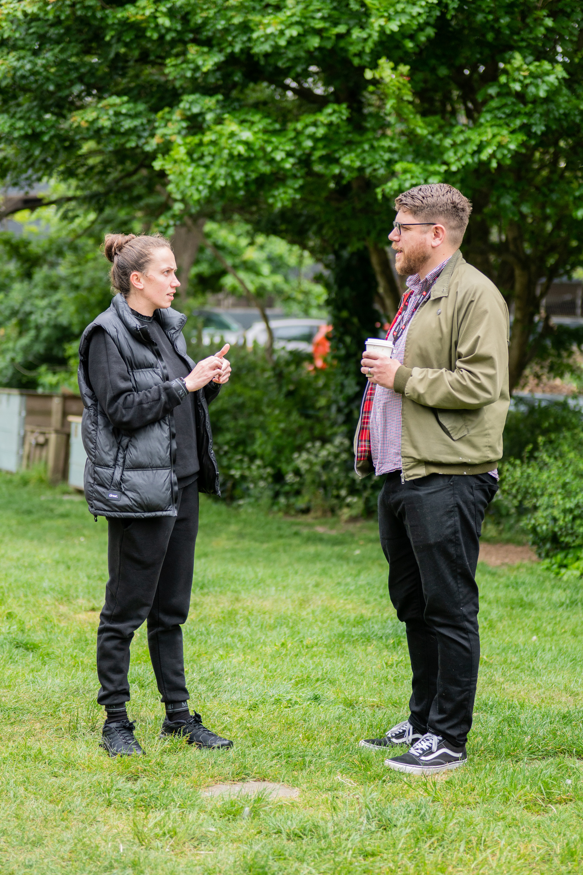
  5 staff - various specialisms
  In addition to this a post in A&E, Hep C trust and Changing Futures
  Intensive non-clinical support
  Assertive outreach model supporting clients to access health and community services
  Multi agency work both homelessness and specialist health services
  Advocacy for appropriate move on from EA
  Funded via local homelesness GP surgery

Slide 10

How does it fit within inclusion health services?
Health Engagement sits between both homelessness and health services laising between the two to ensure both needs are met.
We are part of the health inclusion network in Brighton’s services

Slide 11
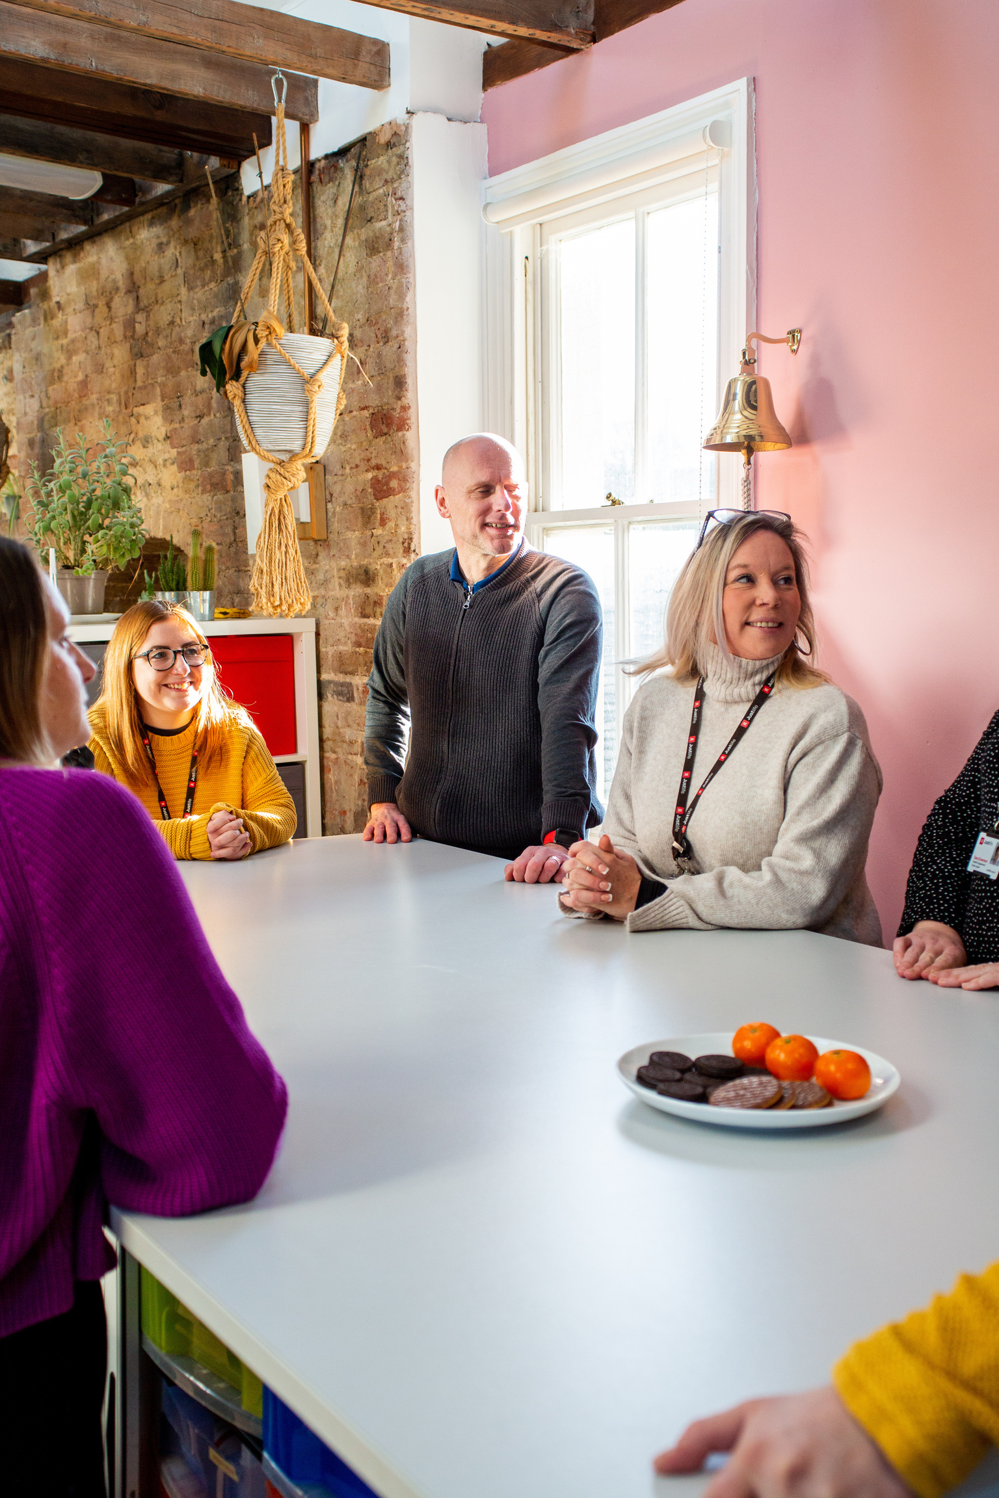
Types of interventions/presenting health needs
Types of presenting health needs: Cancers, HIV & BBV, wounds, chronic illnesses such as diabetes, old poorly healed injuries including poor mental health,
Types of interventions:
Organising every step of an appointment until the paient is comfotable with the enviroment, helping coordinate end of life care, advocating for someone’s mobility needs to ensure appropiate aids and housing
Creating a multi disaplinary team around the client

Slide 12
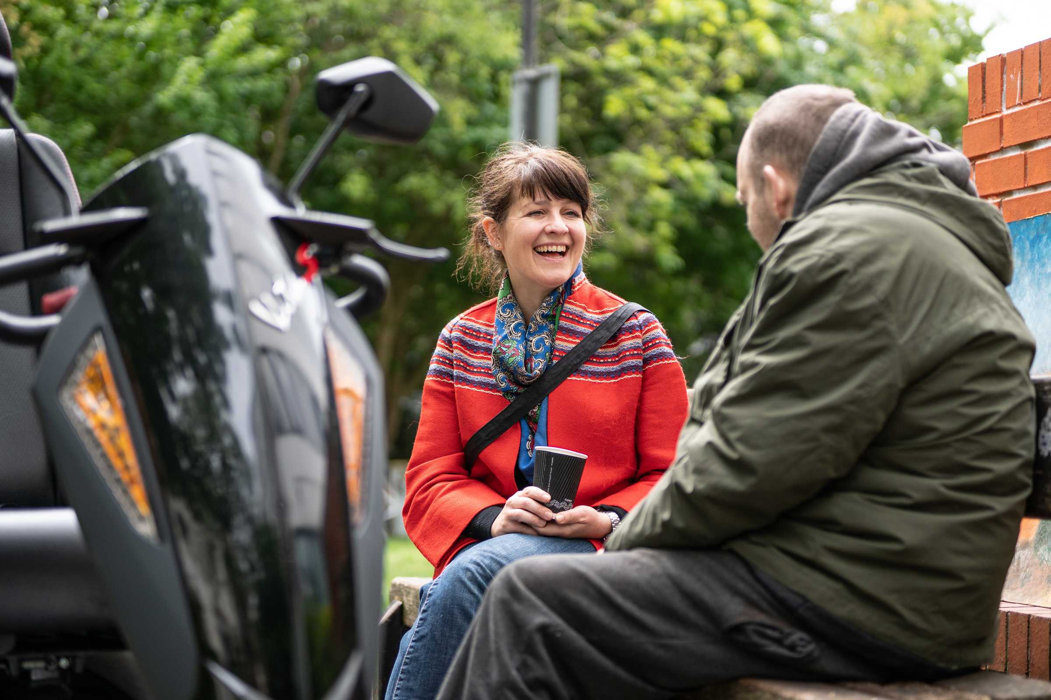
Challenges to Health Engagement
  Smaller team due to funding - high demand
  Very complex, high needs cases
  Sourcing appropriate emergency accommodation for unwell client group
  Appropriate move on options such as care homes
  Access to mainstream health services

Slide 13
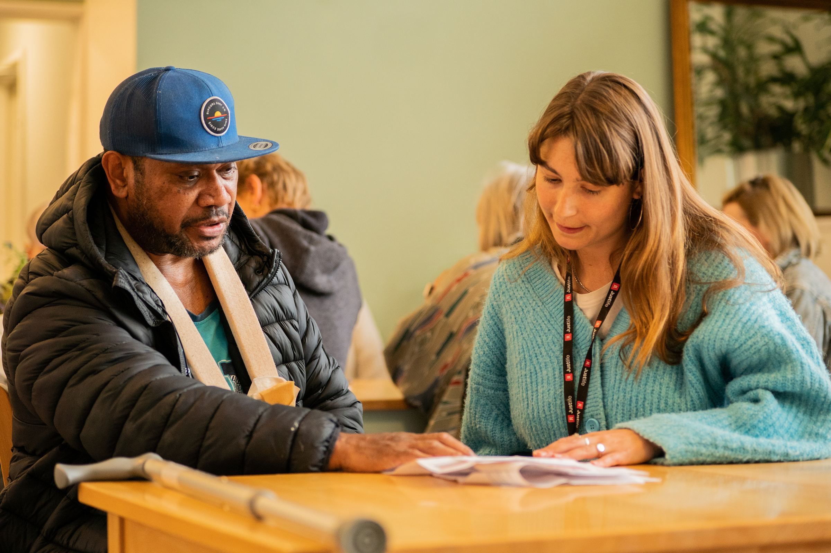
  Always make sure someone is registered at the GP - it is not correct that you need ID to register at a GP
  Priotirtise the client’s priorites - you might think the need is obvious but take their lead
  Consider meeting places around what their needs are - where can they best communicate
  Be persistent - health might not be on their agenda
  Attends appointments with people as much as possible (including traveling with this helps with prep and recalling what the doctor says in the appointment)
  Support people to understand their heath needs as much as possible - it can help support independence
health evidence can support getting the right placements and improving health makes sustaining housing easier
Health Engagement Top Tips!

Slide 14

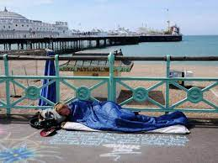




(NICE, 2022)
Pathway homeless team at Royal Sussex county hospital
Meeting NICE guidance 1.3, 1.5, 1.6, 1.7, 1.8 and 1.10
Stepdown Beds
in collaboration with New steine Mews and Arch
Meeting NICE guidance 1.5, 1.7, 1.8, 1.9 and 1.10
Arch Healthcare GP surgery
Meeting NICE guidance 1.3, 1.5, 1.6, 1.8, and 1.10
A&E HEW- Rough sleepers
Meeting NICE guidance 1.3, 1.5, 1.6, 1.7, 1.8 and 1.10
Comprehensive assessments taking into account both health, social and historical context. Ensuring a housing plan for all those discharged
Advocate for patients to receive more flexible care based on individual compound needs
Lead and partake in MDT and DPM’s to ensure more complex discharges are made safe
Use each and every admission as chance to advocate for more comprehensive treatment including things outstanding and not related to the current acute admission
Teaching year 4 medical students on safe discharges and partake in other teaching events across the trust and elsewhere to raise awareness on homelessness being a health and social issue combined
Provide MDT care in a PIE post-hospital admission (nurses, specialist support workers, dedicated HPO)
Referrals predominately from the Pathway hospital team, but when there are more voids they will consider referrals from the specialist community teams for those clients who are deteriorating
Move-on plans based on client needs and wants, MDT approach throughout
Provides transition support between settings when clients move on
Do not penalise patients for DNA’s, appreciating their compound needs affect their ability to keep appts
No restrictions on registering new patients
Offer GP and nurse outreach services for those experiencing particular compound needs related to capacity, MH, Substance misuse etc.
Provides transition support between settings when clients move on
Works closely with all other specialists homelessness services and provides community support by holding MAHHM every 2 weeks,
GP Dr Kate Pitt works with the local university to teach on homelessness and health
Provides great communication between the community and hospital services
Is able to follow-up and take patients to accommodation to settle them in and help with shopping and follow-up referrals
Comprehensive assessments taking into account both health, social and historical context. Ensuing a housing plan for all those discharged
Guidance 1.2 ‘Planning and commissioning’:
There are many areas where we are unable to deliver on all the guidelines. This is predominately down to financial restrictions with the large statutory services and wider UK challenges. None of our services hold commissioning rights.

Slide 15


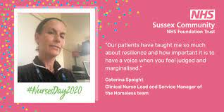
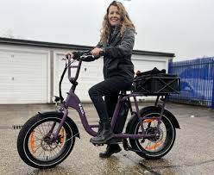



(NICE, 2022)
Health Engagement work (HEW)
Meeting NICE guidance 1.11, 1.5, 1.8 and 1.10
Sussex Community Foundation Trust Homeless Health Inclusion Team
Meeting NICE guidance 1.3, 1.5, 1.6, 1.8, 1.10 and 1.11
Arch outreach
Meeting NICE guidance 1.3, 1.5, 1.6, 1.8, 1.10 and 1.11
Common Ambition
Meeting NICE guidance 1.4, 1.5, and 1.10
Frontline network
Meeting NICE guidance 1.12 and 1.10
Assertive outreach to people in emergency housing placements with health needs.
Supports people to access and engage with healthcare in the community to avoid acute presentations.
Supports people to access healthcare to improve overall health outcomes.
Clinical multi disciplinary outreach team working in all types of homeless accommodation - OT, Physio, HCA, nurses and ANP.
Creating teams around patients to meet multiple health needs. Flexible patient-centred working
Speciality for end of life care and frailty
Assertive outreach to people experiencing homelessness
Has a clinical lead to address health needs while on outreach
Can target most hard to reach patients
Is linked with the specialist homelessness GP surgery
Working with the expertise of people with lived experience of homelessness and health care to identify gaps in services and areas for improvement.
Regularly meeting steering group that have developed training, consultations on current services and models for future services.
Developed a trauma informed approach to co-production and quality improvement
Training and meeting resources for frontline workers
Aim to create accessible training for all
Focus on wellbeing for frontline staff

