Slide 1
CARTREF YW POPETH HOME IS EVERYTHING
Notes:
SMT names & functions & teams sat below each in an organogram – I think Claire said we have on People HR but not otherwise, and it is something we need for all staff.
Board and subcommittee organogram with members listed – I can supply membership for GDSC, Sam for FASC.
Offices bases
SMT contact details

Slide 2
SHELTER CYMRU WHO WE ARE

Slide 3
.
.
RHYL
.
FELINHELLI
WREXHAM
^{SHELTER CYMRU}
^{OFFICE} ^{LOCATIONS}
.
.
PEMBROKE DOCK
.
SWANSEA
CARDIFF

Slide 4
THE HOUSING EMERGENCY IN WALES

Slide 5
The Housing Emergency

Slide 6
SHELTER CYMRU’S
SERVICE DELIVERY OFFER TO CLIENTS AND THE AGENCIES SUPPORTING THEM

Slide 7
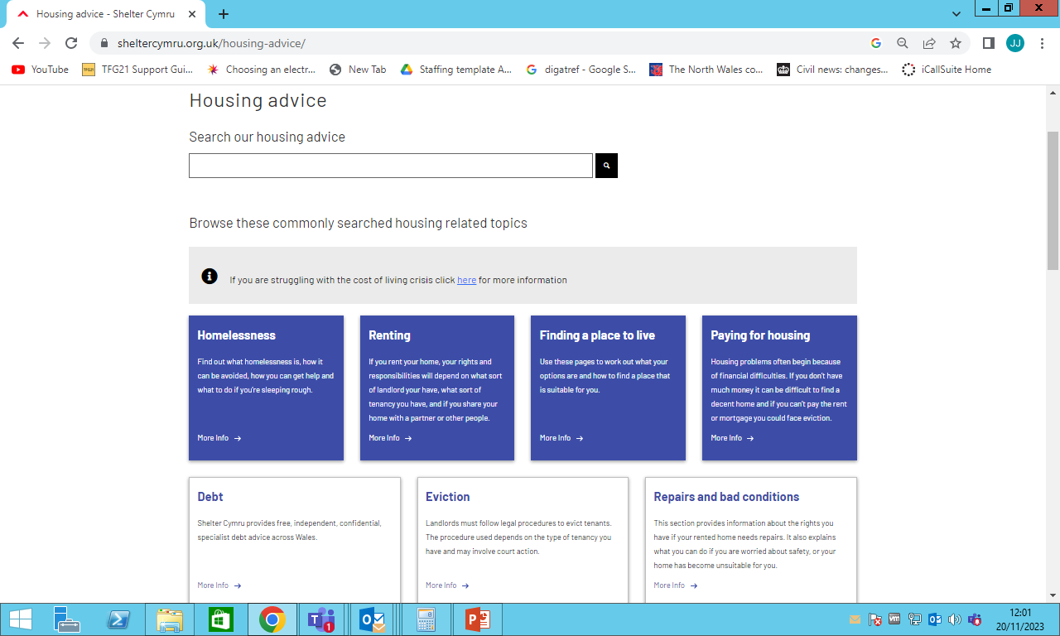
Advice Online

Slide 8
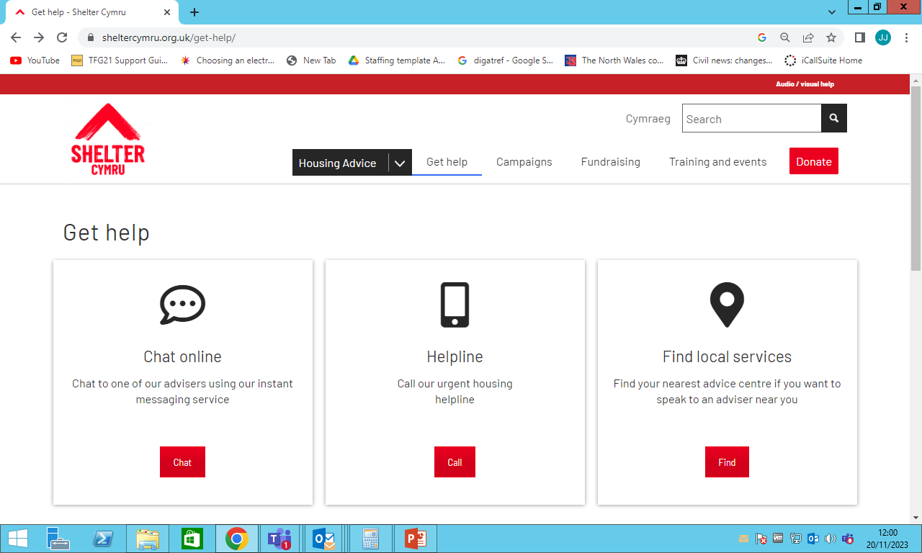
Webchat and Helpline

Slide 9
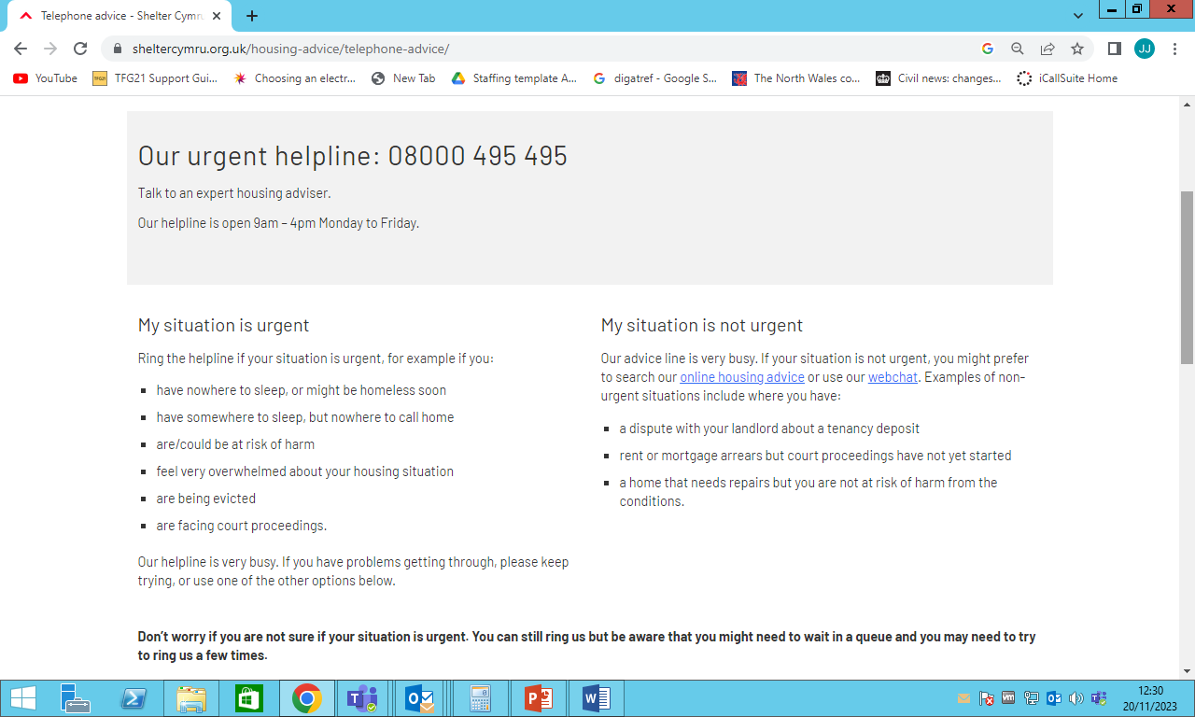
Helpline Hours and Criteria

Slide 10
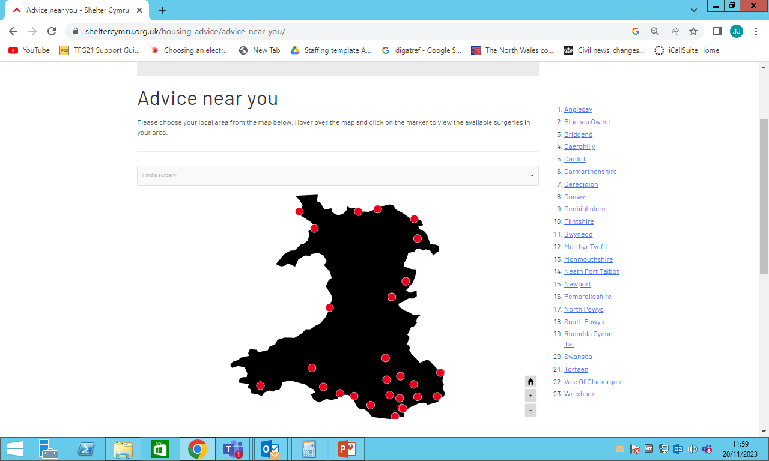
Community Housing Advice Services

Slide 11
Shelter Cymru operates a court duty desk at every Welsh County Court, last year representing at 737 possession hearings. Our solicitor Legal Team were involved in 83 complex litigation cases last year.
Housing Loss Prevention Advice Service and Legal Services
Notes:
Court Duty: 387 in 21/22 – increase of over 90% (CHAS teams are getting 1 in every 5 new clients from court duty sessions)
Litigation: 63 in 21/22 (up 32% from last year – acknowledge challenging year for Legal team - additional fixed term solicitor post advertised soon).

Slide 12
The content of the advice offered
Local authority duties to people at risk of homelessness
• Landlord licensing in the Private Rented Sector
• Social housing allocations decisions
• Occupier’s disrepair rights
• Tenancy rights including grounds for possession, particularly technical advice regarding the validity of notices
• General income maximisation to support housing sustainment or homelessness relief
• Harassment and illegal eviction
• Succession rights

Slide 13
Housing benefit/housing costs rights and obligations
Mortgage and rent arears and related possession proceedings including representation at court and applications to suspend warrants up to and including the day of eviction
Possession proceedings relating to anti-social behaviour and other tenancy breach
Housing options including access to direct access hostels, supported housing, social and RSL waiting lists and PRS accommodation.
Rights for private tenants, such as deposit rights and lettings fee ban

Slide 14
WHERE BEST TO REFER CLIENTS

Slide 15
Where a referral is non-urgent and the query is fairly simple, referrers may wish to advise clients about our Advice Online information pages.
Where a referral is more urgent but likely to require only one-off advice in the first instance, referrals to our helpline and webchat are encouraged as these clients are likely to receive advice sooner via this route.
Where a referral is more urgent and would benefit from local knowledge and/or require local advocacy, referrals to our community-based advice teams are encouraged.

Slide 16
Contact Details
Advice Online - Housing advice - Shelter Cymru
Webchat - Webchat - Shelter Cymru
Helpline (9am-5pm Weekdays) - 08000 495 495
Community Housing Advice Services
NW Wales - 01248 671005
NE Wales - 01978 317911
West Wales - 01792 469400
Western Bay - 01792 469400
Cardiff, Vale and Valleys - 02920 556120
Gwent - 02920 556120

