Slide 1
Frontline Network
Roundtable Discussion – Practical Ways to Support the Wellbeing of Frontline Staff

Slide 2


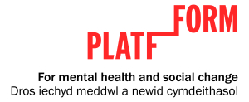
Dr Brett Grellier
Rachel Marshall
Kate Standing
Oliver Townsend

Slide 3
Elements of Wellbeing wellbeing
Positive Emotion
Engagement
Meaning
Accomplishment
Positive Relationships

Slide 4
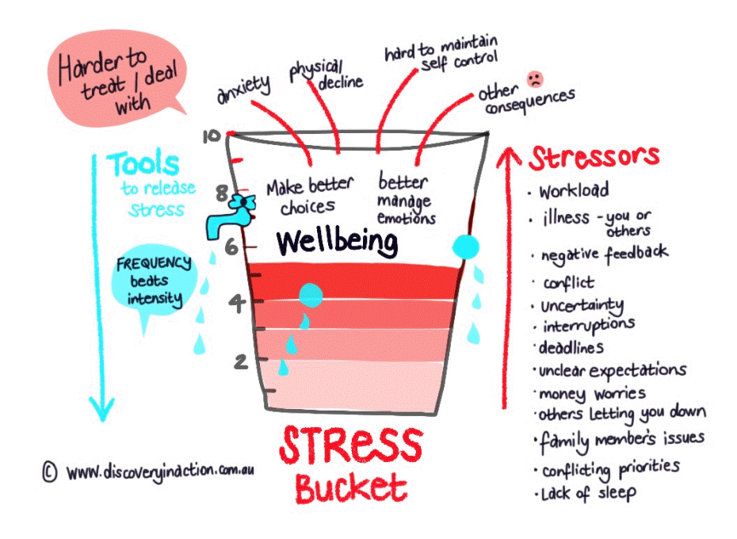

Slide 5
Systemic Betrayal & Moral Injury
Systemic betrayal occurs when an individual is within a system that they can’t remove themselves from (e.g., school, work, social systems), and experiences a trauma that isn’t addressed or acknowledged. This breaks the perceived social contract and betrays trust.
Systemic betrayal can lead to moral injury. Systemic betrayal often leads to more externalised anger and resentment, while moral injury can lead to more internalised guilt.
Moral injury is defined as perpetrating, failing to prevent, or witnessing acts that transgress deeply held moral beliefs and expectations (Litz et al., 2009), as well as betrayal by a leader or trusted authority (Shay, 2014).

Slide 6
Impact of Managers on Staff Mental Health Workforce Institute @UKG (2023)
Sixty percent of employees worldwide say their job is the biggest factor influencing their mental health.
Managers have just as much of an impact on people’s mental health as their spouse (both 69%) — and even more of an impact than their doctor (51%) or therapist (41%).
Eighty-one percent of employees worldwide would prioritize good
mental health over a high-paying job.

Slide 7
Compassion in the workplace model (Roffey Park Institute, 2016)
Non-judgemental
Empathic
Alive to the suffering of others
Appropriate action
Tolerating personal distress

Slide 8
Compassionate Leadership
Michael West – The Kings Fund
Evidence shows that the most predictive factor for patient satisfaction and care quality, is staff wellbeing and satisfaction
Poor staff wellbeing leads to increased errors and reduced quality of service
Culture (how and why we do things the way we do) is the most powerful influence on our behaviour in work settings
Leaders shape the culture. Leader behaviour shows what is valued in practice
A large dataset of questionnaires shows that desired leader behaviour includes authentic, open, honest, humble, curious, optimistic, appreciative, compassionate.

Slide 9
Benefits of compassionate leadership
Benefits clients and employees (those who witness the compassion act and those who are involved in the actual act of compassion) and the organisation (Frost et al., 2000; Goetz et al., 2010; Lilius et al., 2011).
Improves employee engagement and retention (Fryer, 2013; Lilius et al., 2011) and reduces absenteeism and presenteeism. Protects against burnout and compassion-fatigue.
Enables people to experience positive emotions which, boosts productivity (Lilius et al., 2011). Lowers heart rate and blood pressure and strengthen the immune system (Friedrickson et al., 2000). Results in positive customer service (Figley, 1995; Goetz et al., 2010)

Slide 10
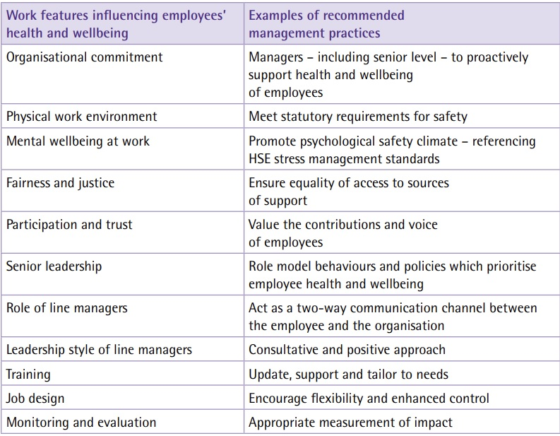
Summary of NICE (2015) recommendations for management practices

Slide 11
Evaluation examples
HSE (2008). Management competencies for preventing and reducing stress at work: Identifying and developing the management behaviours necessary to implement the HSE Management Standards: Available at: http://www.hse.gov.uk/research/rrhtm/rr633.htm
The Warwick-Edinburgh Wellbeing Scale (WEMWBS)
Perceptions of Effective Working Questionnaire
Copenhagen Burnout Inventory (CBI)

Slide 12

Frontline Worker Wellbeing
Learning from the latest Frontline Worker Survey
Rachel Marshall, Policy & Best Practice Manager
at St Martin-in-the-Fields Charity

Slide 13
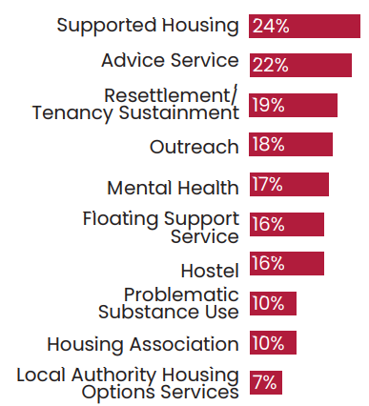
Methodology
Top 10 types of service frontline staff worked in:
Our most recent survey was undertaken in November - December 2022 and we received responses from 1,182 frontline workers. Overall, 80% were based in England, 9% in Scotland, 8% in Wales and 3% in Northern Ireland.
We define a frontline worker as anyone directly supporting people experiencing homelessness. This includes those working in the public, statutory and voluntary sectors.
Approximately 1 in 5 (22%) of frontline workers had also previously or currently used homelessness services themselves.

Slide 14
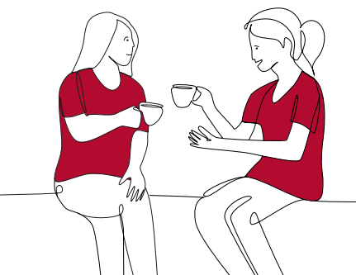
Experiences of frontline homelessness work

Slide 15
Frontline staff are working under extremely challenging conditions.
78%
Of frontline workers stated that demand for their service had increased in the last 12 months.
44%
Of frontline workers said it was ‘very difficult’ or ‘difficult’ to have time to undertake training.
32%
Of frontline workers stated that they were struggling to pay housing costs.
"[We] seem to be firefighting all the time due to poor funding, staff shortages and lack of affordable accommodation.”
Frontline worker,
South East England

Slide 16
This is having a significant impact on staff wellbeing, and threatens to force frontline workers to leave the sector.
The majority (58%) of frontline staff felt that their role had a negative impact on their wellbeing.
Whilst most (68%) frontline workers thought it was ‘very likely’ or ‘likely’ they would continue working in the homelessness sector long-term, the rising cost of living was contributing to increasing uncertainty:
“I love what I do and would love to be able to carry on doing it but unfortunately need to be making decisions for my own benefit - it’s hard to support people when you’re also struggling to keep the wolf from the door. I want to have stable accommodation and this income doesn’t provide that.”
Frontline worker, South West England

Slide 17

What action do frontline workers recommend?

Slide 18
We need to act now to support frontline services through this cost-of-living crisis.
86% of frontline workers thought services needed additional support to help with the rising cost of living.
“Our service delivery is at risk of reduction due to increase in utility, salary uplifts and other costs which impact on a set funding pot which has not changed for 5 years and is not planned to change in the next 18 months.”
Frontline worker, West Midlands
“We are covering some costs, like fuel, that we should be paid, and we are even personally buying food and other items for people in need.”
Frontline worker, Yorkshire and Humberside

Slide 19

We need to act now to equip frontline workers with the tools they need to do their jobs effectively.
Wider recommendations from staff included improving working conditions, providing more opportunities for training, and implementing reforms and policy changes to prevent homelessness.
"More investment into the staff here and a full staff/ management team would mean less churn which would equal a more stable and productive service. Then we could actually look at improving our offer to service users and doing more rather than constantly keeping our head just above water...”
Frontline worker, West Midlands

Slide 20
Read more on our website… www.frontlinenetwork.org.uk/resources/research

Slide 21

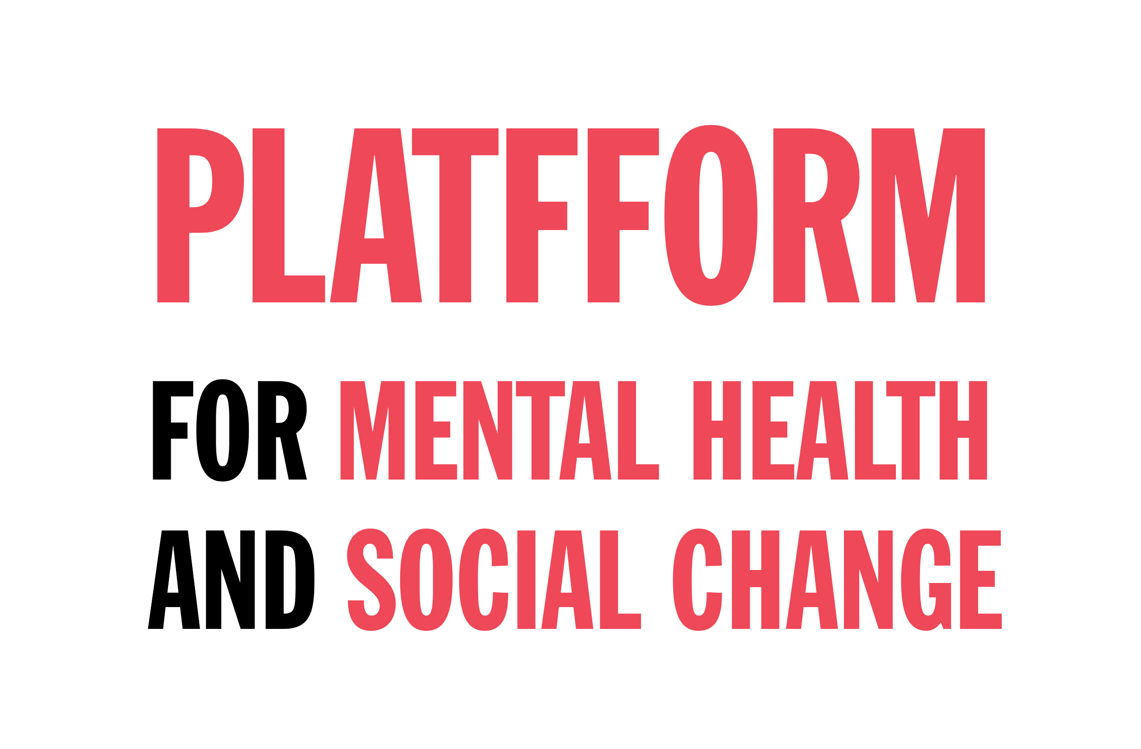
Notes:
Edit logo

Slide 22

Platfform is the charity for mental health and social change.
First established as Gofal, a mental health charity, in 1990.
Our vision is sustainable wellbeing for all:
Wellbeing meaning a sense of purpose, optimism, hope, agency, and direction
All meaning us, our community, the people we work with and beside, humankind, animals and nature
Everything we do is underpinned by our values:
  connected, compassionate, curious and brave.
Notes:
Sarah
Believe in the power of relational support, based on connection & trust, rather than transactional support.

Slide 23

We support people of all ages, across urban and rural communities, in people’s homes and alongside other services.
Our work spans inpatient settings, crisis services, community wellbeing, supported housing and homelessness, businesses, employment, counselling, schools and youth centres.
Through decades of working across housing and mental health, we gained real insight into the reality of mental health in society, the impact of trauma, and the causes of distress.
After seeing thousands of people experiencing similar challenges, we know things have to change.
This led us to become Platfform and publish a Manifesto for Change.

Slide 24


To change the dominant narrative around mental health
      By advocating for the role that trauma, life experiences and socio-economic circumstances have on our mental health + ability to heal.
      By making the evidence for this accessible to help shift public perceptions.
To make our 'helping systems' work better for people
      By changing how we provide services to people in distress.
      Focus first on the mental health, housing, homelessness, and young people's systems we interact with.
24
Notes:
This project directly aligns with our values and purpose – offering an alternative to traditional out of hours crisis support e.g. A&E and police, ensuring people get the right support at the right time.
Recognise unique challenges of Sanctuary – the complexity, and sometimes messiness of providing out of hours support to people in distress, our experience across the full breadth of MH & wellbeing support, alongside social crises, family support etc means we are well equipped with managing these challenges effectively and compassionately.

Slide 25
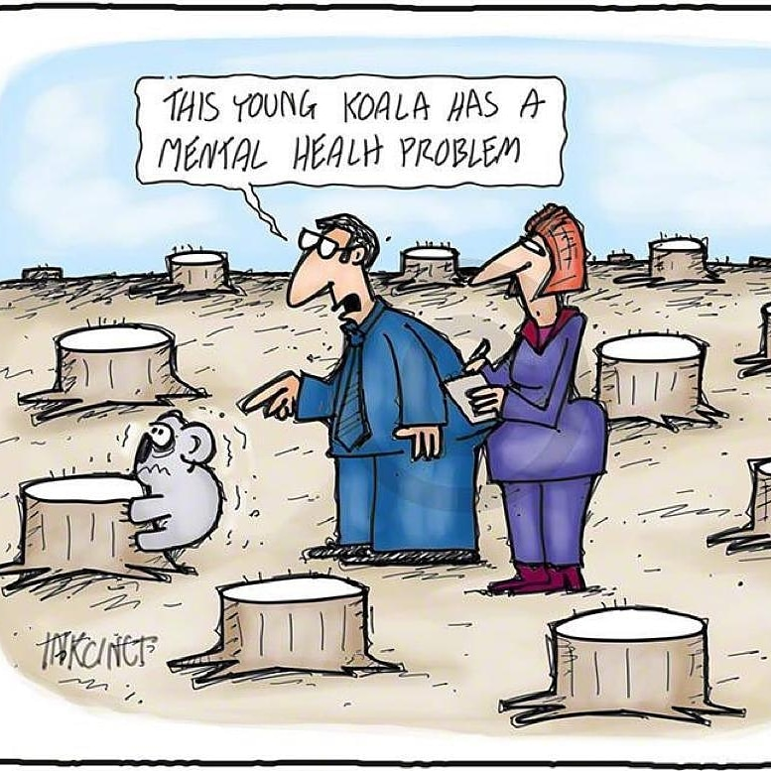

Slide 26
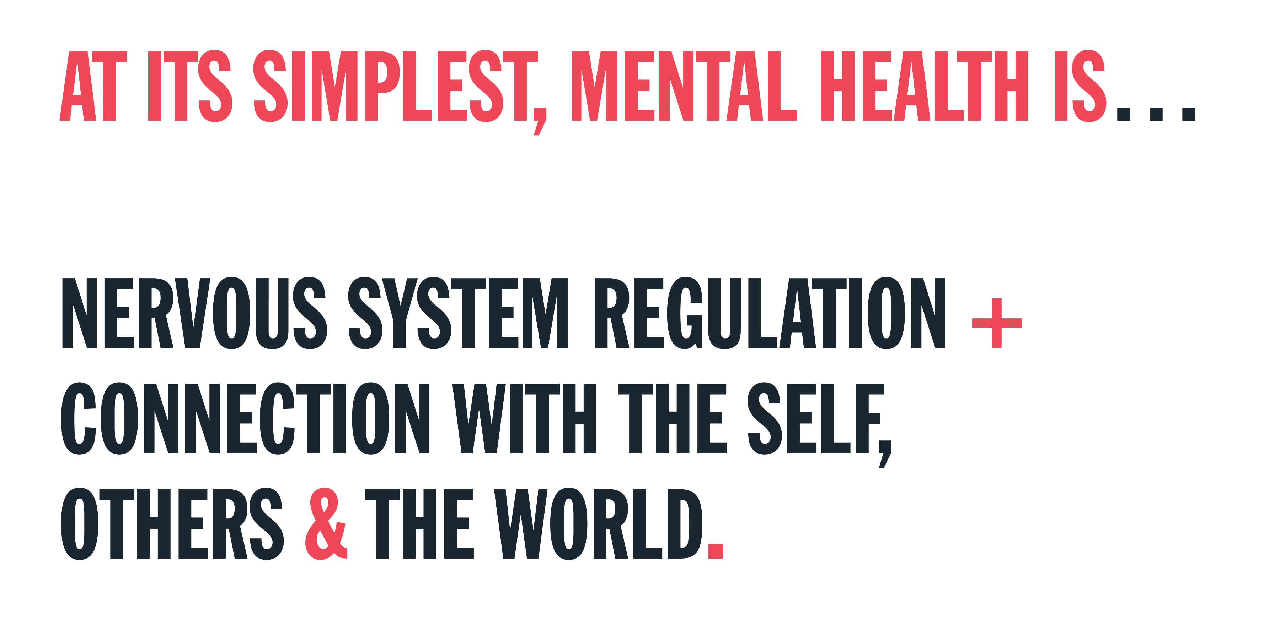
Notes:
This is because in the simplest form mental health is about nervous system overwhelm and loss of connection.

Slide 27
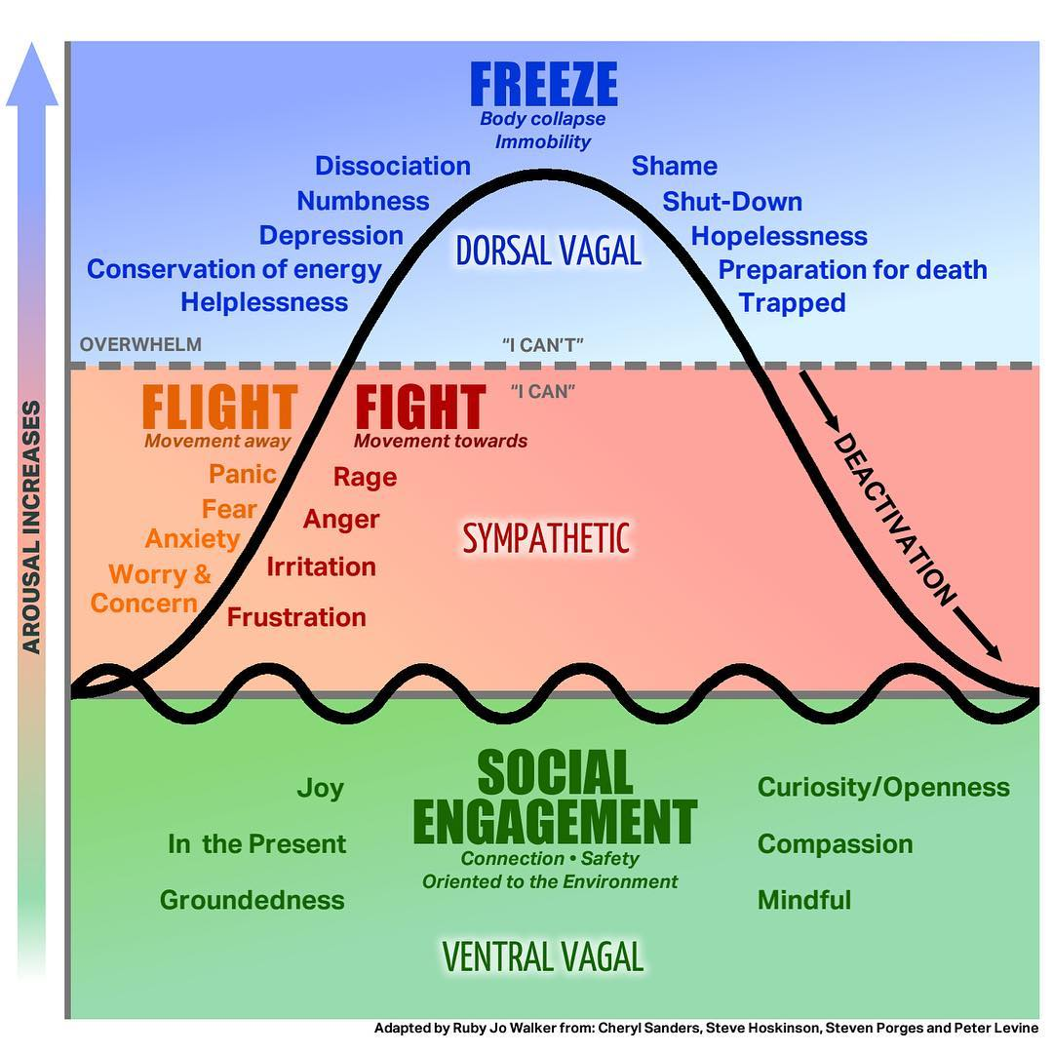
Notes:
We learn to do this – emotional regulation from our parental figures – through secure base. Secure base is how we learn to internalise emotional regulation for ourselves. Though we are always dependant on those around us and we can only be as regulated as our circumstances all us / as those around us are.
VIDEOS

Slide 28
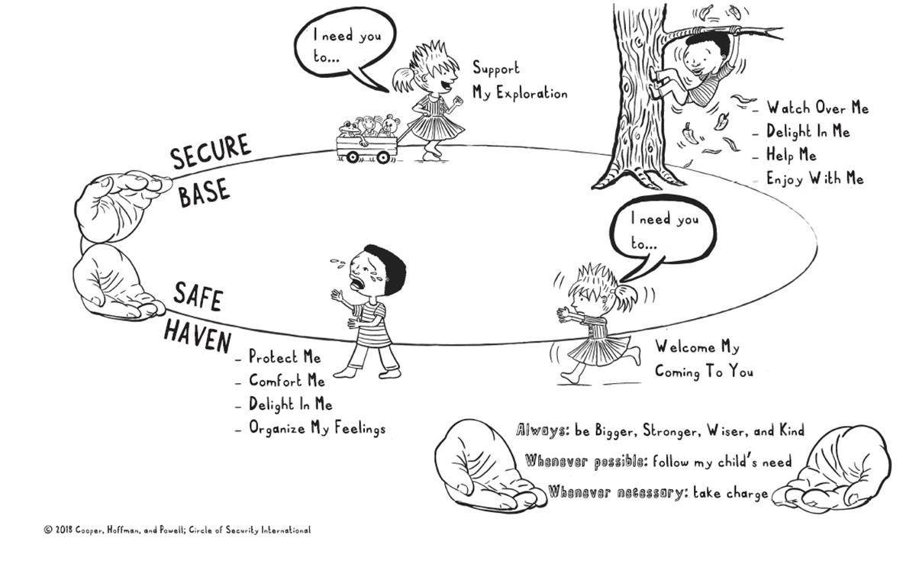
Notes:
This is secure base. VIDEO

Slide 29
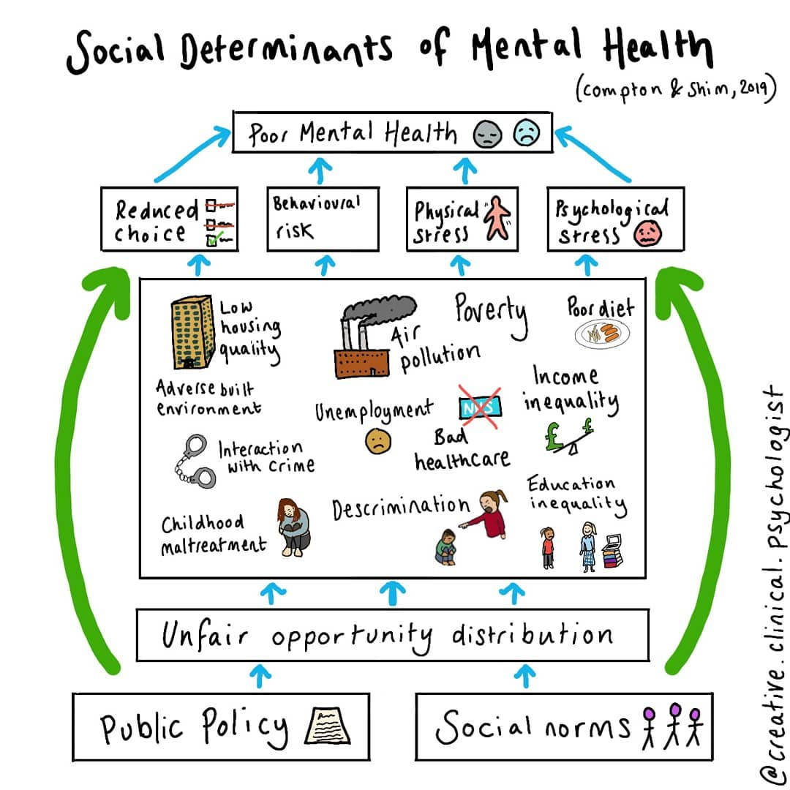
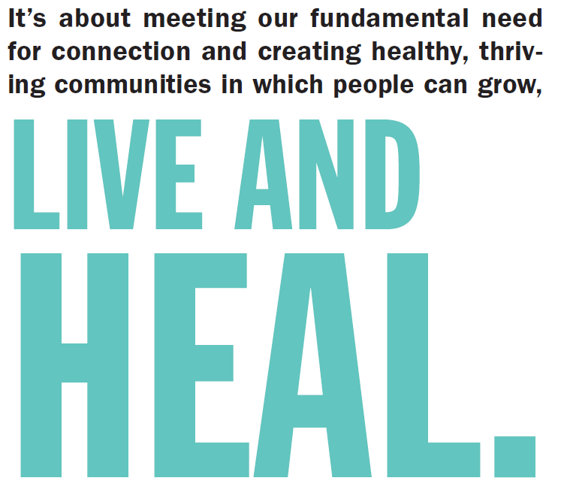


Slide 30
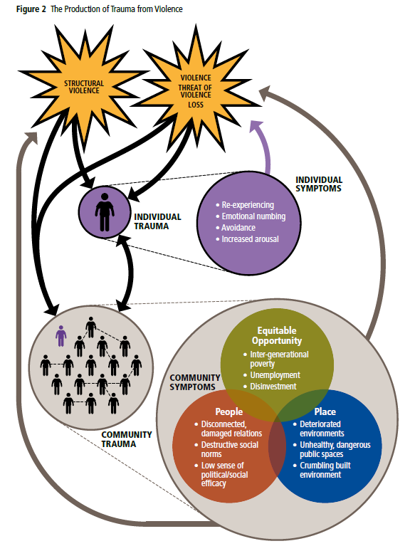


Slide 31
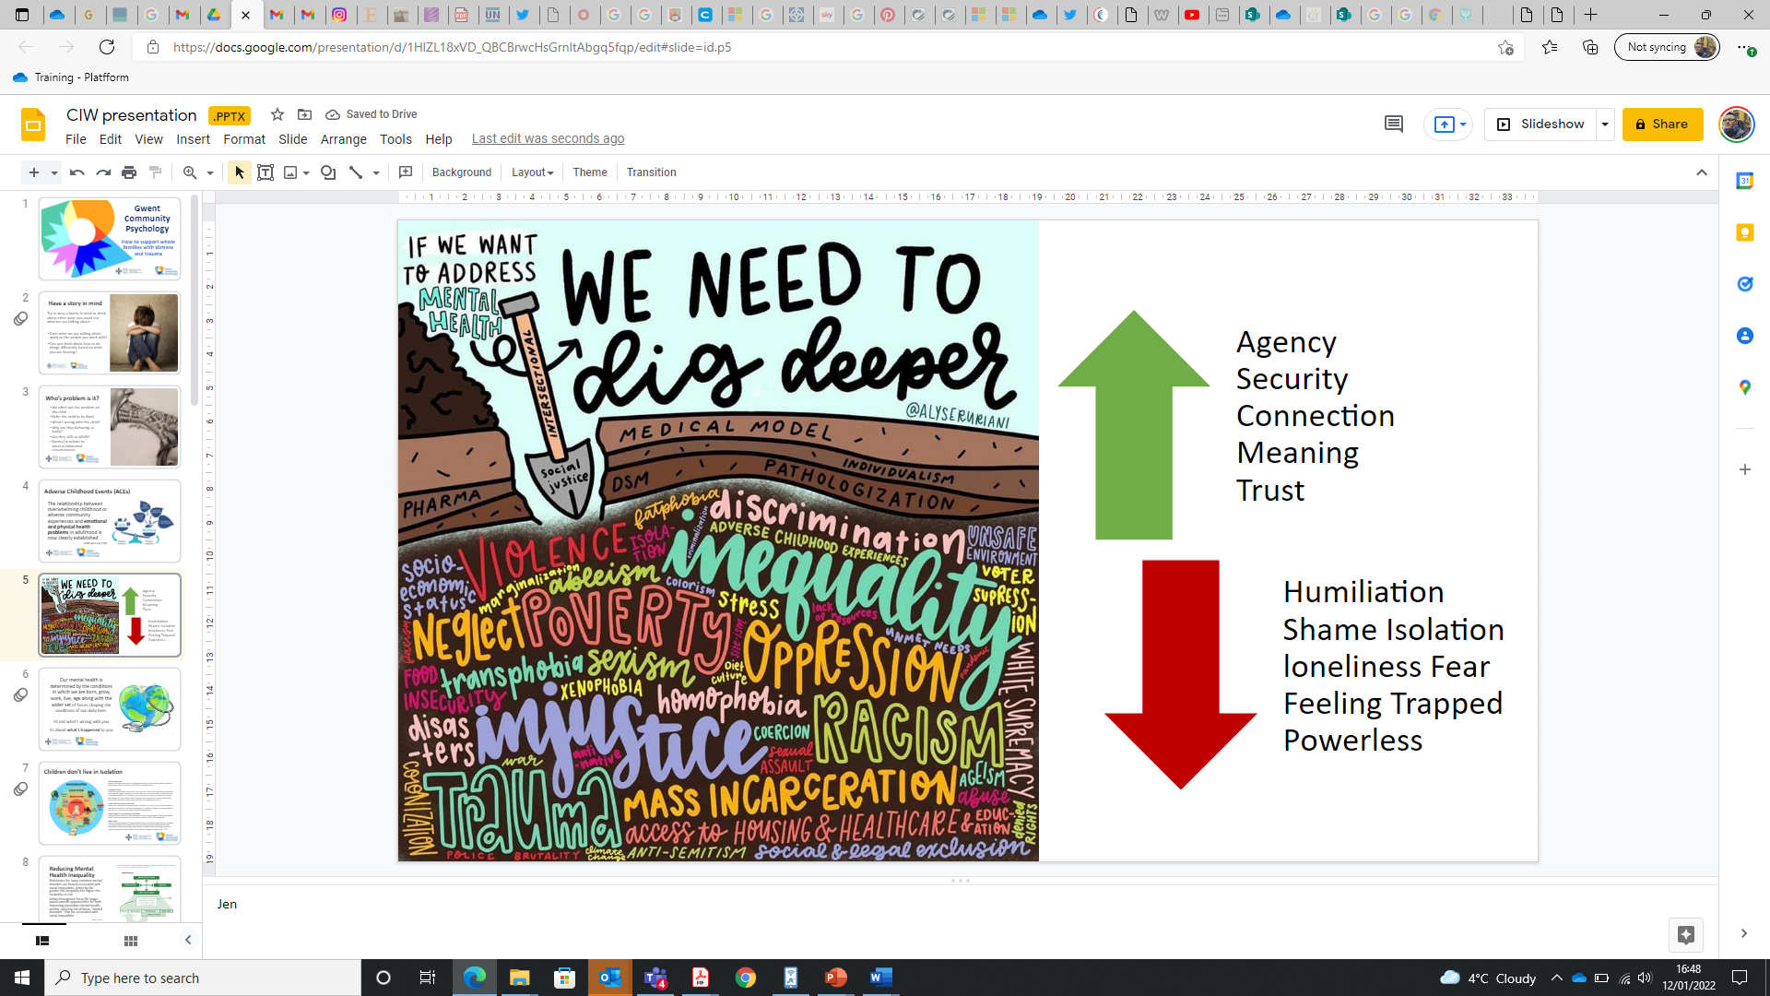
PSYCHOSOCIAL HEALTH
Notes:
If we accept the medical model is not scientifically valid then we need to dig deeper. Understand how circumstances of Psych unhealthy lead to mental health problems aka trauma + distress.
Need to focus on moving towards Psychosocial health.
Our mental health is determined by the conditions in which we are born, grow, work, live, age along with the wider set of forces shaping the conditions of our daily lives.
Its not what’s wrong with you
Its about what’s happened to you
But also what didn’t happen for you

Slide 32
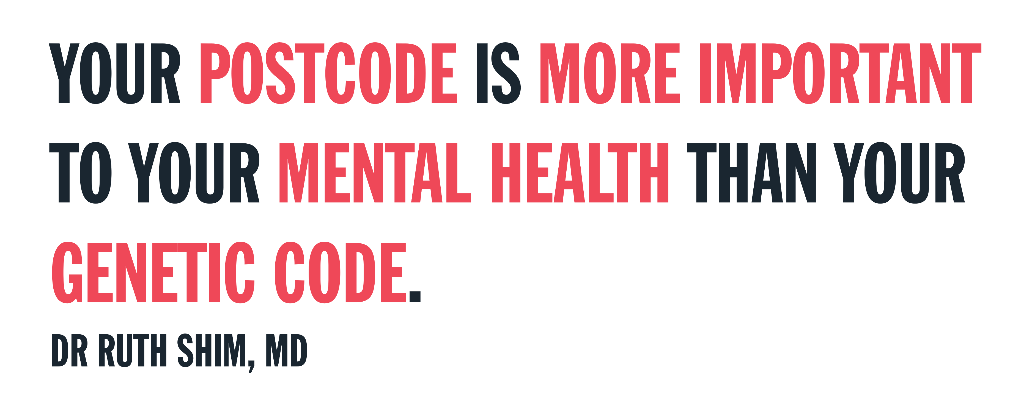
Notes:
From approx. 4.50 mins explanation of SDMH for 5 min

Slide 33
CONTINUUM OF RELATIONAL HEALTH
Nervous system regulation
+ connection
Nervous system dysregulation (overwhelm) + loss of connection
Psychosocially Healthy
Traumatised + surviving
Circumstances a person can thrive in based on agency, security, connection, meaning + trust
Circumstances that harm a person fully of humiliation, shame, fear, isolation, loneliness, feeling trapped and powerless
Trauma Prevention
Trauma Early Intervention
Trauma Support
(Daffin, 2022)
Notes:
TI is the deficit end of the relational health continuum. We need to be able to understand both end and how to move to wards psychosocially healthy.

Slide 34
Notes:
This is secure base. VIDEO

Slide 35
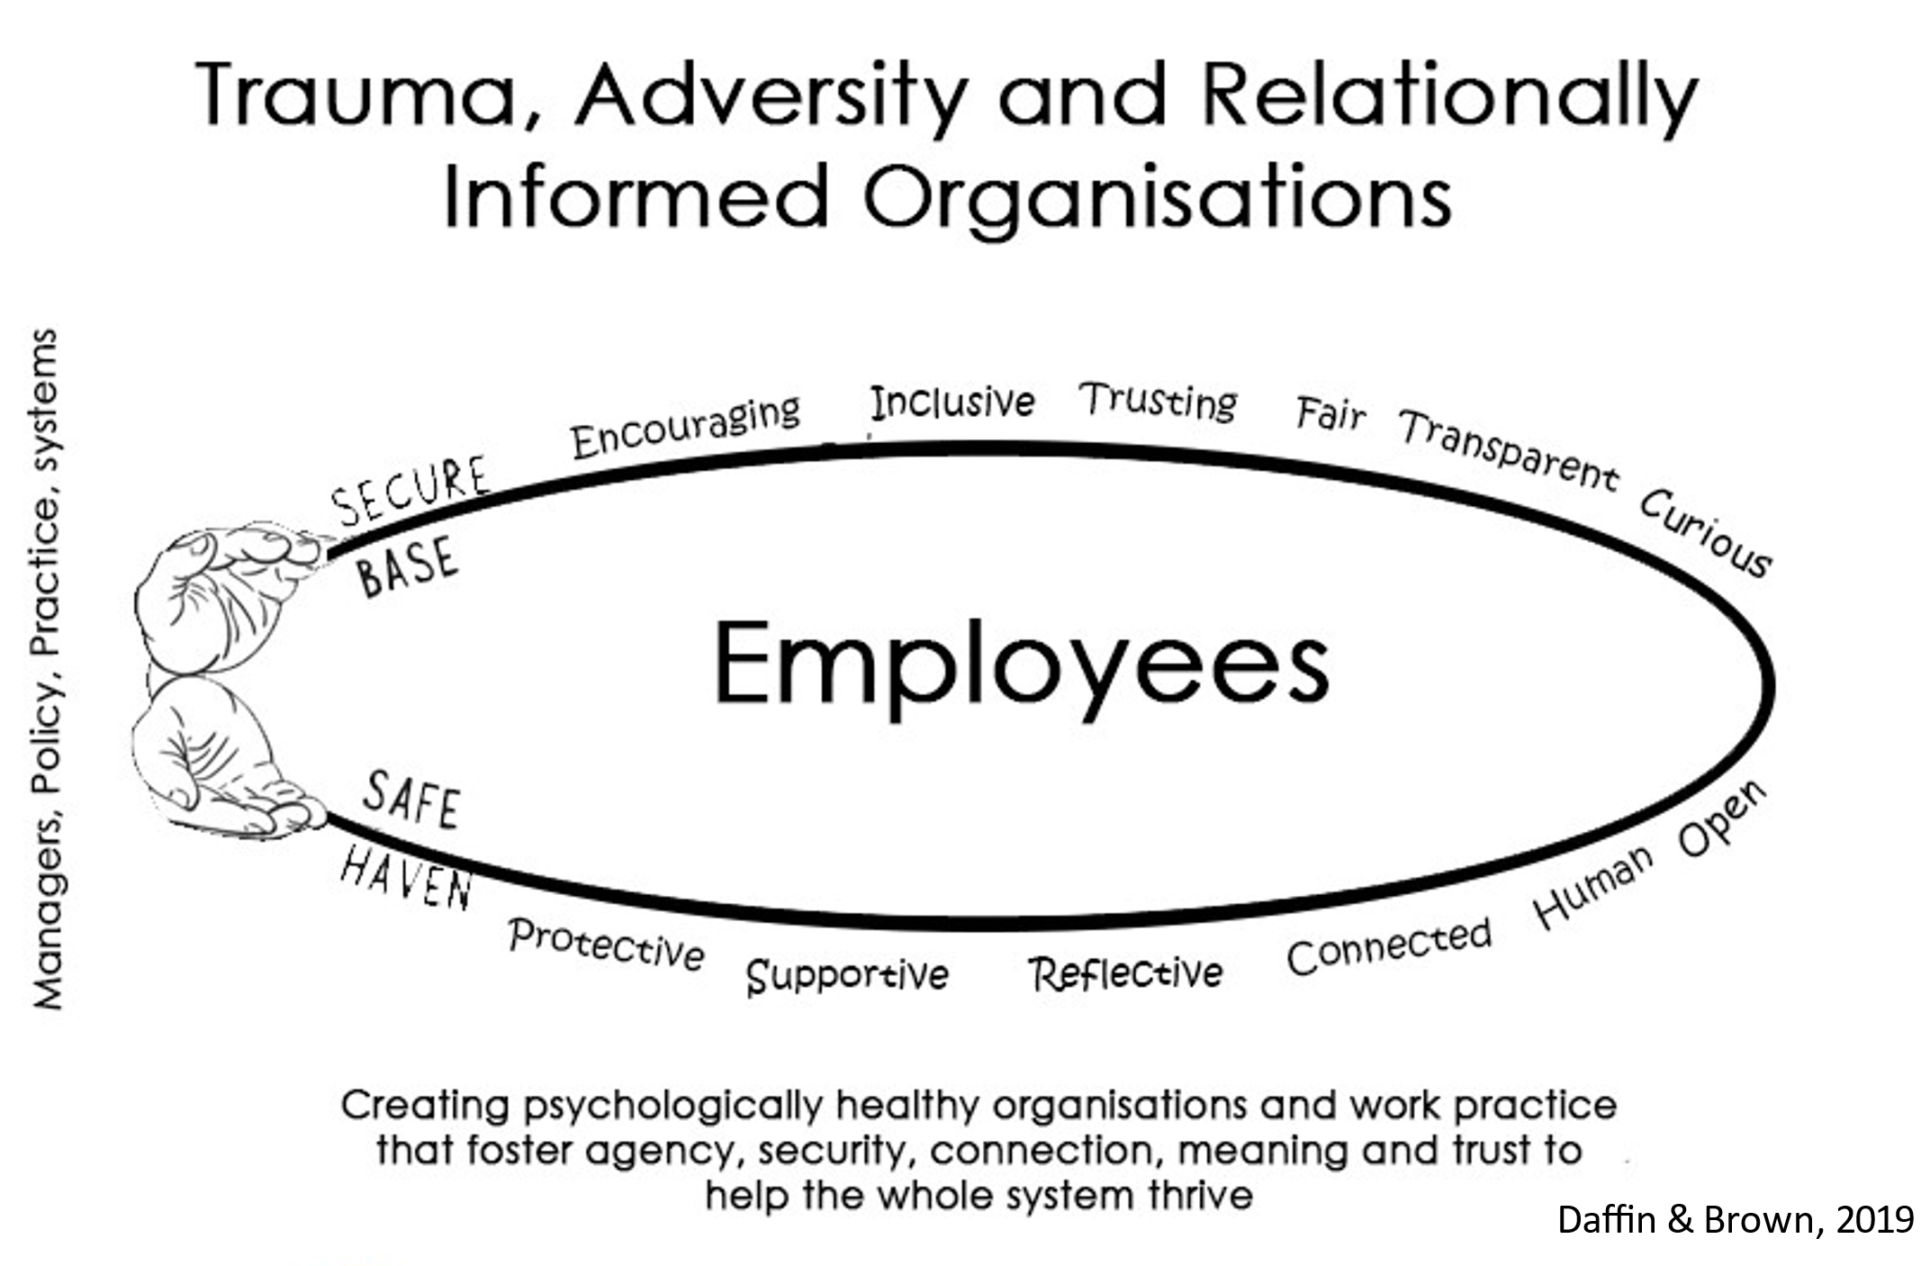
Notes:
This is secure base. VIDEO

Slide 36
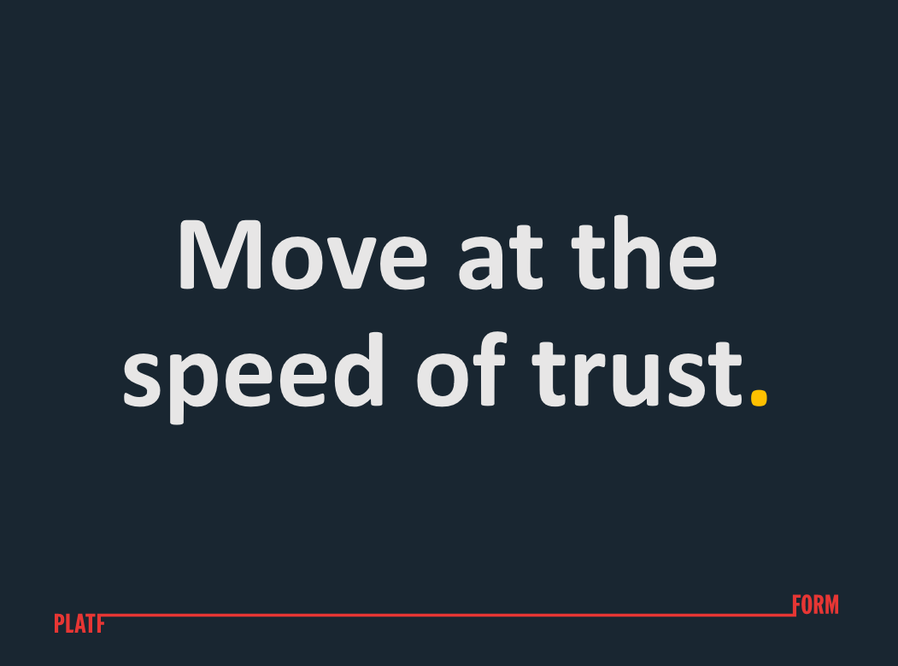

Slide 37


Slide 38

For enquiries about manifesto, partnerships and more:
Oliver Townsend
Head of Connection and Change, Platfform
olivertownsend@platfform.org
For enquiries about Platfform Wellbeing support:
Mary Rogers
Business Development Manager, Platfform Wellbeing
maryrogers@platfform.org

Slide 39
Kate Standing
Networks Manager, Justlife
Brighton & Hove Frontline Network
Becoming Psychologically & Trauma Informed from the Ground Up

Slide 40
Brighton & Hove Frontline Network
  Running since 2017
  Regular events and monthly newsletters
  Workers across whole city. Including…
    VCSE organisations – large and small
    Housing Department
    Health
    DWP
  Not just homelessness and housing – part of wider landscape of support
  Workers tell us what they want us to focus on

Slide 41
Key themes?
Trauma informed Care
PIE (psychologically informed environments)
Co-Production
Lived Experience
Staff Wellbeing
Reflective Practice
Strengths Based Practice

Slide 42
How?
Events – workshops/spaces to share experience
Training – be creative
Newsletters – be brief and focused
Loads of 1-2-1 email conversations
Connect in with other networks and conversations locally and nationally

Slide 43
Who?
Other local networks – Digital Inclusion, Mental Health, food security
Local Programmes – Changing Futures, Fulfilling Lives, Common Ambition
Interagency meetings – ground and strategic level
Connect in with other networks and conversations locally and nationally
Find the allies

Slide 44
It’s a journey…
Opportunities for conversations and learning, not just training.
Facilitating spaces to build networks, trust and understanding.
Different approaches and different points of contact to reach the widest number.

Slide 45
Questions for Leaders
How do we create opportunities to foster elements of positive wellbeing?
How do we support staff to process difficult experiences and emotions?
How do we create a sense of agency/control and predictability for staff members?
What should we be doing and not doing to support staff wellbeing?
How can we evaluate whether our interventions have a positive impact on wellbeing?

Slide 46
Contacts
Dr Brett Grellier
Brett Grellier Psychological Services
brett@bgpsych.com
www.bgpsych.com
07970 974 424
Oliver Townsend
Head of Connection and Change, Platfform
olivertownsend@platfform.org
Kate Standing
Networks Manager
Justlife, Brighton and Hove Frontline Network
kate@justlife.org.uk
Rachel Marshall
Policy & Best Practice Manager, St Martin-in-the-Fields Charity
rachel.marshall@stmartinscharity.org.uk

