Slide 1
Frontline Network
Resilience Session
Duncan Gordon – SCCR Trainer

Slide 2
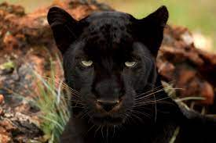
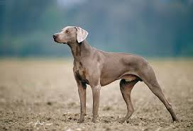
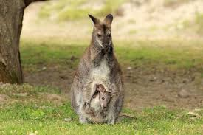
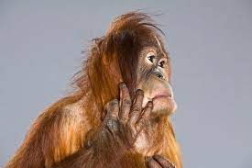
How are you feeling to today ?
…The goal of resilience is to thrive.
Jamais Cascio
Resilient
Managing
Coping
Not so good
www.frontlinenetwork.org.uk/funding

Slide 3
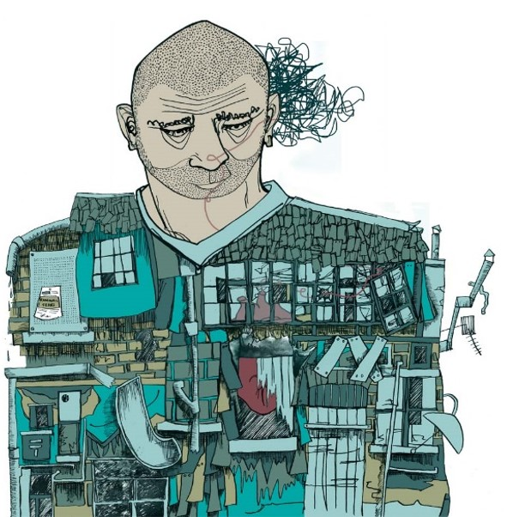
Frontline Worker Wellbeing
Most frontline workers feel that their job negatively affects their wellbeing.
Uncertainty about continuing to work in the sector, reasons cited included, the impact of the role on their mental health and wellbeing.
Frontline Network – Annual Frontline Worker Survey 2022
Resilience is built on wellbeing

Slide 4
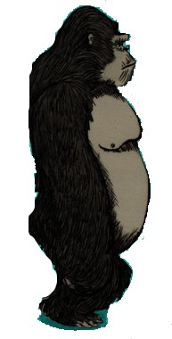
Resilience
“Resilience means you experience, you feel, you fail, you hurt, you fall. But, you keep going.”
Yasmin Mogahed, Motivational speaker
Most people would describe resilience as the ability to ‘bounce back’ from adversity.
Adversity, a difficult or unpleasant situation

Slide 5
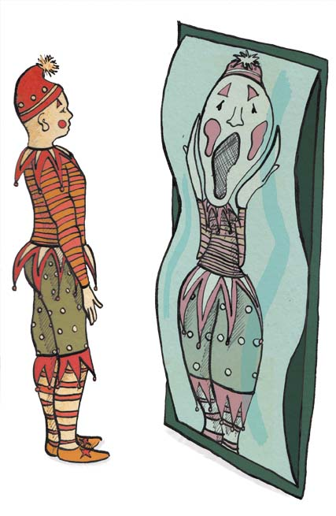
Resilience
What is it?
I have suggested it is “bouncing back” but how do people identify “their” resilience the ‘strength within us’ - for some it is in there but not recognised.
How do people identify resilience ‘the strength within us’?
Menti.com 5198 4051

Slide 6
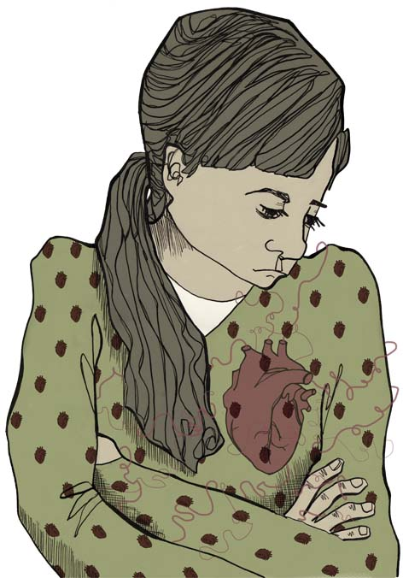
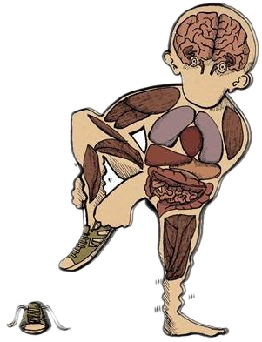
Building Resilience
Being Present
Within yourself
Attitudes & beliefs
Understanding emotions
Triggers
Mind, body connection
Self Awareness
Positivity
Confidence
Competence
Resilience Skills, Factors and Strategies of the Resilient Person
https://positivepsychology.com/resilience-skills/

Slide 7
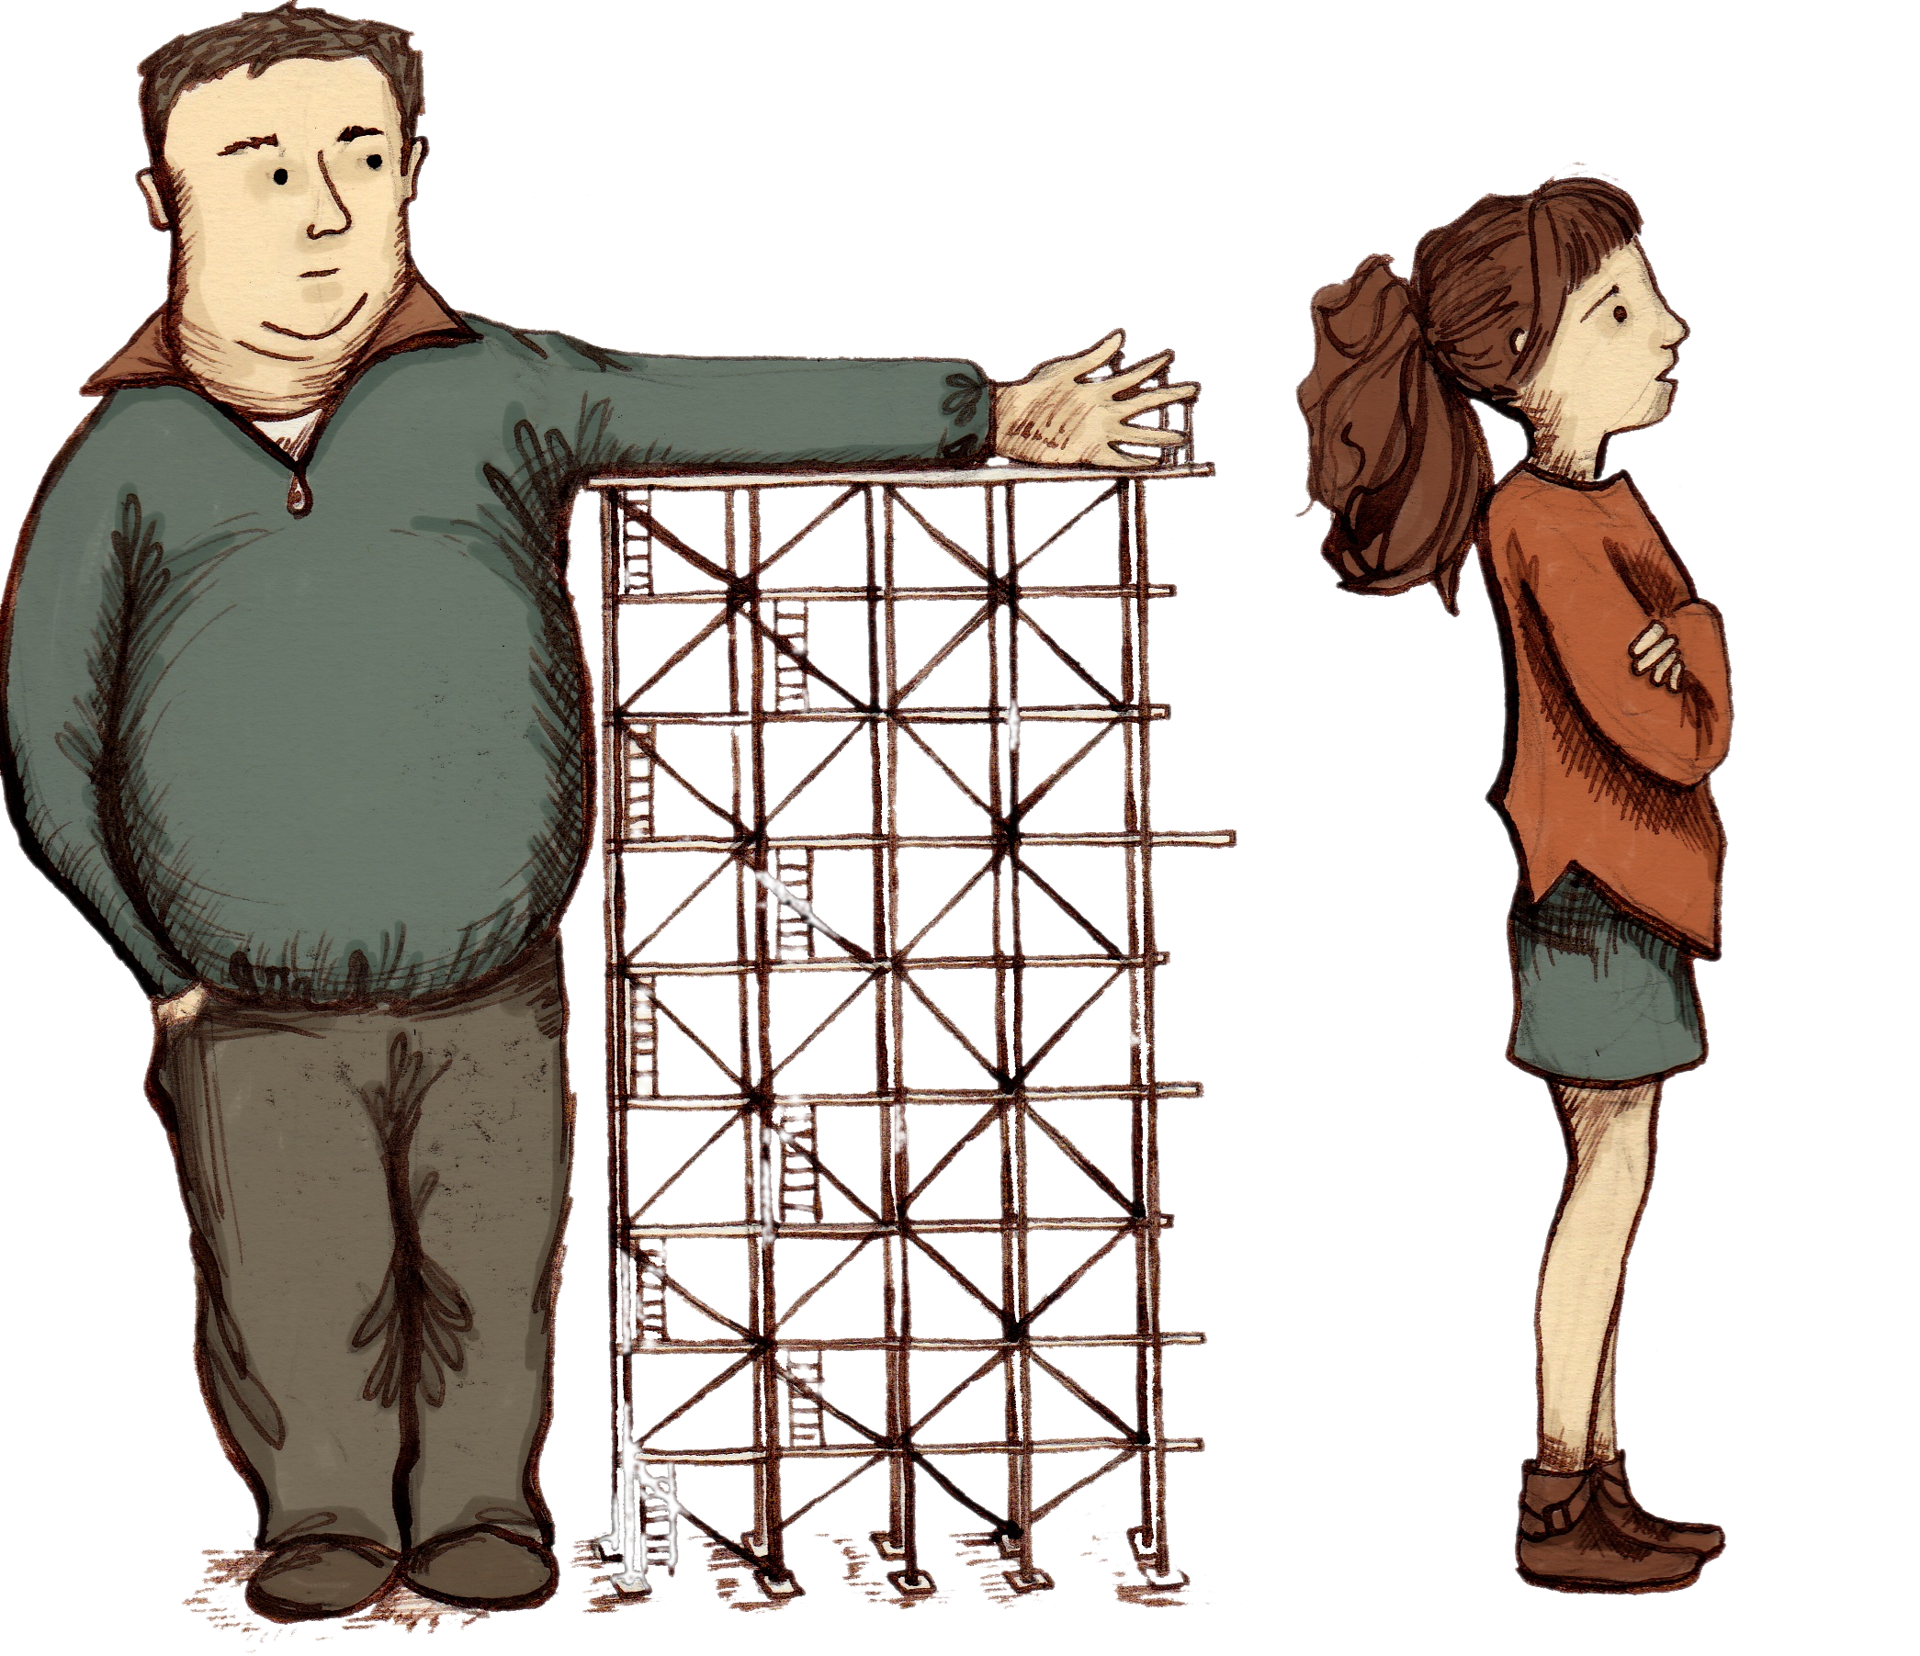
Resilience & Relationships
5 Pillars of resilience
Clear sense of purpose and direction
Maintaining physical presence and energy
Open and optimistic
Self belief, confidence, motivation and perseverance
Meaningful relationships

Slide 8
Barriers to Resilience
Barriers to resilience can include:
The five most common barriers to resilience include (1) an imbalance between work and personal life, (2) overexposure to stressful events, (3) insufficient time and space to process negative feelings, (4) humiliating experiences, and (5) social isolation.
Being resilient does not make you immune to difficult situations or adversity, it means you are human!
Resilience is not a character trait, it is something we need to work at and build on throughout our lives

Slide 9
Resilience
Take home messages
Resilience is not a character trait but something that we have and build on through our lives through experiential learning.
Resilience is about how we ‘bounce back’ from adversity no matter how big or small, physically, mentally and emotionally, its building our inner strength, our self-belief.
By acknowledging the reality of the situation, we can try to understand where we can make positive changes, no matter how small to help us maintain our resilience.

Slide 10
Keep in touch
Explore our website and follow us on all of our social media channels to receive information on upcoming events, resources, digital projects and blogs:
sccrcentre
Scottish Centre for Conflict Resolution
@sccrcentre
sccr@cyrenians.scot
scottishconflictresolution.org.uk

