Slide 1
Frontline Network Annual Conference 2023

Slide 2
Homelessness and Health

Slide 3
Plan for the session
11.50 – 12.00 Welcome (Lucy Holmes, Groundswell)
12.00 – 12.15 Homeless Health: Peer led approaches to tackling health inequalities (Özgür Gencalp, Groundswell)
12.15 – 12.30 Listen Up! health insights (Tess Tainton and Caoimhe McCullough, Groundswell)
12.30 – 12.45 Improving access to primary healthcare services and support for people experiencing homelessness (Jo Prestidge, Homeless Link)
12.45 – 13.00 Fireside chat & Q&A with Groundswell Homeless Health Peer Advocate Manu Benaissa and the panel.

Slide 4
Homeless Health
Peer led approaches to tackling health inequalities
Oz
ozgur.gencalp@groundswell.org.uk

Slide 5
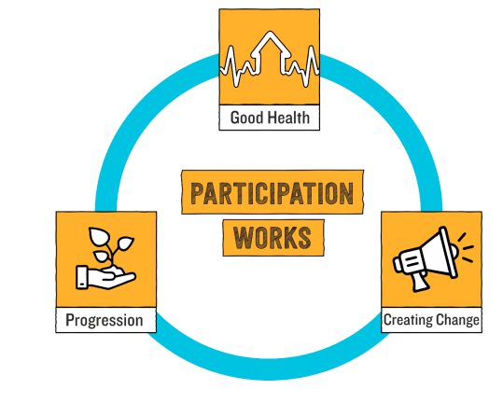
Who are Groundswell?
Groundswell exists to enable people who have experience of homelessness to create solutions and move themselves out of homelessness – to benefit of our whole society.
Most of our frontline staff and volunteers have experienced or are currently experiencing homelessness.

Slide 6
Groundswell’s core beliefs
The whole community benefits when we effectively tackle homelessness and social exclusion.
We believe in people! People are society’s most valuable resource, and everyone has the capacity to make a contribution.
There is no them and us – only us! Groundswell brings everyone together to create genuine solutions to homelessness.
Participation works! Supporting homeless people to participate creates more effective services and policy - and crucially enables people to move out of homelessness.

Slide 7
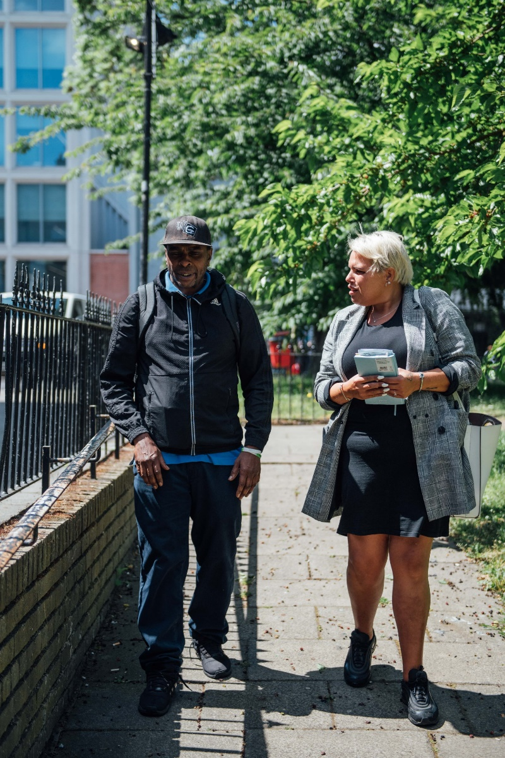
Homeless Health Peer Advocacy
HHPA is a peer support service delivering one-to-one engagements as well as in-reach and health promotion activities to enable people experiencing homelessness to access the healthcare they need.
In addition to providing practical support peers also work with clients to build the skills and confidence needed to access healthcare independently.

Slide 8
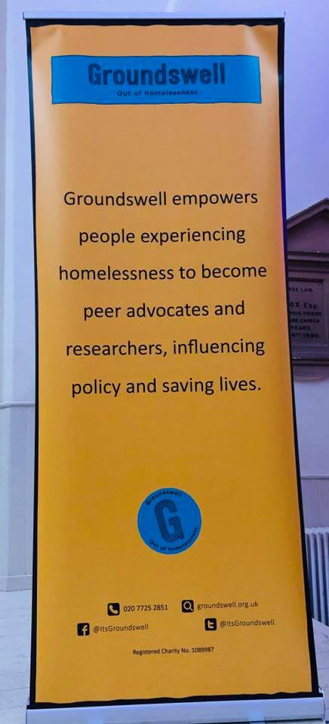
HHPA London – where we work
Started in Westminster 2010 – Pilot
Westminster
Hammersmith & Fulham
Kensington & Chelsea
Lambeth
Camden
Tower Hamlets
Hackney & City
Lewisham
Southwark
Ealing & Brent

Slide 9
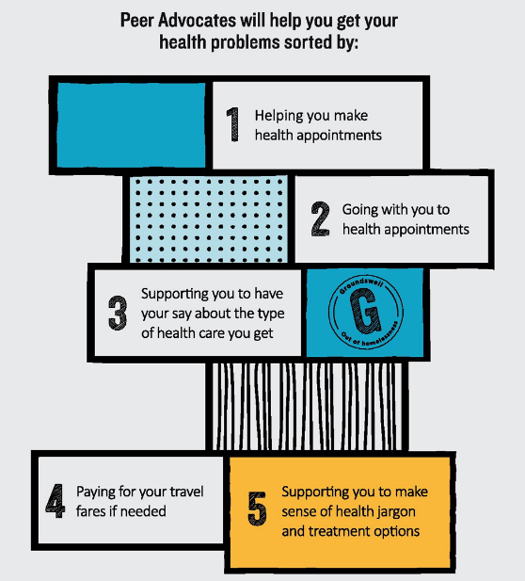
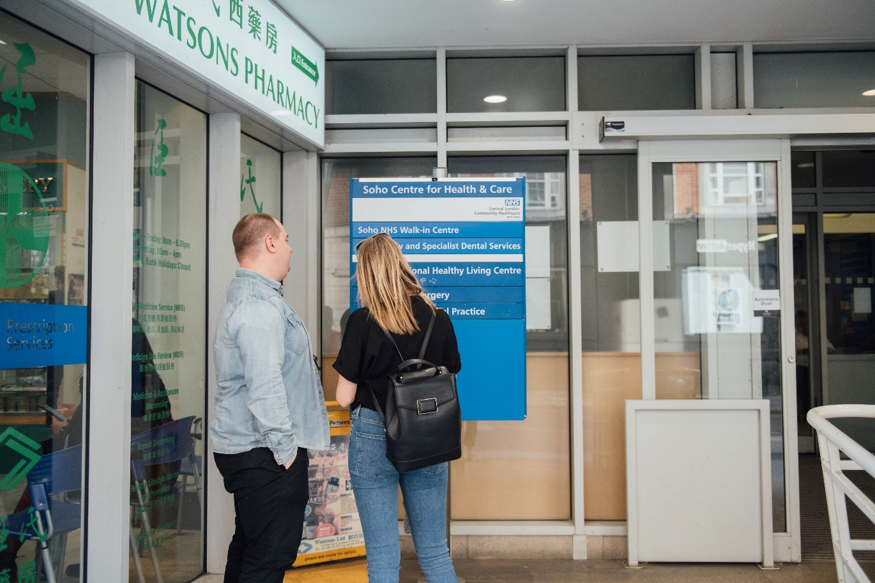
Case study: HHPA

Slide 10
Why peers?
Speak the language!
Peer
Real understanding of the problems people face.
Person exp. homelessness
Professional
Not an authority figure
Don’t feel judged
Re-build trust!
Provide inspiration!

Slide 11
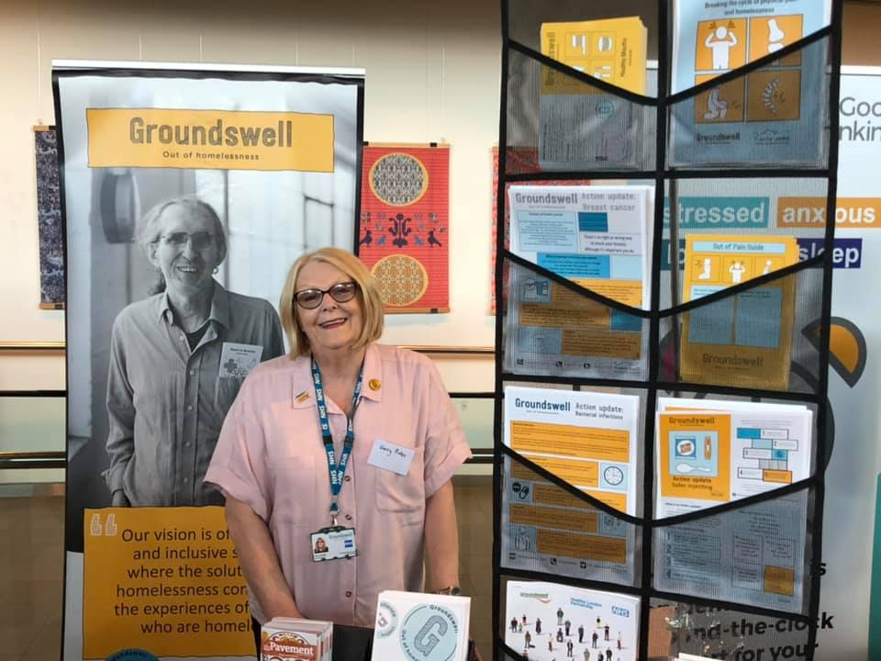
Homeless Health Peer Advocacy
In plain language
We provide a trained advocate to accompany people experiencing homelessness to their health appointments and advocate on their behalf to try to ensure they get the health service they need.

Slide 12
Homeless Health Peer Advocacy
In-Reach
All Groundswell in-reach activity focuses on offering people experiencing homelessness access to health and wellbeing information and services on the spot and on site, at hostels or their local day centre. ​
The model used has been developed with our partners, with reference to the expressed health and wellbeing priorities of the people we work with and for who are experiencing homelessness. ​
This model builds on what we found worked to engage people experiencing homelessness in accessing the offer of vaccinations during the pandemic and continues to evolve, tailored to the specific needs of our different partners and their clients.​
This model is informed by direct feedback and direction from people with experience of
homelessness. ​

Slide 13
HHPA delivers results!
68% reduction in missed outpatient appointments (DNAs similar to gen pop)
Up to £60,000 reduction in DNA costs in 12 months for one trust.
42% reduction in reliance on unplanned secondary care in 30 days following support
£870 reduction in costs per client over 6 months after HHPA input
For every £1 spent on HHPA see a £2.43 return on unplanned care
Peer advocates transition to employment saving a possible £24,000 per advocate per year
https://groundswell.org.uk/wp-content/uploads/2018/10/Groundswell-Saving-Lives-Saving-Money-Full-Report-Web-2016.pdf

Slide 14
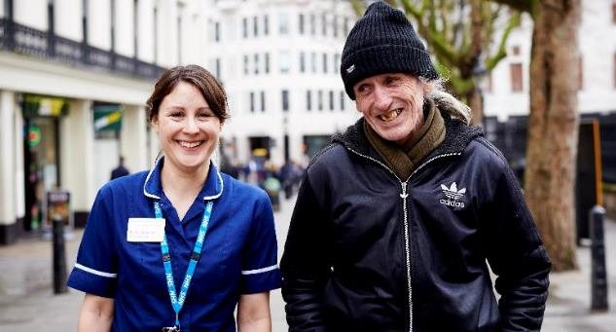
Partnership work
“Groundswell are the stitches that keep homeless and health professionals working together”. HHPA Client

Slide 15
#HealthNow
Peer led research
Homeless Health Peer Advocacy
Health equality
#HealthNow Alliances
Peer led campaigns
https://groundswell.org.uk/healthnow/

Slide 16
Resource Hub
Health Promotion Leaflets
Posters
Workbooks
Podcasts
Films
https://groundswell.org.uk/resources/
You can search by resource type, tag (e.g., covid, mental health) and who the resource is aimed at (staff or people experiencing homelessness)

Slide 17
Further info
London HHPA https://groundswell.org.uk/what-we-do/homeless-health-peer-advocacy/london/
#HealthNow https://groundswell.org.uk/healthnow/
The Escape Plan https://groundswell.org.uk/our-approach-to-research/peer-research/the-escape-plan/
Clarissa, the film and resources pack https://groundswell.org.uk/resources/clarissa/
Groundswell research publications https://groundswell.org.uk/our-approach-to-research/publications/

Slide 18
Useful contacts
London Partnerships Manager, Martin Murphy martin.murphy@groundswell.org.uk
Services Director, Kate Bowgett kate.bowgett@groundswell.org.uk
Participation and Progression Director, Rachel Brennan rachel.brennan@groundswell.org.uk
HHPA Duty Team HHPA@groundswell.org.uk

Slide 19
Listen Up!

Slide 20
Listen Up! Goals to achieve change
Listen Up! has tangible goals that we will work towards that will contribute to the wider change we want to see:
Key decision makers in health, housing and homelessness have an increased awareness and understanding of the barriers to accessing services for people who are experiencing homelessness across the country.
A movement of people experiencing homelessness is created, influencing decision makers and holding them to account for creating change in practice and policy.

Slide 21
How will we achieve these goals?
The people who make decisions about services or policies are listening to people who are homeless.
The power of stories
Real-time research
Lasting change
Shifting the power

Slide 22
Listen Up! Real time research
Research Methods
Interviews and focus groups with people who are experiencing homelessness
Insights into action
Data from both research and reporting informing regular Insights reports and webinars to provide better evidence to decision makers
To understand the barriers to healthcare and help inform solutions to tackling healthcare inequalities

Slide 23
Listen Up! Insights
100 participants (London, Manchester, Bristol and Norwich)
We ask questions related to a person's health and homelessness situation.
Topics include:
Mental Health
Drug and Alcohol dependency and recovery
Digitial inclusion and exclusion
The cost-of-Living crisis

Slide 24
Insight spotlight: drug and alcohol dependency and recovery
Findings showed relationships with housing, relationships, health and healthcare, access to services, stigma and experience of services, which hindered or helped recovery.
6 main themes emerged:
Interaction between drug and alcohol dependency and housing and homelessness.
Interaction between drug and alcohol dependency and mental and physical health
Trust and feeling listened to
Stigma and prejudice
The roles of Peers and Mutual Aid
Access to suitable services

Slide 25
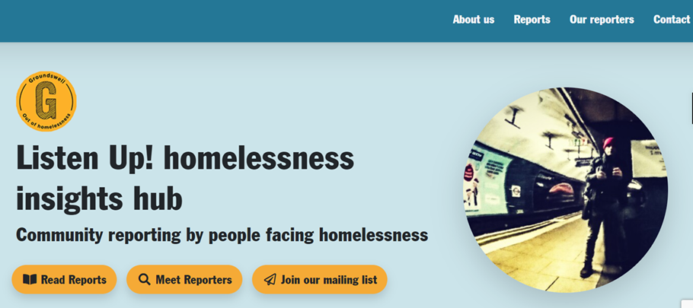
Listen Up! The power of stories
Support ‘volunteer reporters’ across the country to share their stories via Telegram on a mobile phone
Access: Volunteer reporters can reach people in their community who are less likely to be heard
Provision of a platform to spotlight and share reporter stories through our Listen Up! Hub

Slide 27
Listen Up! Rights Based Training
As part of our Listen Up! Project, we are creating and delivering Rights Based Training
This will take a workshop format and will be focussed on bringing everyone involved in health and homelessness together to ensure people receive their rights.
It will be available online and in person from September

Slide 28
Listen Up! How you can help
Find out more – https://groundswell.org.uk/listenup/
Read our stories - Home - Listen Up! Groundswell’s Homelessness Voices Hub (groundswell-listenup-hub.org)
Learn more about our Insights - https://groundswell.org.uk/listen-up-insights/
Join the mailing list, read our stories and tell others about our work!

Slide 29
Improving access to primary healthcare services and support for people experiencing homelessness

Slide 30
Health and Wellbeing Alliance
….a partnership between sector representatives and the health and care system….enabling the sector to share its expertise at a national level with the aim of improving services for all communities’.
‘The HW Alliance is jointly managed by the Department of Health and Social Care (DHSC), the UK Health Security Agency and NHS England and is made up of 18 VCSE Members that represent communities who share protected characteristics or that experience health inequalities and a VCSE coordinator.’.
https://www.england.nhs.uk/hwalliance/

Slide 31
Health and Wellbeing Alliance
Homeless Health Consortium
Projects have looked at:
Mental capacity assessments in A&E settings
Making dentistry inclusive
COVID-19 vaccine uptake
Suicide prevention and postvention
Cancer screening and treatment
Improving conversations about health….

Slide 32
Bridging the Health Gap Understanding the need
Frontline workers spend a lot of their time supporting people with health and care needs
Conversations initiated typically focus on emergency health care needs
There is reluctance to initiate conversations sooner due to perceived conflict with person-led support
Concerns re’ ethical conflict between a responsibility to act and individuals’ personal choice

Slide 33
Bridging the Health Gap Understanding the need
Conversations about health should begin early on in someone’s contact with services
Conversations around health need to be proactive not reactive
Staff that successfully initiated healthcare conversations did so because of confidence not healthcare knowledge
Existing training is issue-specific

Slide 34
Bridging The Health Gap
What we did
Developed a suite of resources that focuses on improving confidence and skills of frontline worker around having conversations about health
Co-produced with staff from across the VCSE and health inclusion sectors, and with people with lived experience of homelessness
https://homeless.org.uk/knowledge-hub/holding-conversations-about-health/

Slide 35
Bridging the Health Gap
Workshop for your team
Ready made workshop:
Myths about access to health care
Barriers to access
What does good support look like
Videos and exercises
To complete in your team/organisation
Accompanying instructions
https://homeless.org.uk/knowledge-hub/holding-conversations-about-health/

Slide 36
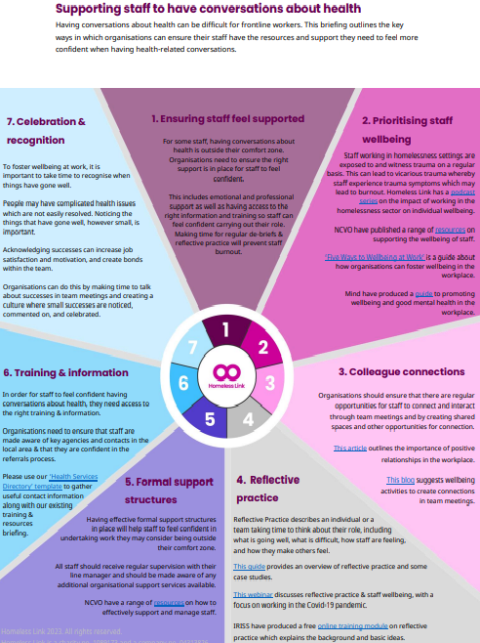
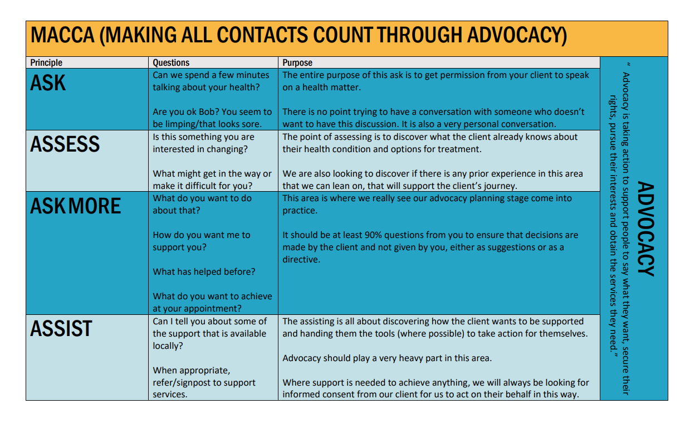
Bridging the Health Gap
Toolkit
Directory: existing resources and training
Template: useful contacts in your area
Making All Contacts Count through Advocacy briefing
Resource for managers: supporting staff to have conversations about health

Slide 37
Other resources Health and Care
Homeless Link’s Knowledge Hub includes 100s of free resources for frontline workers, including:
Free e-learning on safeguarding and strengths-based practice
Guidance on supporting people with autism, learning disabilities, brain injury
Guidance on the mental health system and how to access it
https://homeless.org.uk/knowledge-hub/

Slide 38
Other resources Health and Care
Check out our podcast ‘Going Beyond’ on Spotify and Apple podcasts (and the Knowledge Hub):
Series 1: relationship based approaches including attachment, trauma and strengths-based working
Series 2: staff wellbeing including boundaries, mindfulness and burnout
Series 3: health and care needs including supporting people with self-neglect, brain injury and hoarding

Slide 39
What we do
Homeless Link is the national membership charity for frontline homelessness services. We work to improve services through research, guidance and learning, and campaign for policy change that will ensure everyone has a place to call home and the support they need to keep it.
homeless.org.uk
@HomelessLink

Slide 40
Time to talk

Slide 41
Thank you

