Slide 1
The role of peer advocacy in helping people experiencing homelessness access healthcare

Slide 2
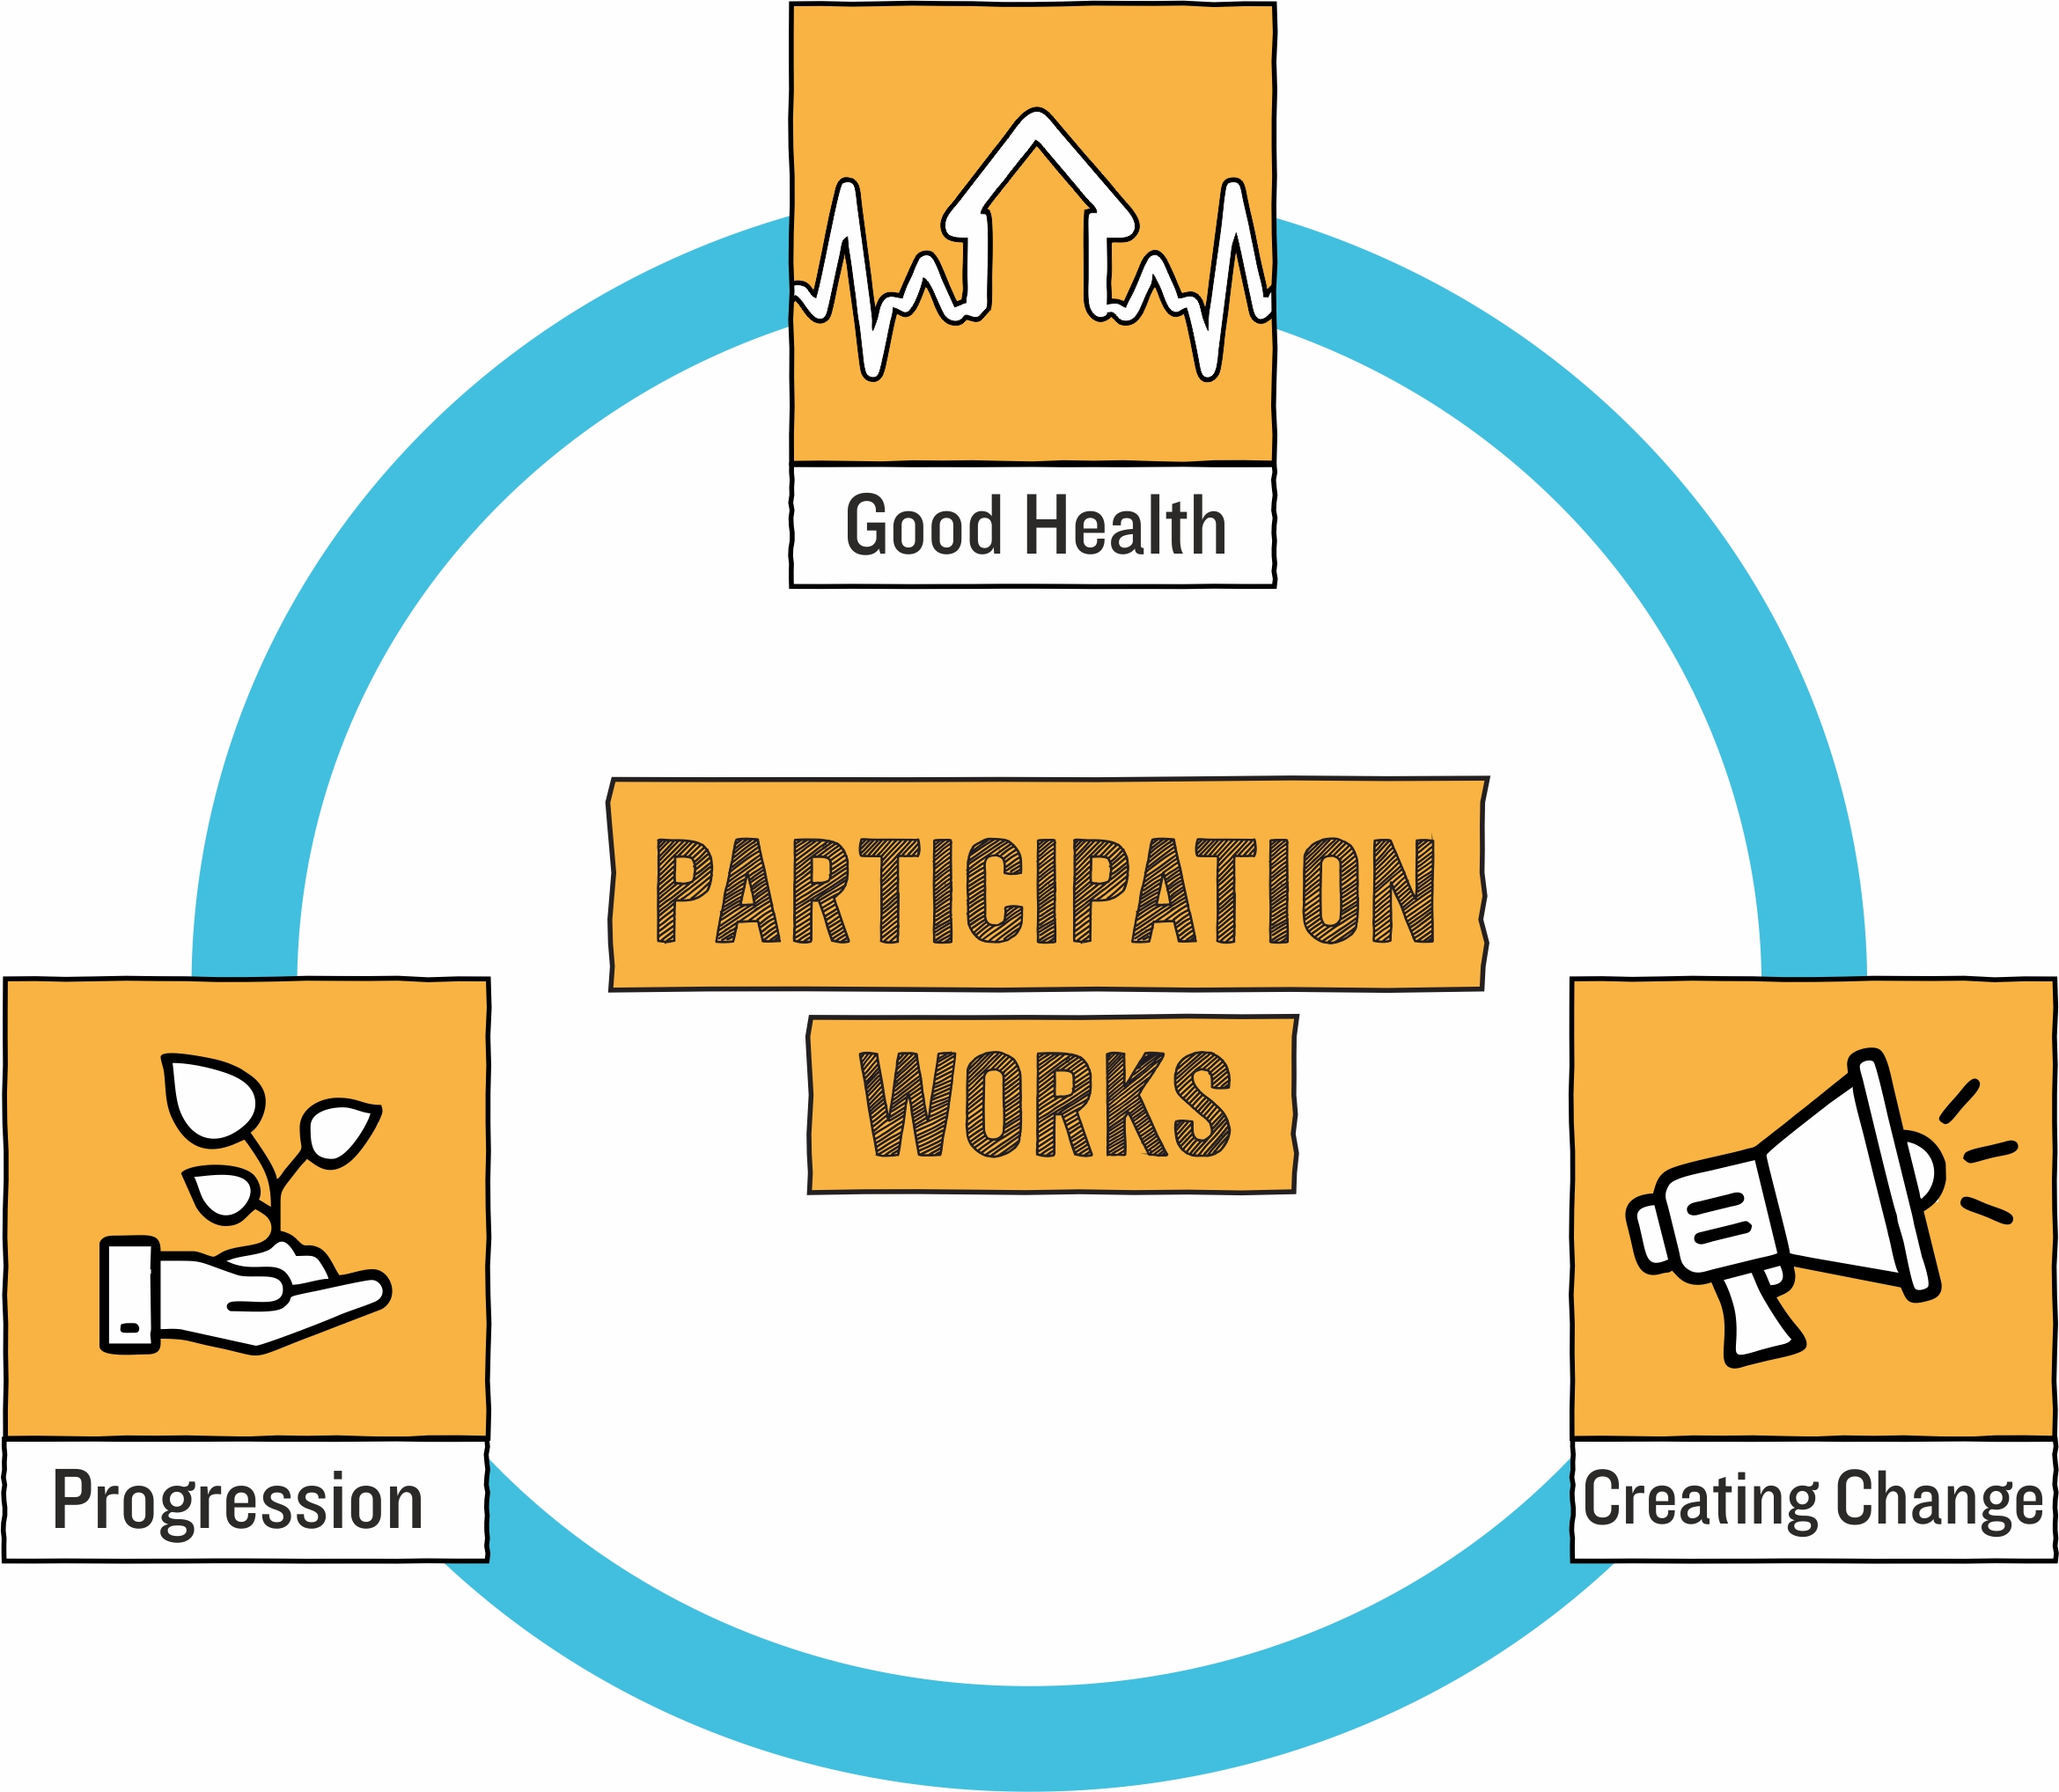
About Groundswell
Participation of people with lived experience of homelessness at our core
Opportunities for people to contribute to society and create solutions to homelessness.

Slide 3
A little bit about me
Serial volunteer
Volunteer Peer Researcher on Groundswell’s women’s health research in 2019
Lambeth Care Navigator since 2020

Slide 4
About Homeless Health Peer Advocacy (HHPA)
HHPA = volunteers and staff with experience of homelessness support people experiencing homelessness to understand their health issues, access healthcare and engage with the support they need.
GP registration
Ensuring people understand their health and their rights
Phone calls/welfare calls
Appointment reminders
Travel support
Drug and alcohol
Accessing medication
Connection between health and homelessness services

Slide 5
Why peer advocacy?
Shared experience of homelessness
People often don’t trust ‘professionals’
Build trust and relationships over shared experience
We’ve been there and understand what they’re going through

Slide 6
Where is HHPA?
Elsewhere (run by partners):
Birmingham (Crisis)
Bradford (Bevan)
Cornwall (Cornwall Housing)
Dublin (DePaul)
Exeter (CoLab)
Leeds (Bevan)
Luton (Signposts)
Manchester (Shelter)
Newcastle (Crisis)
Contact: rachel.brennan@groundswell.org.uk
London (run by Groundswell):
Camden
Hackney
Tower Hamlets
Hammersmith & Fulham
Kensington & Chelsea
Greenwich
Westminster
Islington
Lambeth
Contact: hhpa@groundswell.org.uk

Slide 7
And finally: we’re looking for new volunteer Peer Advocates in London!
The person will:
Be fully trained by Groundswell
Have expenses associated with training and volunteering covered
Be supported to access further training
Receive help with identifying and developing skills, and building a CV
The person must:
Have personal experience of homelessness
Be free from active addictions
Be able to attend training from 6th July
Be able to volunteer their time regularly
Have access to the internet
Have a phone they can use regularly
F
More information: recruitment@groundswell.org.uk or groundswell.org.uk

Slide 8
Thank You

