Slide 1
Frontline Network Conference
Integrated Homelessness Mental Health
Jonathan Dickson
Senior Homelessness Mental Health Practitioner
Non Medical Prescriber

Slide 2
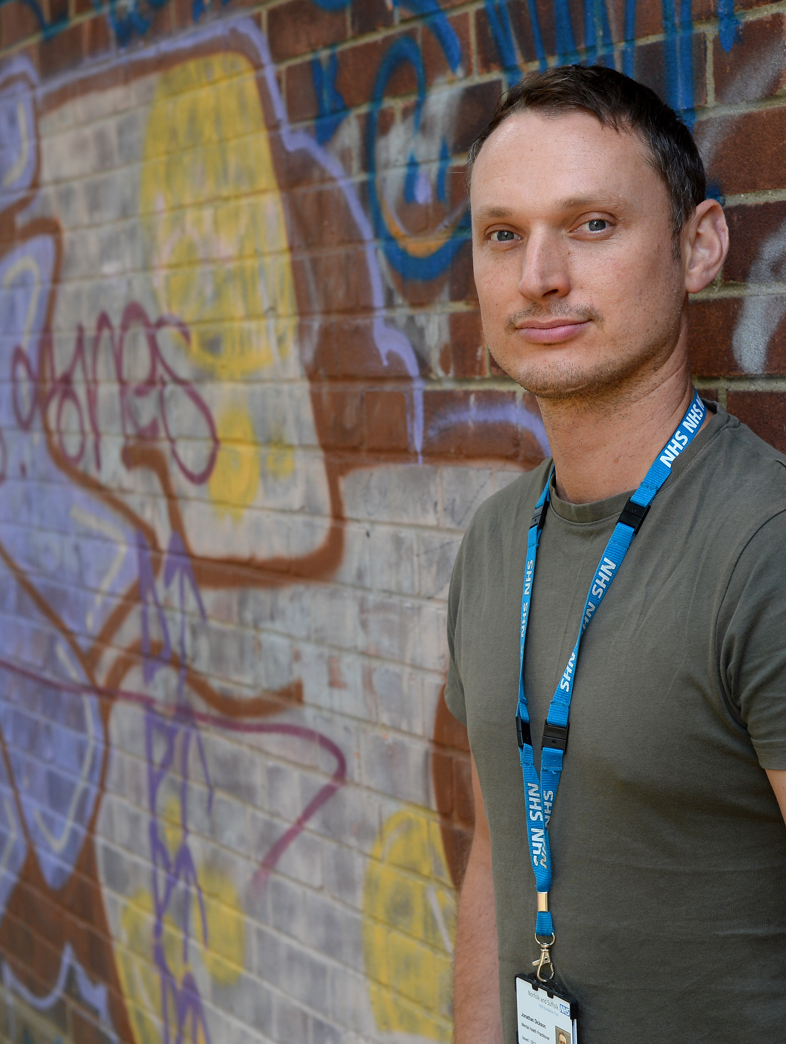
Who am I?
Senior Homelessness Mental Health Practitioner
Non-Medical Prescriber
Masters in Advanced Healthcare Practice

Slide 3
Background to role
Ipswich Borough Council secured funding from MHCLG in 2016 to prevent and relieve Rough Sleeping.
The council commissioned a dedicated mental health service from NSFT.
I took up the role from 2nd July 2018.
I am based within mental health trust and integrated with homelessness services.

Slide 4
Barriers to access…
St Mungo’s (2016) suggest that traditional routes in to mental health services are too complex and hard to navigate for people who are homeless and when they do manage to get an appointment with a mental health team it may be weeks or even months away, meaning their mental health and their situation may get much worse before they are able to access any support.

Slide 5

Person Centred
Referral route as simple as possible
Assertive engagement
No caseload – no discharge
Less paperwork
Work with people with multiple and complex needs

Slide 6
Seeing people where they are…
St Mungo’s (2016) endorse this outreach approach, enabling clients to access support and treatment in community settings, including drop in centres, hostels and supported housing.

Slide 7
Integrated/Multiagency working
Homeless Link (2018) advises that every locality should have a multiagency response for rough sleepers with complex needs. They should have clear mechanisms to identify and refer people across sectors with partnerships that can provide flexible, practical, personalised, multiagency support to rough sleepers.

Slide 8
Integrated/Multiagency working
Mental Health Services, Health Outreach Service, General hospital alcohol nurse and Safeguarding Lead, Drug and alcohol team, Police, GPs, Supported housing providers, Domestic abuse charities, Sexual abuse charities, Probation, Street wardens, Church run night shelter, Homeless drop in centre, Drug and alcohol outreach workers, Hostels, B+B managers, Housing Options, Social Services, Soup kitchen, Job Centre, Refugee charity and many more……..

Slide 9
Case Study - Alice
31 year old, referred while in hospital on IV Antibiotics following infection from injecting heroin
Very unstable mental health
Had children removed 1yr ago, started using heroin 10 months ago
Homeless – sofa surfing with abusive partner
Referred by substance use service

Slide 10
Case Study - Alice
Completed mental health assessment, gave diagnosis
Asked hospital to start prescribing medication
Referred to Winter Night Shelter
Referred to Eating disorder team
Referred to Health Outreach to register with GP

Slide 11
Case Study - Alice
Mental health stabilised
Eating improved and put on weight
Moved to long term supported accommodation
Remains substance free
Started to have contact with children
Looking into volunteer work

Slide 12
‘It saved my life having someone who understood and cared for me even though I was homeless’.

