Slide 1
Meeting safeguarding, health and wellbeing of ‘vulnerable migrants’
Frontline Network June 2021
Drawings by people seeking asylum from different countries of Africa and Asia – source www.dgsjournal.org
Elaine Goodwin National Homeless & Inclusion Health Nursing Lead
NHS England & NHS Improvement
elaine.goodwin2@nhs.net @GoodwinElaine

Slide 2
Asylum seeker
Person who has departed their country of origin and officially applied for asylum in another country but is awaiting a decision on their request for refugee status
Refugee
A person who ‘owing to a well-founded fear of being persecuted for reasons of race, religion, nationality, membership of a particular social group, or political opinion, is outside the country of his nationality, and is unable to or, owing to such fear, is unwilling to avail himself of the protection of that country
Vulnerable migrants
Undocumented migrant
Undocumented migrants may have entered the UK legally but have lost their right of residence or entered the UK illegally and do not have the right of residence
Vulnerable migrants
Can include: People seeking asylum; refugees; unaccompanied children; people who have been trafficked; undocumented migrants; low paid migrant workers

Slide 3
Common experiences of ‘vulnerable migrants’:
Extreme poverty & harsh environmental conditions
Physical/ psychological trauma of conflict, torture, rape, domestic and sexual slavery, trafficking, deprivation of liberty
Witness torture or killing
Disappearance or killing of loved ones
Betrayal, by people in authority, by enemy forces, or by the politics of their world in general
Risks associated with population movements
Lack of access to healthcare
Journey can take weeks, months & years
Fear and mistrust
Pre-migration Context
Notes:
Many people seeking asylum have endured physical/ psychological trauma and extreme fear of conflict, torture, rape, domestic and sexual slavery, trafficking, deprivation of liberty and disappearance or killing of loved ones
The flight process can last days or years. During flight, refugees are frequently separated from family members, robbed, forced to inflict pain or kill, witness torture or killing, and/or lose close family members or friends and endure extremely harsh environmental conditions. Perhaps the most significant effect from all of the experiences refugees endure is having been betrayed, either by their own people, by enemy forces, or by the politics of their world in genera

Slide 4
PTSD
Anxiety & depression and other mental disorders
Sexually transmitted infections
Female genital mutilation
Pregnancy following rape
High risks to maternal, newborn and child health
Drug and alcohol addiction
Communicable diseases
Non-communicable diseases
Respiratory infections Gastrointestinal illnesses
Malnutrition
Musculoskeletal complaints
Oral disease
Physical and/or Learning Disability
Incomplete medical/ immunisation history
Untreated health needs
COVID-19
Health needs susceptibility
Notes:
Specific health needs e.g. risk of TB, blood borne infection (Hep B/C, HIV, syphilis), nutritional deficiency, abuse on journey and lack of adequate food/water/safe environment

Slide 5
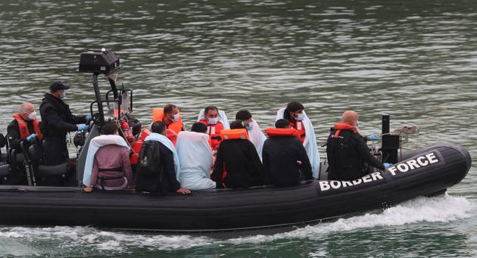
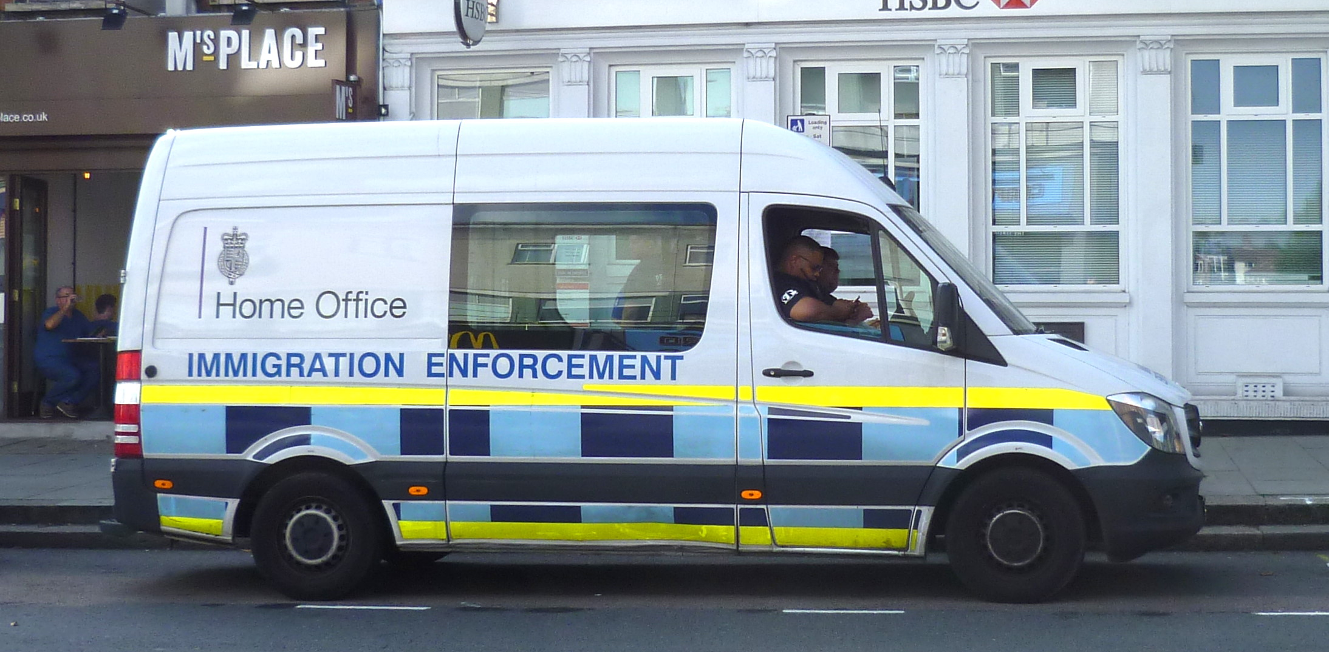
International
UN Convention Relating to the Status of Refugees 1951
European Convention on Human Rights 1998
UN Convention on the Rights of the Child 1989
Domestic
Immigration and Asylum Act 1999
Care Act 2014
Children Act 1989
Modern Slavery Act 2015
European Union (Withdrawal) Act 2018
Domestic Abuse Bill 2021
New Plan for Immigration Policy 2021
International and national policies
Conflict / Balance
Policies can contradict each other i.e. tackling violence against women and girls and inequalities often conflict with the ‘Hostile Environment’ to encourage illegal immigrants to leave the UK borders
Notes:
Calls for migrant women with no recourse to have access to refuge accommodation and protections for data on immigration status not to be shared with the Home Office were rejected
Southall Black Sisters have been awarded the Support for Migrant Victims Scheme to deliver a one year pilot to address the ‘evidence gaps’ about the needs of abused migrant women before govt will commit to any long term solution and that it must prevent the ‘exploitation of the immigration system’

Slide 6
NHS
Health and Social Care Act 2012
NHS (Charges to Overseas Visitors) Regulations 2015
Exemptions
No charges for coronavirus (COVID-19) testing, treatment and vaccination
Accessing COVID-19 vaccination without an NHS number
NHSE England campaign encouraging GP registration
Health policies
Conflict / Balance / Ethical Dilemmas
Health inequalities and COVID 19
Charging Regulations and data-sharing agreements between the NHS and the Home Office
Differences and misunderstanding of entitlements to healthcare
Emphasis on clinicians to prove ‘urgent and necessary’
Evidence that exemptions do not prevent migrants from being deterred from accessing healthcare
Learning from vaccine roll out – fear & mistrust
Public health implications
Notes:
Vulnerable individuals are those who “face[s] a significant probability of incurring an identifiable harm while substantially lacking ability and/or means to protect oneself” (Schroeder and Gefenas, 2009: 177). Vulnerabilities can occur because of individual and structural factors or often a combination of both. One such structural factor being uncertain immigration status, which can cause increased vulnerability (Craig et al., 2015; Medecins du Monde, 2015; MigrationWork and Migrants’ Rights Network, 2009) as access to services and resources have been limited by recent governments (Home Office, 2016) in a bid to create a “hostile” environment denying undocumented migrants access to welfare, housing, employment and banking. Uncertain immigration status increases the risk of harm (e.g., limited access to services, greater exposure to exploitation, limited recourse to justice and protection, etc.) while simultaneously decreasing people’s means of protecting themselves.
H&SC Act
first legal duties about health inequalities. It included specific duties for health bodies including the Department of Health, Public Health England, Clinical Commissioning Groups, and NHS England which require the bodies to have due regard to reducing health inequalities between the people of England.
Victims of violence A new exemption is introduced in the Regulations for victims of torture, female genital mutilation, domestic violence and sexual violence. While recognised that women are more likely to benefit from the latter two types of violence than men and, by definition, are the only sex that can benefit from the female genital mutilation exemption, the decision to focus on these types of violence and not others (e.g. street crimes) is because of the particularly vulnerable and powerless situations that victims find themselves in.
The exemption for children in local authority care under the 2011 regulations has been expanded to include children looked after by a local authority (which is a broader cohort of children), however it was decided not to extend this further to children supported under section 17 of the Children Act 1989. Although it is recognised that children may be particularly vulnerable, including illegal migrant children, it is considered that the various exemptions in the regulations for vulnerable individuals (asylum seekers, refugees, supported failed asylum seekers, victims of human trafficking) are sufficient to protect the most vulnerable children.
• Retention of free GP/nurse consultations • Retention of existing exemptions for infectious diseases • Immediately necessary or urgent treatment (clinically decided) will always be provided without delay, regardless of whether the overseas visitor can pay • Maternity services are always considered to be immediately necessary • Extension of the exemption for those detained, in guardianship or subject to community treatment orders under the Mental Health Act 1983 or who are subject to treatment Equality analysis: The National Health Service (Charges to Overseas Visitors) Regulations 2015 17 imposed by a court order to include those overseas visitors deprived of their liberty under the Mental Capacity Act 2005 • Retention of exemptions for refugees, victims of human trafficking, asylum seekers and Home Office supported failed asylum seekers • Working with NHS frontline staff (e.g. overseas visitor managers) to raise awareness on the issues faced by vulnerable groups

Slide 7
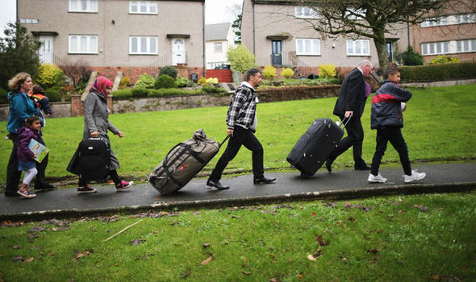
Loss of identity and status
Fear for family back home & with them
Vulnerability to exploitation & risk
Increased safeguarding risks
Lack of support
New culture language & integration
Racism, discrimination, negative rhetoric
Poverty & poor housing
Long asylum process, negative and positive decisions
Uncertainty fear of deportation
Navigating healthcare system
Every contact ‘not’ counting – repeating traumatic history
Difficulty accessing primary care
COVID-19
Trust - key barrier – highlighted through vaccine roll out
NHS Overseas Charging Regulations
“I just try as much as possible not to get sick, I know you can’t prevent it, but if I had pain, I would never go [to the doctor], I can’t call the ambulance or anything, I would never have done that because of the fear”
Post-migration Context
Notes:
Recent work has verified that post-migration stress significantly influences the emotional well-being of refugees, and often provides a risk similar to or greater than war-related trauma.⁸⁻¹³ Pre- and post-migration stress may differentially predict specific kinds of symptoms and distress in both children and adults.^{14, 15} This information is important; it is during the period of resettlement where stress is high and the refugee may be reminded of other traumatic events of their lives, when resettlement agencies and health care workers might start to reverse the effects of trauma across the lifespan of the refugee by providing culturally sensitive care that gives the refugee support.

Slide 8
ALL migrants
Everyone in the UK is entitled to free primary health care regardless of immigration status
A+E, emergency care and palliative care, family planning (not maternity or TOP) and some communicable diseases are also exempt
People seeking asylum or with refugee status
Entitled to full NHS medical care
However people with refused asylum applications often become undocumented migrants and have ‘no recourse to public funds’
Healthcare entitlements
Undocumented migrants
Charged for secondary care
Except:
Victims of modern slavery/human trafficking, domestic violence and FGM (but only for conditions related to their ill treatment)
Refused asylum seekers on S4 OR S95 support
Children under the care of the local authority
Treatment under the mental Health Act
Notes:
Calls for migrant women with no recourse to have access to refuge accommodation and protections for data on immigration status not to be shared with the Home Office were rejected
Southall Black Sisters have been awarded the Support for Migrant Victims Scheme to deliver a one year pilot to address the ‘evidence gaps’ about the needs of abused migrant women before govt will commit to any long term solution and that it must prevent the ‘exploitation of the immigration system’

Slide 9
Frontline
Understanding of context & rights’, learning & training, advocacy, holistic screening and health assessment, use interpreting services, work in partnership, know your local services and pathways (
primary care; VCSE; social prescribing, community champions) trauma informed practice, self care, access to supervision, escalate concerns, challenge system and professional barriers, familiarise
Service/ Organisational Level
Work with trusted services to identify populations at risk, know your ‘hard to reach’ services and adapt them - Localised place base approaches, know your HI and inclusion health leads, challenge system barriers, auditing access in partnership with people with lived experience, organisations that work closely with them and the local Healthwatch, Groundswell, Refugee VCSEs. Culture to support staff to practice in a trauma informed and culturally competent way, recognise staff vicarious trauma, especially in the heat of a Pandemic response
Inclusion health – taking action
Strategic level
ICS, regional, national, cross government collaboration, understanding need, system collective responses working with people with lived experience, trusted organisations, challenge current ways of working and advocating for the consideration of inclusion health groups in service design and commissioning, challenge hostile policies
https://www.gov.uk/government/publications/inclusion-health-applying-all-our-health/inclusion-health-applying-all-our-health

Slide 10
https://www.refugeecouncil.org.uk/information/refugee-asylum-facts/the-truth-about-asylum/
https://www.refugee-action.org.uk/
https://www.uaschealth.org/resources/
https://www.freedomfromtorture.org/
https://www.gov.uk/guidance/covid-19-migrant-health-guide
https://www.gov.uk/guidance/assessing-new-patients-from-overseas-migrant-health-guide
https://www.gov.uk/guidance/nhs-entitlements-migrant-health-guide
https://www.gov.uk/guidance/language-interpretation-migrant-health-guide
https://www.gov.uk/government/publications/inclusion-health-applying-all-our-health/inclusion-health-applying-all-our-health
https://www.london.gov.uk/sites/default/files/toolkit_for_social_prescribing_link_workers_0.pdf
https://www.qni.org.uk/nursing-in-the-community/homeless-health-programme/homeless-health-resources/
Building vaccine confidence - https://www.doctorsoftheworld.org.uk/wp-content/uploads/2021/03/English-COVID19-Vaccine.pdf
https://www.gov.uk/guidance/hong-kong-uk-welcome-programme-guidance-for-local-authorities
Useful information

