Slide 1
UC Problem Areas
‘Complex Needs’ and Universal Credit
St Martins in the Fields Conference
STEVE JOHNSON
24th JUNE 2021

Slide 2
Complex Needs Agenda
How DWP defines Complex Needs
The problem of Universal Credit (UC) ‘claim closure’
How UC conditionality should fit around Complex Needs
Dealing with unfair UC sanctions
Deciding whether to jump ship from Legacy to UC
A model to propose Complex Needs
Further training needs relating to Complex Needs

Slide 3
Recent Covid driven changes to UC include:
Some 2021 Budget changes indicated in red…
UC personal allowance increased by £1,040.00 to September 2021
UC/JSA conditionality halted to June 2020 – ordinary rules now?
WCA assessments done by phone/paper evidence – Lockdown 3
Suspension of Health Professional face to face – Lockdown 3
MIF income threshold assumption suspended until end July 2021 and then reintroduced from August 2021 – individual discretion
  Surplus earnings threshold of £2,500.00 extended to April 2022
  Managed Migration pilot suspended – likely change?

Slide 4
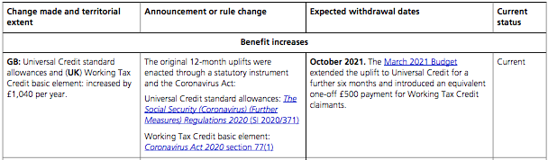
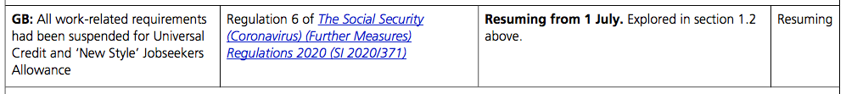
Current covid requirements
Clips from HoC Briefing Paper 8973 (latest: 30/4/2021)…
These regulations were not extended

Slide 5
Why ‘Complex Needs’ problems?
UC is inherently complicated
UC is intended to cover both work seekers/workers/carers/sick etc
Assumed savings to include less DWP staff and more computers
Claimants expected to RISE TO DEMANDS of online complexity
NO AUTOMATIC VULNERABILITY ASSESSMENT carried out by DWP
But a VULNERABILITY ASSESSMENT from YOU would be sensible
Having ‘complex needs’ status is a good status
Means it should be EASIER to secure more help from DWP
Should more more relaxed time limits, fewer sanctions etc
Having complex needs may be an ADVANTAGE to claimants
Would there be a stigma issue?

Slide 6
How DWP defines Complex Needs

Slide 7
‘Vulnerability’ started with ESA ‘Safeguarding’
ESA has had a ‘safeguarding’ system of sorts since around 2000
Vulnerability was linked to claimants who may have mental health problems, learning disabilities and cognitive difficulties etc
Associated with failures to attend Jobcentre interviews, ESA50 return or Health Professional visit failures/other non-compliances
Staff encouraged to use Home Visit system – at least two attempts
DWP failure to follow safeguarding principles could then lead to ESA reinstatement etc pending proper application of processes
But all these processes are discretionary – no tribunal appeal rights
Notion of vulnerability then changed with introduction of UC…

Slide 8
‘Safeguarding’ evolved to ‘Complex Needs’
UC uses wider concept of ‘complex needs’ instead of ‘safeguarding’
More discretion under ‘complex needs’ – still no appeal rights
Idea of vulnerable groups has been replaced with idea that some claimants may experience difficult life events /circumstances
Lack of willingness to see claimants with permanent difficulties?
Relies on listed scenarios, or ‘description by bullet point’
Home visits still apparently available in UC – ever witnessed this?
Claimants given 5 days to demonstrate complex needs status?
Improper claim closure may trigger immediate incidence of complex needs problem – some DWP illegality – see later
Actually UC also has a ‘safeguarding’ policy! – see later

Slide 9
No National Plan to address vulnerability
Clips from NAO report to Work and Pensions Committee (July 2020)
“…However, it [DWP] does not use data ‘flags’ or markers to highlight claimants’ vulnerabilities or complex needs within the Universal Credit digital system. This means it cannot produce NATIONAL LEVEL management level information on VULNERABLE CLAIMANTS, and its front-line staff cannot use data within the system to easily identify all those people who might struggle with the process… The Department will need to work with organisations that support claimants, SUCH AS LOCAL AUTHORITIES, CHARITIES AND HOUSING ASSOCIATIONS to implement these recommendations effectively.” (my emphasis)

Slide 10
No Duty of Care in relation to social security?
DWP duty to ensure welfare benefits fairness rejected
From Therese Coffey to Work and Pensions Committee (Sept 2020):
  “… I felt that the line of questions submitted by the Committee was taking us down a track that THAT IMPLIED THAT WE HAD A STATUTORY DUTY, AND THAT IS WHY I WAS BEING QUITE CAREFUL IN TRYING TO POINT OUT THAT WE DO NOT. I do not think it is the responsibility of DWP to have that statutory care duty. We are not the local council, social services, the doctors and other people who have that…” (my emphasis)

Slide 11
Duty of Care? Where we are so far…
Some politicians etc seem anxious to pass these RESPONSIBILITIES on local authorities, charities, etc (may include you advisers!)
May be up to advisers to help ASSESS and AVERT consequences of client vulnerability… SO DO WE HAVE ANY BULLETS TO FIRE?...
There are clearly some LEGAL STANDARDS OF FAIRNESS in WRA 2012/UC Regulations (eg allocating claimant conditionality in UC)
Potential EQUALITIES ACT duties to protect vulnerable people
‘Complex Needs’ processes may be applied via DISCRETION only, but that may be enforceable through Judicial Review and so on
May well be other angles you can identify / try to rely on

Slide 12
Hold the Front Page: ‘Claimant Profiles’
‘Spotlight’ on recent ‘Claimant Profiles’ for complex needs:
Government proposals to record vulnerability (March 2021)
Joint hearing of committees in Parliament in March 2021
Regarding public criticism of UC failures to address vulnerability
For example use of UC and parallel need to use foodbanks
DWP building ‘claimant profiles’ system to record vulnerability data
Will facilitate data collection about vulnerable GROUPS using UC
Will also assist ‘pinned notes’ system to help INDIVIDUALS who need help within UC system
In development now, and surfaced via FOI in March 2021
See discussion later…

Slide 13
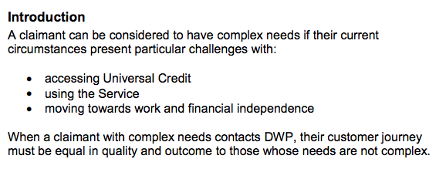
‘What are complex needs in Universal Credit?’ From the DWP ‘Complex Needs Overview’ (v16)
It means you have ‘particular challenges’
It means you are are entitled to an equal UC journey

Slide 14
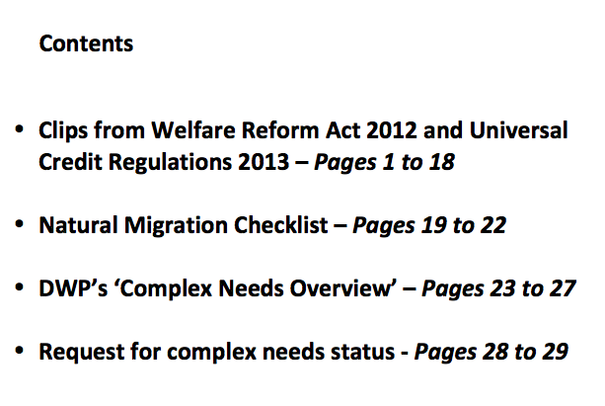
Document A: ‘Universal Credit documents relating to vulnerable people’
‘Complex Needs’ request – see later…

Slide 15
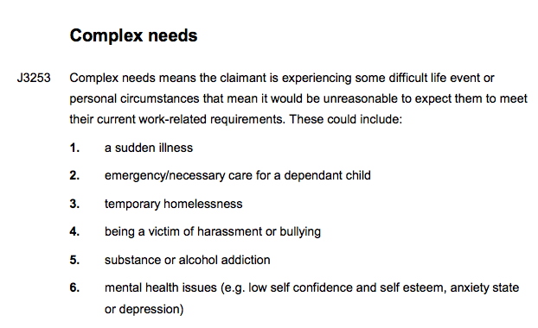
‘Complex needs’ in Chapter ADM J3
Should this guidance be modified due to COVID?

Slide 16
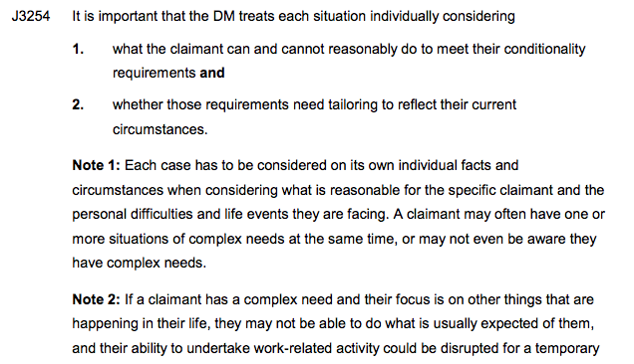
Has ‘Complex Needs’ been considered? Where is the evidence of this? Should we be confident?
Touchbase magazine announced creation temporary ‘Senior Safeguarding Leader’ roles to act as escalation points within DWP when no local solution found

Slide 17

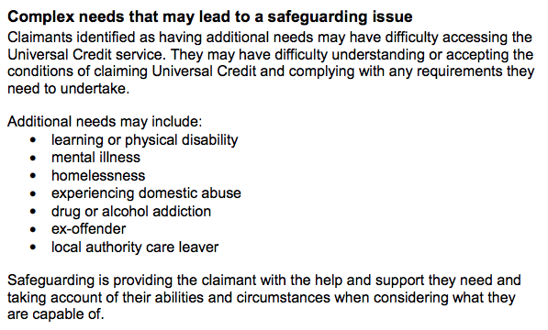
But UC also now has a ‘Safeguarding’ policy(!)
‘Safeguarding’ means your complex needs have led to a need to protect your health / well-being

Slide 18
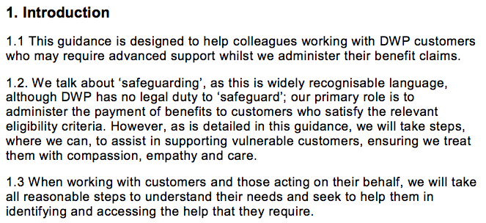
Who might require ‘Advanced Support’ (1)
From DWP Intranet Guidance issued March 2021

Slide 19
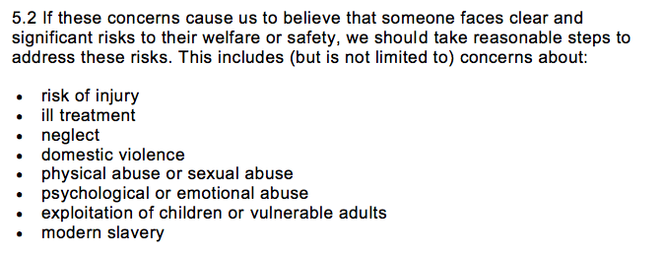
Who might require ‘Advanced Support’ (2)
From DWP Intranet Guidance issued March 2021

Slide 20
Who is vulnerable?; Pinned Notes
From NAO report to Select Committee (September 2020)
The DWP continues to: '... record it in things called PINNED NOTES, which are the digital equivalent of a post-it note ... written in whatever way the work coach or case manager wanted to write it.’ (my emphasis)
’…it does not work from having a data-led approach to understanding what is going on. It also does not work from a checking how work coaches are applying [it] ... [DWP have] no means to check the quality or approach that work coaches are taking around the country.’

Slide 21

Is there a better way?
Is there a more structured and consistent way of recording the needs of vulnerable people, as well as the action DWP needs to take to help them?
New ‘client profiles’ system from DWP intended to build on ‘pinned notes’
We have some ideas…
Please see later…

Slide 22
From ‘Spotlight on claimant profile’…
What is the claimant profile?
“…Once a complex need is identified it is important to RECORD IT CORRECTLY. Complex needs information must be recorded in profile notes within claimant history. It must provide a clear overview of any COMPLEX NEEDS a claimant has so that we can TAILOR the way we deliver the service to meet their needs.
The claimant profile must always be the first place you look when dealing with a case and interacting with a claimant. This information is used in conjunction with other information in the JOURNAL to ensure you have the MOST UP TO DATE claim details and claimant circumstances.
It is essential to identify claimants with complex needs QUICKLY and ACCURATELY so that we can tailor the way we deliver the service to meet their needs…” (my emphasis)

Slide 23
From ‘Spotlight on claimant profile’…
What are Pinned Notes? What’s new?
“…PINNED NOTES is a feature that:
allows agents to fix important claim profile and PROFILE NOTES to the claimant overview (including barriers and support which is in place) which all agents must be aware of
REDUCES THE NEED to scroll through note history to find relevant notes and documents - and consolidates all notes in one place
better equips agents to HIGHLIGHT a claimant’s complex needs
What’s new?
Claim history notes and Profile notes are now viewed in the same 'History' tab under 'Recent history'
every note created can be pinned UP TO A TOTAL OF THREE - meaning the exact content of the note and any attached files are copied and placed directly onto the Claimant History for quick and easy access”

Slide 24
From ‘Spotlight on claimant profile’…
When to use the claimant profile
“…The claimant profile MUST BE UPDATED with any temporary or LONG TERM COMPLEX NEEDS and how that affects the claimant's ability to use the Service.
Colleagues can record any identified issues which REQUIRE SUPPORT so it can be offered at the earliest opportunity. Colleagues must also record what support is being provided through the jobcentre and/or external partners or services…
It is likely that a claimant may have MULTIPLE COMPLEX NEEDS that are co- dependent - for example, homelessness, drug or alcohol misuse, mental health. It is helpful to record multiple complex needs as a single entry to make sure they are all identified. For more detailed information, see Complex needs…”

Slide 25
So where do all these ideas now fit together?
‘Complex Needs’ = a status that means you have particular challenges
‘Safeguarding’ = ‘Complex needs position that has led to a requirement to protect your health and well-being
Customers who need ‘Advanced Support’ – seems aimed at claimants who need specialised help because of risk to ‘safety or wellbeing’
‘Claimant Profile’ = a recent UC system to record complex needs within an electronic ‘Pinned Note’, so that services can be ‘tailored’ (generating individual and presumably national data?)

Slide 26
2. UC and improper claim closure

Slide 27
Different kinds of UC interview(s)
Evidence is in Green… Claimant Commitment is in Blue…
Series of interviews or interview phases
New Claim Interview
Identity verification phase
Possibly Habitual Residence issues – including right to reside
Possibly immigration status issues
Evidence to support claim – including housing costs evidence
May be required to provide a Fit Note if relevant
Claimant Commitment should be finalised and accepted
Arrange ongoing conditionality interviews and attend them
Work Focused Interviews and Work Search Reviews etc

Slide 28

Warning! Improper ‘claim closure’ may be an inappropriate and blunt instrument
DWP may improperly ‘close’ a UC claim if failure to book or attend a routine Jobcentre interview
May happen in 20% of all claims?
May include claimant commitment or evidence interviews
We believe ‘claim closure’ is at best a blunt instrument and frequently unlawful
Be prepared to challenge

Slide 29
Neither claimant nor DWP probably understands
GDC v SSWP says pre claim information gathering stage is not part of formal claim
PP v SSWP says post claim appointment stage is not part of claim process
“Submit Claim” starts and ends the claim phase
info/evidence may be requested
before claim is started
info/evidence may be sought
after claim ends and award starts

Slide 30
A delayed finish is not a claim
GDC v SSWP (CUC/986/2019)(23/3/2020)
Claim data inputted but claimant logged out before ‘submit claim’
Claim later submitted but claim of date held at ‘submit claim’ date
It was argued by claimant that the claim was defective at the earlier date and capable of correction to earlier date
Judge said relative generosity of HB rules (see Novitskaya v London Borough of Brent (SSWP intervening) [2009] EWCA Civ 1260 [2010] AACR 6. did not apply to UC
Judge held UC rules did not allow for earlier date of claim in such circumstances
What then of claimants with complex needs?

Slide 31
Improper claim closure: information or evidence interviews
Regulation 37 gives you a month to supply…
Regulation 8 gives you a month if defective…

Slide 32
Claim closure in EVIDENCE failure cases
PP v SSWP (CUC/1389/2019)(14/2/2020)
UC claims illegally ended because claimant ‘too slow’…
UC claim is not invalid because of failure to attend appointment…
  Para 38: “…There is nothing in the 2013 Claims and Payments Regulations that makes attending an interview about self-employment a part of the process of claiming universal credit in the prescribed manner.”
The UC interview request is simply a request for evidence…
  Para 40: “… a claim for universal credit in the prescribed manner is made before the question of the claimant’s self-employment is fully explored… In effect, the request that the claimant arrange and attend an interview about self-employment is no more and no less than a demand for information or evidence under regulation 37(2) of the 2013 Claims and Payments Regulations.”

Slide 33

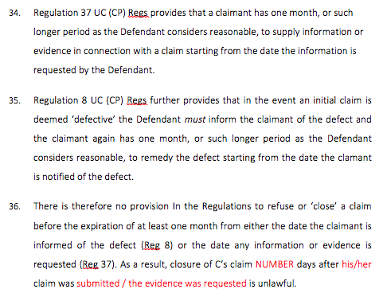
From CPAG JR pre-action letter JR43
To remedy illegal claim closure…
Whether it is reg 37 or reg 8 you have a month plus

Slide 34
Improper claim closure: claimant commitment interviews

Slide 35
Claim closure in COMMITMENT failure cases
You submit a UC claim ‘on-line’
s8(1)(a) of the Social Security Act 1998 must apply and DWP is obliged to decide the UC claim and issue a UC decision (with appeal rights etc)
On-line acceptance of the basic claimant commitment is the start of meeting s4(1)(e) of WRA 2012 requirements
If it is to be amended at interview etc, it must be drawn up and presented to claimant (7 day discretion applies)… only then should DWP correctly begin to consider benefit termination if there is a failure
Termination of benefit may correctly follow refusal to accept a claimant commitment, but failure to book or attend a PARTICULAR claimant commitment interview is not in itself automatic grounds to terminate UC
A formal and separate decision to terminate UC must be made
Failure to book/attend a subsequent commitment interview risks sanction
Sanction action also requires meeting fairness principles

Slide 36
Points from R v SSWP [2013] UKSC 68 in relation to UC claimant commitment
General principles of fairness must therefore apply in relation to the setting of the claimant commitment:
  In relation to the application of particular work related requirements
  From point of view of how that claimant is supposed to deal with them
  For example, would a 7 day ‘deadline’ always pass the test of ‘fairness’?
Claimants should be given sufficient information for them to make meaningful representations regarding content of the commitment
Claimants should thus be able to make meaningful decision about whether to accept claimant commitment or not (no appeal)
Clearly, this cannot be achieved at the on line ‘Declaration’ stage

Slide 37
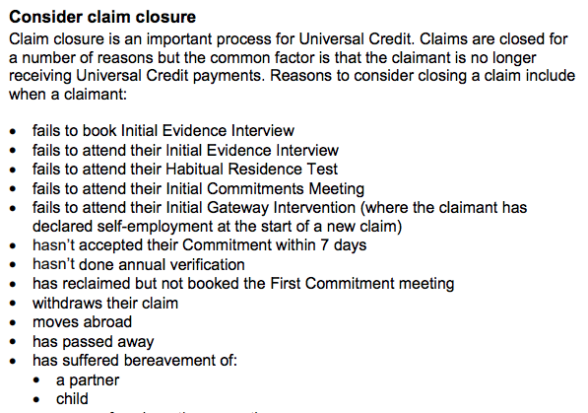
DWP have limited power to ‘close’ cases
Aside from withdrawing the claim, emigrating or dying, there are no lawful grounds to close any of these listed cases!

Slide 38
Taking this kind of matter on
To be effective for claimants
Most importantly we must know the LAW and have the confidence to express and argue for it
We must know what the Complex Needs GUIDANCE says
We must have confidence we can be creative within it
We must be able to define claimants within Complex Needs
We must be able to ensure these needs are recorded
And consistently applied as time passes
And have confidence Complex Needs helps improve equality

Slide 39
Concerns about ‘Non-Digital Claims’

Slide 40
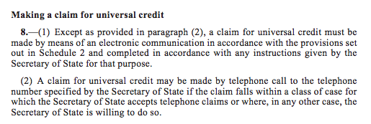
‘Non-digital relationships’
From the UC Claims and Payments Regulations…
What ‘class of case’ permits a telephone claim?
Call UC helpline, call is registered, and call back appointment made
Some will need to claim and maintain an award by telephone

Slide 41
“Spotlight on: claims by phone”
FOI response from DWP on 24/6/2019
To be allowed a phone claim, ALL these circumstances must apply…
Claimant must be unable to make a claim online independently, and
Claimant does not have anyone to support them to make a claim online, and
Is unable to claim online with in-house jobcentre support, and
Is unable to obtain help through the Citizens Advice etc, and
Process only be used when all other assisted digital options exhausted, and
All reasonable attempts have been made to enable support
Note: Such call may be made be an appointee (but same rules apply – see above)
Note: If claimant has a corporate appointee the new claim should always be taken by phone as a personal email cannot be provided
Note: If claimant does not satisfy the above circumstances but insists on making a claim by phone, they should be allowed to do so. Claimants should then be advised to contact the UC Service Centre number and an appointment will be booked for the claim to be taken by phone

Slide 42
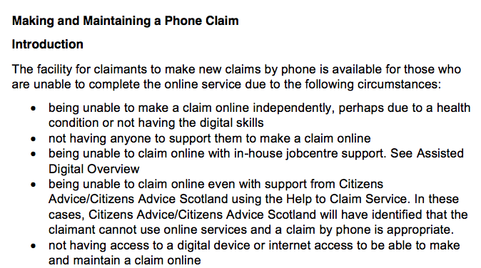
Clip from ‘Making and Maintaining a Phone Claim’
DWP guidance issued in August 2019

Slide 43
3. Conditionality and Complex Needs
UC/JSA conditionality still substantially held back?
Do you want a Second Opinion?
Does the Claimant Commitment reflect your Complex Needs?

Slide 44
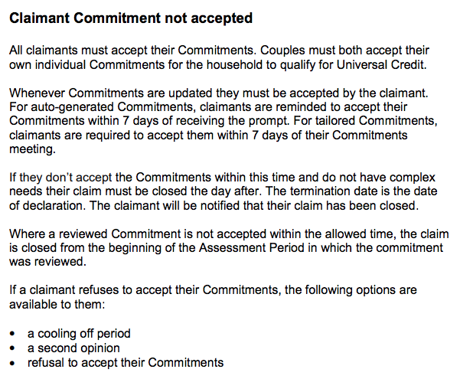
If you refuse to ‘ACCEPT’ and there are NO Complex Needs – you may then lose award…

Slide 45
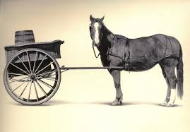
You cannot appeal nature of requirements in commitment – only sanction decision that follows

Slide 46
Do the REQUIREMENTS match your TRUE ABILITY?
A sanction referral will often be made if CC not complied with (hence need to optimise it so far as possible)…
Need to look carefully at requirements to see if claimant has truly failed – are claimant commitment requirements REASONABLE?
The claimant commitment may not have been properly drafted to reflect health issues /caring issues and so on
Claimants should certainly DISPUTE (although cannot appeal) any requirement that does not properly reflect the claimant’s ability
The adviser may well want to help with this
As a result of Covid, UC Work Search requirements were halted, as were – these are now resuming (?) – now sanction risks?

Slide 47

It all depends on your Work Coach
Variability in Work Coach approach can make a big difference
Notes:
CPAG case studies Page 5

Slide 48
Easement and Limitations
UC requirements may be subject to Easement in specified temporary circumstances (complex needs) - see next slide…
UC requirements are subject to statutory Limitations (some are permanent and others limited to set periods) – see later

Slide 49
Challenging lack of Complex Needs assessment of UC claimant commitment
A claimant commitment is supposed to take into account the ability of the claimant to keep to it…
See Regulations 95 and 97 of the main UC Main Regulations
See Regulation 97(2) – carers and allowed work search restrictions
See Regulation 79(6) – allows restrictions due to physical or mental impairments
See Regulation 88 – the legal framework permitting adjustments
See for example Chapter J3 of the UC ADM Guidance – para J3165
See for example DWP operational guidance – availability for work
Potential JR challenge for failure to apply above law
Are you up for these kind of challenges?

Slide 50
For example, the main messages in Regulation 95
‘All reasonable action’ is the gold standard od Work Search requirements and the main driver of limitation provisions
Time spent seeking work should be your ‘expected number of hours’ per week (see Reg 88) MINUS and ‘relevant deductions’
The test of ‘all reasonable action’ to get work (irrespective of number of expected hours) is not problematic as long as claimant has best prospects of obtaining work
‘Relevant deductions’ = volunteering (50% rule), work preparation, temp child care, domestic emergency, funeral, temp crisis

Slide 51
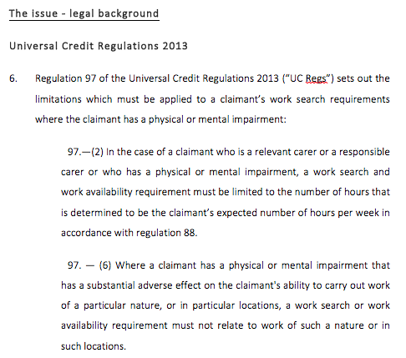
From CPAG JR pre-action letter JR39
To remedy unreasonable claimant commitment…
Note that the claimant commitment MUST be adapted to a reasonable level

Slide 52
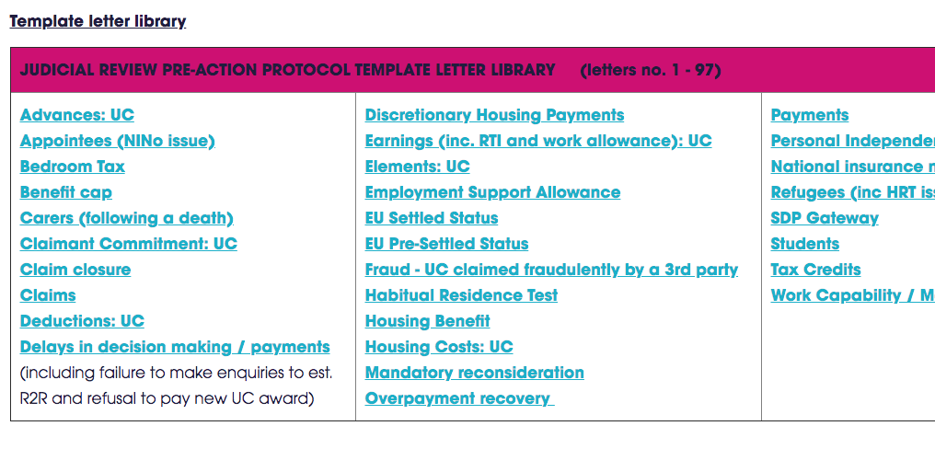
CPAG has a JR template letter library

Slide 53
Your 4 Point Sanction Action checklist
Subjective approach is vital at all levels (safeguards?)
1. Has the required compliance condition been properly and appropriately notified in view of this particular claimant?
⬇
2. Is the compliance condition reasonable, appropriate and achievable by this particular claimant? – see ‘limitations’ discussion
⬇
3. Has there been a breach that was within the capacity of this claimant? – see ‘limitations’ discussion
⬇
4. Is there a ‘’Good Reason’ defence for a sanctionable claimant?
⬇
Should you adopt a pro forma?

Slide 54
May help generate
conditionality limitation
Also a sanction buster
RR v SSWP

Slide 55
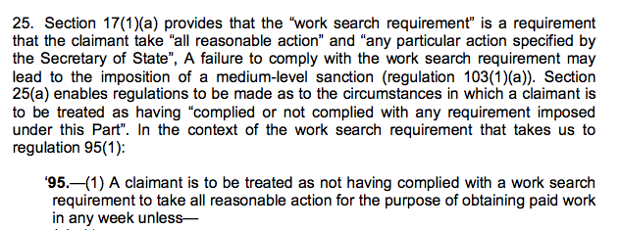

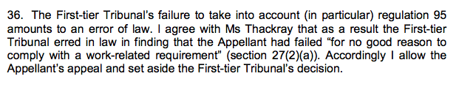
RR v SSWP: Limitation action is mandatory
s17 of WRA and Reg 95 include take ‘all reasonable action”
Suggests should pro-actively consider easement
Failure is an error of law

Slide 56
4. Complex needs in relation to Sanctions

Slide 57
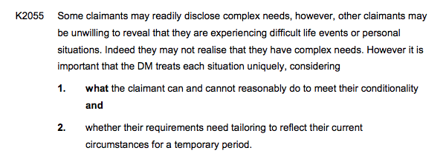
Complex Needs should addressed before conditionality is set by Jobcentre
Problem of failure to assess or disclosure of Complex Needs…and failure to update it

Slide 58
ADM J3 “Work-related requirements”
Complex Needs checks should be made before punishing
“J3257…It is essential therefore that where a claimant fails to comply with a work-related requirement, and before referring the case to a DM to consider sanction action, a check is made to see if there is any evidence that the claimant has a complex need which may require an easement to be applied. However, it may not be until the claimant fails to comply with a work–related requirement and faces a sanction that they actually disclose the personal difficulties they are facing in their ‘good reasons’.
Disclosure is often dependant on the sensitive nature or the complexity of the issue(s) and the vulnerability of the claimant. Some claimants fear being stigmatised because of their complex needs. In such cases, if the case has already been referred for a sanction decision, the DM will make a determination on ‘good reason’ for the particular failure and return the case to the adviser to consider temporarily suspending conditionality requirements.”

Slide 59
JB v SSWP (CSUC/494/2017)
Sanctions can only follow proper notification of valid requirements – see Memo ADM 05/19
Some of the main messages from this decision:
When tribunals consider sanctions, they must ask (i) if in-work requirements have been validly imposed (notified the ‘substance’)?, and (ii) is there good reason for any failure to comply with requirements?
Burden of proof on DWP to demonstrate proper notification – if DWP fails, any sanction must fail (list of expected documents to prove this)
Absence of formality in method of notification of UC work related requirements is intended to allow increased flexibility in scheme
But flexibility must come with control… public law principles of fairness dictate sanctions only apply if adequate notification and DWP records
Means of notification must be tailored to clients circumstances/needs

Slide 60
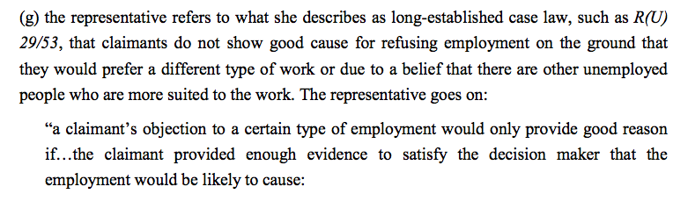
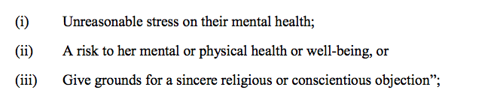
KB v SSWP (CUC/2274/2018)
Good Reason defence against UC sanction (para 29…)

Slide 61
KG v SSWP (CUC/563/2020)(6/11/2020)
Improper nature of requirement to attend interview
Claimant failed to attend JC+ phone interview, despite reminders
Claimant eventually attended an interview, but months later
Claimant produced GP letter confirming stomach ailment
Claimant was sanctioned – failure to comply WFI requirement
UT decided there was ambiguity in DWP notification to attend
Failure to properly require attendance / consequences of failure
Failure to specify the precise nature of interview
Therefore there was no failure to notify… therefore no valid breach of conditionality requirements… therefore no sanction
Also found the was ‘good reason’ for any failure

Slide 62
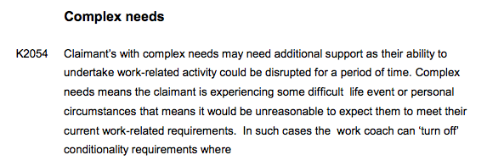
Before sanctioning, are there Complex Needs?
Protecting vulnerable claimants
Notice how ‘complex needs’ are frequently seen as ‘life events’ – implies short term – not convenient to consider possibility of permanent complex needs!

Slide 63
5. Deciding whether to jump ship to UC
What shape is UC in now?
Who wants to claim or jump ship?

Slide 64

Goodbye Legacy Benefits
Benefits that are being abolished due to UC
Income Support
Income based JSA
Income related ESA
Housing benefit
Tax credits

Slide 65
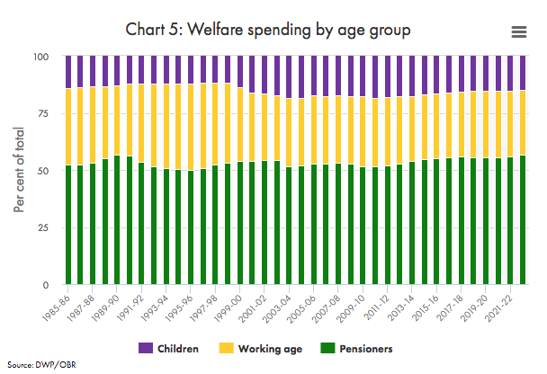
Benefit spending by age range (OBR)
UC is mainly targeting the yellow band

Slide 66
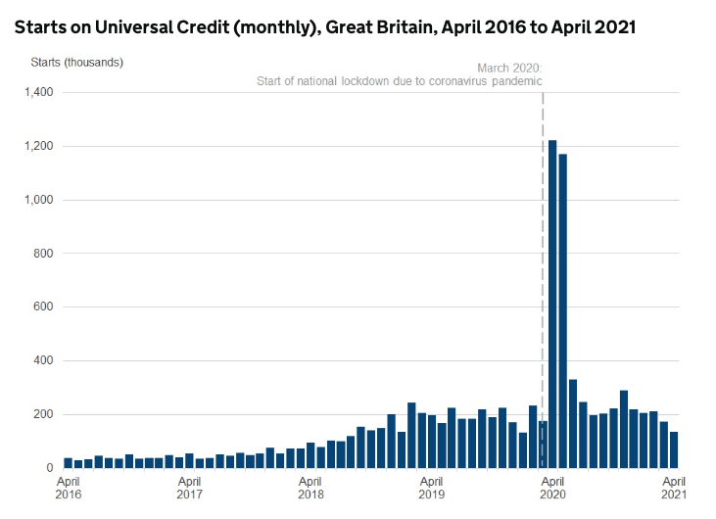
As UC start rate slows, more remain on Legacy
1.2 million starts in April 2020
170,000 starts in March 2021
130,000 starts in April 2021

Slide 67
Some UC claim figures to April 2021
There were 3 million UC claims as at March 2020
6 million claims by April 2021 (roughly 100% increase in a year)
There were 130,000 starts to UC in 5 weeks to 8/4/2021, a 23% decrease from March 2021
Percentage of women claiming UC is 49%
Proportion of UC claimants aged between 16 and 24 is 19%
89% of designated ‘work searchers’ sub-set have no work at all
37% are not working or are on low earnings
87% of UC claimants have UC actually in payment

Slide 68
Are claimants MORE COY about claiming UC?
From the ‘Welfare at a (Social) Distance’ report (April 2021)
Report concerns UC claims at start of COVID pandemic
Estimates around 220,000 claims for UC were NOT MADE by those who thought they WERE eligible
  59% chose not to claim because of perceived hassle / the UC claim process / risk of sanctions, and 27% because of stigma
Also estimates around 280,000 to 390,000 WRONGLY thought they were NOT eligible – a ‘sense’ of ineligibility
Nearly 50% were under severe financial strain
Nearly two thirds could not deal with an unexpected expense (like replacing a fridge)

Slide 69
Legal changes to squeeze out Legacy
Power to abolish Legacy was introduced (for example s33 and Schedule 6 Welfare Reform Act 2012, in this case regarding IRESA )
Commencement Order provide for abolition of legacy when a claim for UC is made (for example Article 4, regarding IRESA)
‘Submit Claim” = UC award = issue of Stop Notice = end of Legacy
Later, SDP Gateway regulations introduced to prevent UC claims in relation to certain disabled people on Legacy benefits
SDP Gateway regulations later revoked (27/1/2021)
No further impediment to eventual end of Legacy
Although still no requirement to claim UC – still the choice
Even at Managed Migration there will be a choice – Q live on air?

Slide 70
SDP Gateway
Born: 16/1/2019
Died: 27/1/2021
‘That’s all folks’

Slide 71
SDP revocation since 27/1/2021
Regulation 7 of Universal Credit (Managed Migration Pilot and Miscellaneous Amendments) Regs 2019 applies since 27/1/2021:
    “Abolition of restriction on claims by persons entitled to a severe disability premium
    7. Regulation 4A (restriction on claims for universal credit by persons entitled to a severe disability premium) of the Universal Credit (Transitional Provisions) Regulations 2014 is revoked.”
Revocation is intended to make a UC transfer more inevitable by removing last impediment to a UC claim (as well as NSJSA and NSESA)
Revocation also introduces possibility of ‘Transitional (SDP) Element’
But advantages of remaining a Legacy claimant (including SDP top up) remain in place until claimant is eventually migrated to UC – no pressure
See Memo ADM 01/21 for DWP guidance

Slide 72
How disabled people are now affected by UC
Revocation does NOT require anyone to claim UC
Revocation does NOT require transfer to UC if there is a change of circumstances affecting Legacy
Revocation does NOT affect the expansion of a Legacy award that is already in place (SDP or otherwise)

Slide 73
Are there any NEW or EXPANDED Legacy possibilities under Universal Credit domain?
SDP Gateway revocation has ENDED all NEW Legacy claim possibilities
New HB claims possible if in ‘Specified Accommodation’ or ‘Temporary Accommodation’ – but must claim UC for rest of needs – no SDP safety net
AWARDS of all pre-existing Legacy can be INCREASED (eg premiums)
SCOPE of all pre-existing Legacy awards can be EXPANDED (eg WTC on top of CTC, or IRESA / IBJSA on top of ‘old style’ CESA / CJSA)
OBR forecasting 50,000 increase in Natural Migration traffic by 2025/26, ‘saving’ £470 million otherwise payable if stayed on Legacy
3 million on Legacy now?... 1.6 million by point of Managed Migration?

Slide 74
T(SDP)E ‘UC Maximum Amount’ compensation
A different system since 27/1/2021
Here is ‘Transitional (SDP) Element’…

Slide 75
Who is eligible for T(SDP)E?
To get T(SDP)E you must satisfy all these requirements…
You are not forming a couple with a pre-existing UC claimant, and
You or your partner was receiving IS, IBJSA or IRESA at time of transfer to UC (HB receipt not relevant) or you were within the last month at point of transfer to UC (a rolling entitlement), and
Your Legacy award included SDP within the last month prior to the UC award, and continued to satisfy SDP requirements up to and including the first day of that UC award (see Reg 3 of Universal Credit (Transitional Provisions) (Claimants previously entitled to a severe disability premium) Amendment Regulations 2021)

Slide 76
Timing and T(SDP)E might be important
Must ensure pre-established entitlement to Legacy SDP status over a FULL LEGACY WEEK in order to qualify for T(SDP)E later on
The TIMING of this sequence could be important
May need to DELAY UC transfer to get full Legacy week on SDP?
But if you delay UC claim too long you could also lose out
Various possibilities to claim Legacy benefit RUN-ON amounts
Watch out for Legacy change of circumstances that might REVEAL NEW SDP status (eg death of partner, departure of partner etc)
PIP APPEAL TIMING?...‘Old UC Rules’ and ‘New UC Rules relevant
Date of UC claim since 27/1/2021 = New Rules = T(SDP)E potential
If you WIN PIP APPEAL during New Rules… restores SDP in Legacy, and then OPENS DOOR to T(SDP)E when you switch to UC

Slide 77
T(SDP)E: How much and how processed?
Ongoing fixed elements added to UC Maximum Amount:
£120.00pm – if on LCWRA element in Legacy before UC claim
£285.00pm If no LCWRA element in Legacy before UC claim
£405.00pm if a couple, if each with SDP entitlement
These amounts cannot increase… can only go down (see later)
Initial and subsequent amount rules:
During the first UC assessment period – fixed amount rules apply
During subsequent UC assessment periods – ‘treated as’ rules apply – as if it was Managed Migration ‘Transitional Element’ – see later
How is T(SDP)E processed by DWP?
Should be assessed proactively by DWP, but we suggest you put request T(SDP)E on UC journal + chase – there are appeal rights

Slide 78
Rahim is aged 52, lives alone. In LCWRA Group. Gets Enhanced DL PIP: NEEDS FIGURES if migrated...
IRESA needs amount…
Personal Allowance of £74.70pw
Support Group = £39.40pw
EDP = £17.20pw
SDP = £67.30pw
Total needs = £198.60pw
or £860.60pm with Rahim in Support Group
Universal Credit needs amount
Standard Allowance = £411.51pm
LCWRA Group element = £343.63pm
Transitional (SDP) Element =£120.00pm
Total needs = £875.14pm with Rahim in the UC LCWRA Group
Improved COVID standard allowance temporarily exceeds total Legacy would pay

Slide 79
Better news if relationship change
Nature of relationship change | When T(SDP)E can be awarded
You are now newly single | T(SDP)E can be awarded to EACH single person newly claiming UC, NO MATTER who if any was previously the lead Legacy claimant (as long as the UC claimant is SDP eligible at time / in last month)
You have newly formed a couple (making a new UC claim covering both parties) | T(SDP)E can be awarded on a couple basis, as long as you are BOTH SDP eligible at time / in last month
You have newly formed a couple, but one member of couple is ALREADY on UC | No T(SDP)E is payable at all

Slide 80
What might diminish ongoing T(SDP)E?
The TSDP)E amount is fixed for the first assessment period
From second assessment period it is ‘treated as’ Transitional Payment under Managed Migration – that permits T(SDP)E erosion
Therefore it is vulnerable to reductions if other changes of circumstances serve to increase your UC Maximum Amount
For example the arrival of a new baby; arrival of LCWRA element; increase in your rent etc will all reduce T(SDP)E pound for pound
Exception: increases in child care element are ignored
Which routine changes are most likely to apply to your client?
Might need a crystal ball to work this out
Might affect any decisions whether to Stick or Twist – see later

Slide 81
Termination of T(SDP)E
When T(SDP)E is terminated
When T(SDP)E is not terminated
UC Maximum Amount exceeded by increases due to changes of circumstances
Relationship change
Earnings drop to nil for four months or more
Earnings drop below threshold for more than three months
Loss of UC entitlement for other reasons
Clashes with Managed Migration Transitional Element
Someone subsequently gets carers allowance
Someone subsequently gets carer UC element
Non dependent moves in
PIP or DLA subsequently ends

Slide 82
‘Transitional SDP Element’ is inadequate…
Motion from Baroness Sherlock (Shadow Spokesperson [Work and Pensions]) to House of Lords on 11/2/2021…
  “…These regulations remove that gateway and give some compensation to those who will then be moving over to universal credit. But it is not full compensation; it does not compensate for the loss of the enhanced disability premium, only the severe disability premium. Nothing is paid where the SDP is attached only to housing benefit. And it is a fixed sum, which is reduced when any part of your universal credit rises, even if that is only because your rent has gone up. So claimants will see the support they receive fall in real terms, year on year.” (my emphasis)
Comment: These points may affect ‘Stick or Twist’ debate – see later

Slide 83
‘SDP Gateway’ effect is not finished
SDP Gateway regs are gone… no impediment to Natural Migration
But you can still activate T(SDP)E in pre-established Legacy cases
Even if you are on Legacy and only become disabled subsequently
Obtaining SDP Gateway in Legacy directly boosts Legacy now
Obtaining SDP Gateway status in Legacy insures you in case you slip into Natural Migration later (to some extent)
Obtaining SDP Gateway in Legacy status insures you when you are later subject to Managed Migration later
Vital that SDP status is remembered and promoted now
What does your web site say about this now? Is it on front page?
Do your clients understand any of this?

Slide 84
Natural Migration: Stick or Twist?
STICK!
Potential LEGACY advantages
TWIST!
Potential UC advantages
Retention of key Legacy premiums
Capacity to establish new premiums
Better off if disabled children
Value of legacy premiums exceeds level of UC compensation
System for self-employed people
Avoid increased UC debt recovery
On-line claim responsibilities
Variable work coach discretion
More conditionality/sanctions
Lack of need for ESA MR
Higher income, for example…
  If in LCWRA Group (if no PIP impact)
Better earnings disregards compared to Legacy possibilities
Higher child care support?
Added help for working carers
Better non-dep rules for most
Lodger income ignored by UC
Convenience of digital interface if you prefer it

Slide 85

In one pocket and out another…
GOOD NEWS
Covid Uplift payments have increased UC income by £20.00pw
BAD NEWS
Number of UC claimants Benefit Capped has
Therefore doubled

Slide 86
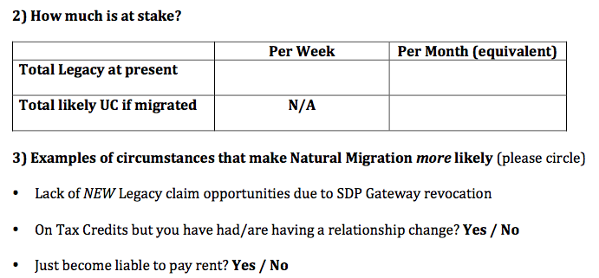
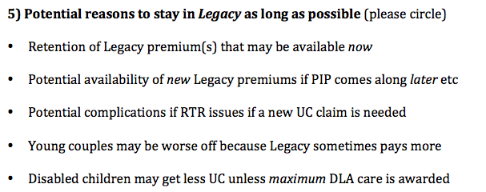
How about a Natural Migration Checklist?

Slide 87
6. A model to propose Complex Needs

Slide 88
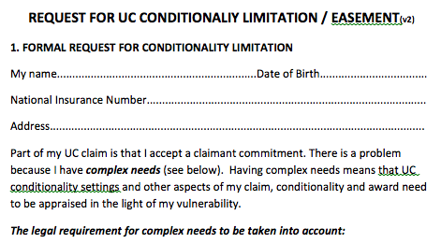
Targeted ‘complex needs’ request
Could this be amended further to suit your needs?

Slide 89
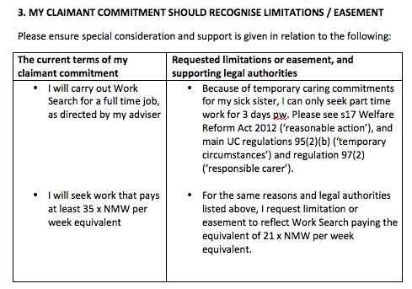
Example of requested easement
Are you up for this?
This data could feed into proposed ‘claimant profile’ system from DWP
If your client is ignored and a sanction follows, your client will be very well placed at appeal Tribunal

Slide 90
Unfortunate response from a Work Coach
A previous training proposed ‘Complex Needs’ status for a client using a paper based ‘easement’ pro forma
The adviser offered it by hand to a Work Coach at the Jobcentre
A frosty reception!
Work Coach said “It is not necessary”
Work Coach said “It might make things worse”
The Work Coach declined to accept the pro forma
The adviser did not press the issue at the time
What do you think? How might we handle this better?
How can we keep ‘Complex Needs’ on the DWP agenda?

Slide 91
7. Further matters and further training needs to consider
Domestic Abuse and ID verification
Advance Payments problems
Recovery of overpayments
Recovery of court fines
LHA rates
Food Bank usage data
Other proposals?

Slide 92
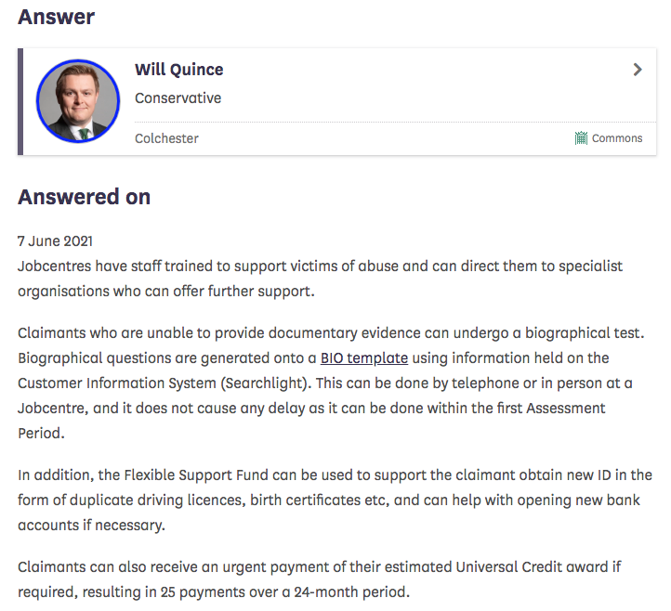
Domestic abuse and ID problems
House of Commons written answer UIN 7125 (25/5/2021)
Possible to switch to Biological ID test by phone or at jobcentre and no delay in payment if done promptly
Also reference to use of Flexible Support Fund (again!) to come to the rescue (re cost of duplicates) – does any one find this works?

Slide 93
UC Advance Payment recovery and the law
Recovery should relate to Reg 11 of Soc Sec (Overpayments and Recovery) Regs 2013 SI 384, stipulating recovery at following rates:
  30% of standard allowance (was 40%) if guilt is found/admission/penalties
  25% of UC standard allowance if earned income
  Otherwise 15% of UC standard allowance in all other cases
Note all these rules are pre-ambled by “may be recovered’ and all include “not more than” – this discretion is brushed aside by DWP
But we do not try to challenge this either…
DWP also asserts that Advance Payment recovery is not ‘recovered’ at all, but rather tied to ‘offset’ regulations via Soc Sec (POAB) Regs 2013 SI 383 (which says no maximum recovery rates apply!)
CPAG disagrees – potential JR if a good case arises
See also CPAG draft JR Template letter JR69 re awards / deductions

Slide 94
Recovery of UC Advance Payments
Nature of recovery (and Food Bank impacts)
Sharp rise to 5.7 million UC claims by October 2020
Unchanging policy = UC is paid in arrears… 1 month + 5 days rule
For many, no option but to seek a UC Advance Payment
Trussell Trust report… 47% of Food Bank households paying UC debt
  73% of Foodbank users on UC are repaying a UC Advance
  53% of those have someone in household with a mental health problem
Clearly considerable impact on those with complex needs
UC Advance Payments | Previously | April 2021 (not October)
Recovery Period: | 12m (+ 3m if hardship) | 24m
Max recovery rate: | 30% of Standard Allowance | 25%

Slide 95
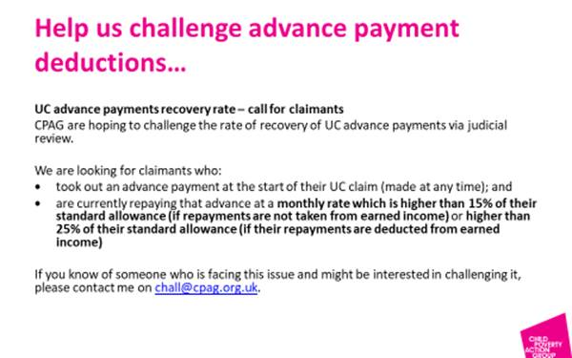
CPAG still want to pursue Advance Payments issue
From CPAG JR training course…

Slide 96
Recovery of UC UC overpayments
UC OPs are always recoverable (unlike in most Legacy cases)
OPs caused by claimant error risks a £50.00 Civil Penalty:
  Civil Penalty is recovered as well as the OP itself
  May be due to claimant negligence / failure to provide info or change of circs
  If a multiple failure cases, only one Civil Penalty should be considered
  Only one Civil Penalty can be imposed in couple cases (either)
DWP says no decision on recoverability needed once OP occurs
There is a right of appeal re OP and / or Civil Penalty decisions
All OPs must be identified and referred to UC Debt Management
Small OPs of £65.00 or under are not normally recovered
Non-fraud OPs normally recovered at 15% of Standard Allowance

Slide 97
What about the legal position regarding ordinary UC overpayments?
See s71ZB of Social Security Administration Act 1992 – it reads… “(1) The Secretary of State MAY recover any amount of the following paid in excess of entitlement…. (a) universal credit…”
See Regulation 11 of the Social Security (Overpayments an Recovery) Regulations 2013 – it reads… “in any other case, an amount equivalent to NOT MORE THAN 3 times 5 per cent of that allowance…” [in relation to non-fraud cases]
Therefore, there is a WIDE DISCRETION to limit amount and rate of overpayment recovery, but this is not being taken up by DWP
Older DWP guidance emphasised discretion in hardship cases
You may want to try your MP / Complaints etc

Slide 98
UC and Deductions – general problem
For 3 months since April 2020 reductions from UC for certain debts (TC overpayments, benefit overpayments etc) suspended
DWP data (April 2021) now confirms…
33% of ongoing UC awards subject to UC Advance recovery
15% for a Budgeting Advance
10% for a tax credit overpayment (Natural Migration consequence)
4% for a UC overpayment
Ongoing and long term reliance on food banks
Potentially possible to obtain reduction in recovery rate in relation to certain debts (if hardship grounds) – patchy success rates
See CPAG report ‘One Million COVID UC claimants have deductions’

Slide 99
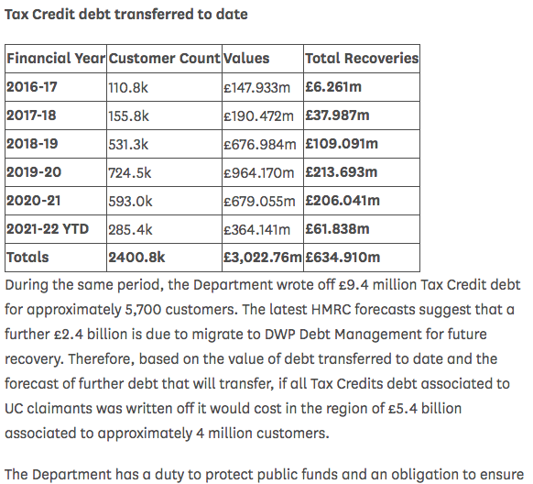
Tax Credits overpayments moving into UC
House of Commons written answer UIN HL55 (11/5/2021)
Total Tax Credit O/P debts moving to UC over 6 years = 2.4 million claimants
Total value of O/Ps = £3 billion (see table)
Total written-off so far = £9.4 million, or 3% of the total £3 billion debt
Total number of claimants helped by write-offs so far = 0.2% of 1% of claimants

Slide 100
Implications for TC claimants switching to UC
TC overpayments may be written-off as a matter of policy
Predictable high conversion from Legacy TC to UC (eg due to relationship breakdown, also loss of access to new HB claims etc)
Many people therefore set to migrate to UC
There will be billions of pounds to be recovered as UC debt
Note all UC badged overpayments are always recoverable
Government policy is go hard on all UC debt recovery
This means far more pressure on poorer claimants
Over a far longer period of time, to recover all the debt total
Apart from that, it is all ok
Inevitable increase in pressure on Food Banks…

Slide 101
UC Court fines: DWP policy is unlawful
See Blundell & Ors, R v SSWP [2021] EWHC 608 )Admin)
Case bought by SHELTER concerning group of rough sleepers
Concerns destitution after application of automatic maximum deductions (30%) to repay Court fines (an other case concerning disabled person left in hardship due to same policy)
High Court held current policy is unlawful (lack of exceptions)
You can now ask for a reduction in recovery levels
DWP has obtained permission to appeal
DWP may disregard reduction requests on light of pending appeal
DWP recently announced collection of court fines from UC will be restricted to 5% of Standard Allowance (from Oct 2021)

Slide 102
Changes to LHA rates since April 2021
Local Housing Allowance (LHA) rates were frozen as part of the COVID response since April 2020
LHA rates refrozen since April 2021, despite a predicted increase in unemployment to 2.6 million next year (see OBR report for details)
This means the rate will fall below the current level which is set to cover the lowest 30% of rents in any given area
This risks will a growing shortfall in their income against rent
Potential DHP bid needed?
From June 2021 care leavers in GB up to age 25 and those under 25 (if spent at least 3 months in homeless hostel) exempt from shared accommodation rate in UC / HB (was due to be from October 2023)
See LA Welfare Direct 3/ 2021

Slide 103
Trussell Trust: UC claimants and Food Banks
New Trussell Trust research released in May 2021
The “State of Hunger 2021” report
520,000 adults and 320,000 children used Food Banks in 2019/20
62% were disabled (3 x rate of general working age population)
18% of households were single parents (2 x rate of general working age population)
Main reasons for needing support are (i) shortfall in housing cost help (28%); (ii) wait before payments start (27%); and (iii) deductions / recovery from UC award (19%)
90% of UC claimants at Food Banks are already in debt
DWP now the most common creditor by those using Food Banks

Slide 104

UPCOMING WEBINAR
THE ART OF DEDUCTION: ISSUES AND CHALLENGES IN ADVISING CLAIMANTS ON DIRECT DEDUCTIONS FROM UNIVERSAL CREDIT
The system providing for recovery of various debts owed to third parties or directly to the Department for Work and Pensions is a perennial source of problems for claimants.
The webinar will look at:
An overview of how deductions work
Practical tips for, and experiences of, getting deductions paused or reduced.
Legal challenges to the practice of the DWP in taking deductions
THURSDAY 8 JULY 2021
1:00 - 4:00PM
FOR MORE INFORMATION AND TO BOOK YOUR PLACE, CLICK HERE

Slide 105

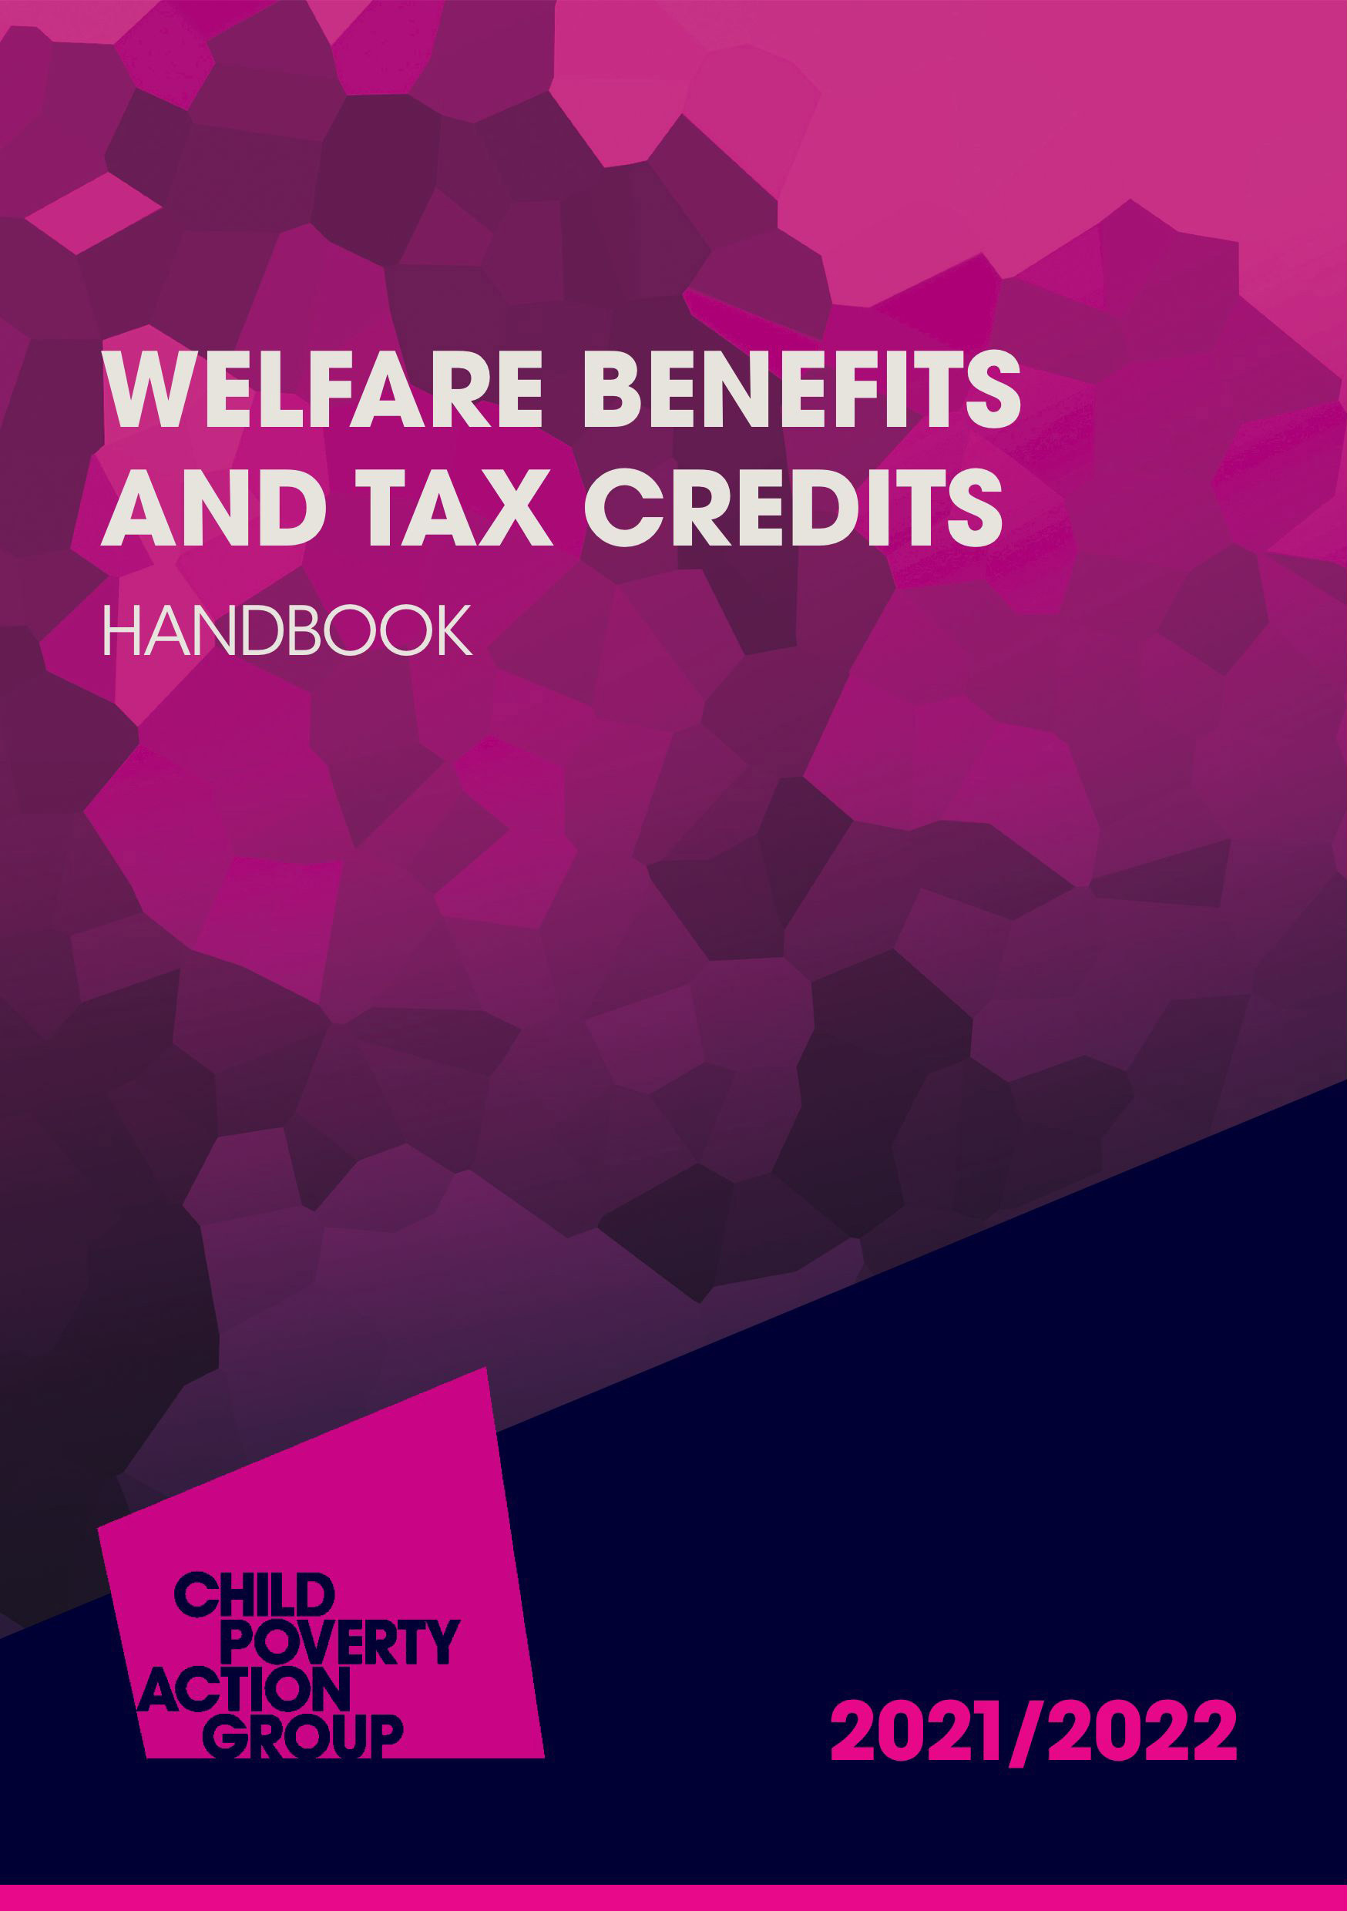

CPAG PUBLICATIONS
WITH THE BENEFIT SYSTEM UNDERGOING ITS MOST SIGNIFICANT REFORM IN A GENERATION, OUR EXPERT PUBLICATIONS HELP YOU TO KEEP UP-TO-DATE WITH ALL THE LATEST CHANGES.
From easy-to-follow guides, to volumes of legislation, you’ll find all the information and advice you need in our publications, no matter your level of experience.
Covering everything from universal credit and tax credits, to benefit entitlements for migrants and beyond, our sector-leading titles help you to navigate the complexities of the latest welfare reforms.
www.shop.cpag.org.uk
Please feel free to contact us with any enquiries
at bookorders@cpag.org.uk or call 020 7812 5236

Slide 106


CPAG ADVICE SERVICES
CPAG advice line for advisers
Tel: 020 7812 5231
Mondays to Friday : 10am – 12pm and 2pm - 4pm
Email advice on UC, tax credits and child benefit
advice@cpag.org.uk
Ask CPAG Online
cpag.org.uk/askcpag
Online information and advice on common problem areas

Slide 107

EARLY WARNING SYSTEM
THE MORE WE KNOW, THE MORE WE CAN DO
The Early Warning System (EWS) gathers information and case studies about the impact of welfare reform on children and families across the UK.
Tell us about:
Wrong decisions
Delays
Complications
Unclear rules
Unfair rules
Anything that is unfair to claimants
So we can:
Publicise problems
Challenge government
Promote solutions
Empower you
cpag.org.uk/early-warning-system
ews@cpag.org.uk 020 7812 5226

