Slide 1
Trauma Informed Counselling and Housing First
Housing First Rotherham

Slide 2
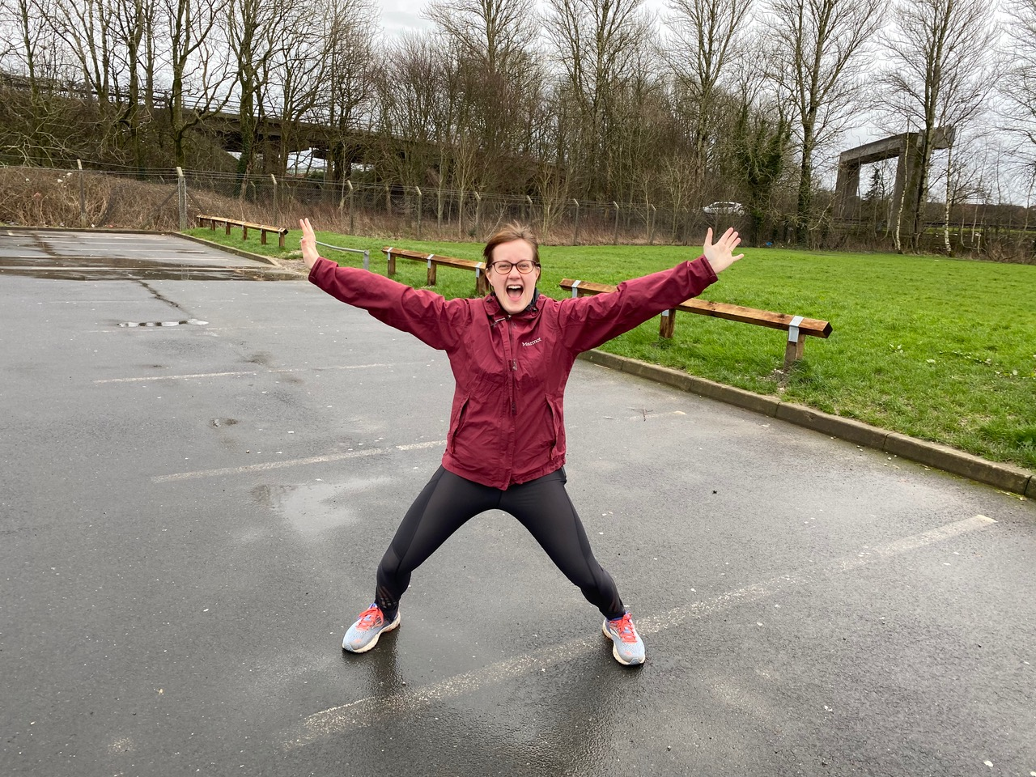
Why do we have a counsellor?
What does the counselling look like?
Any questions?
How does a Trauma Informed approach help?

Slide 3
Why have a Counsellor in Housing First?
Why do we have a counsellor?
Co-design
Healing
Systemic change

Slide 4
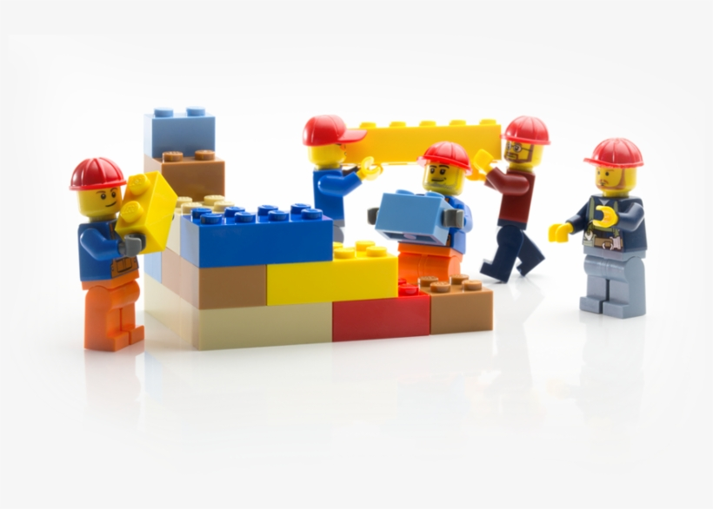
Housing First Counsellor
No waiting list;
Long term therapy
No penalty for missed or cancelled sessions
I travel to the customer
Counselling for people using substances
Barriers to mainstream counselling
Waiting list
Time limited support
Can’t miss or cancel too many sessions
Need to travel
Restricted appointment times
No unaddressed addiction
Co-design

Slide 5
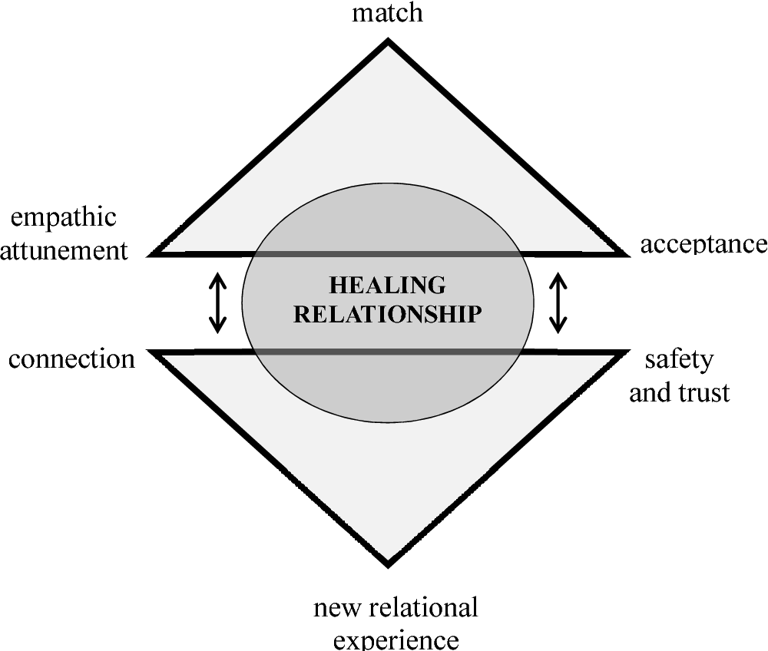
Healing

Slide 6
Systemic change
Trauma informed practice can become a way of working, a culture, a shared experience of soothing our ills.

Slide 7
Having a counsellor within the Housing First team sits really well with the key principles:
People have a right to a home
Flexible support
Housing and support are separate
Choice and control
Active engagement
Based on strengths, goals and aspirations
Harm reduction

Slide 8
What does the counselling look like?

Slide 9
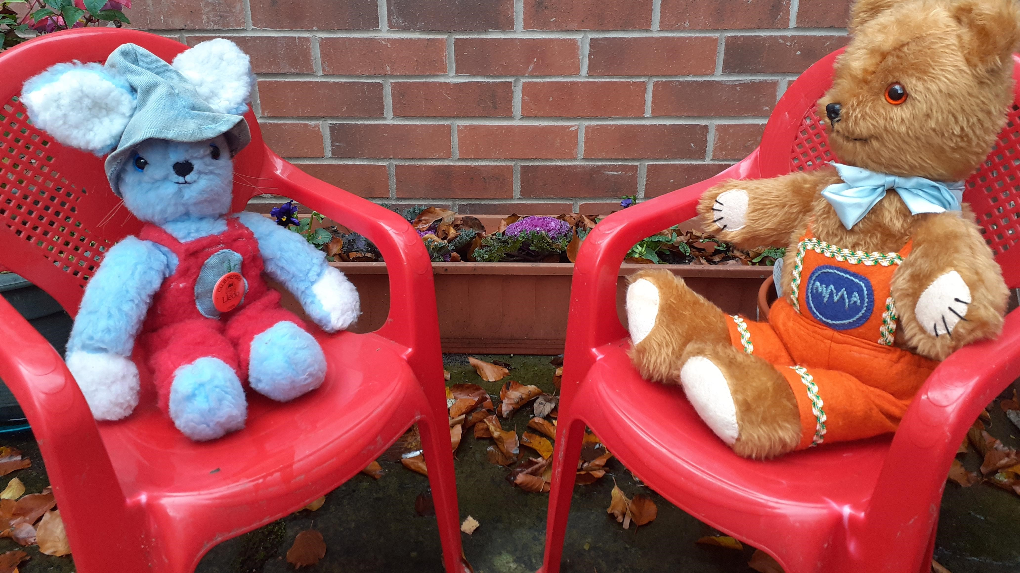
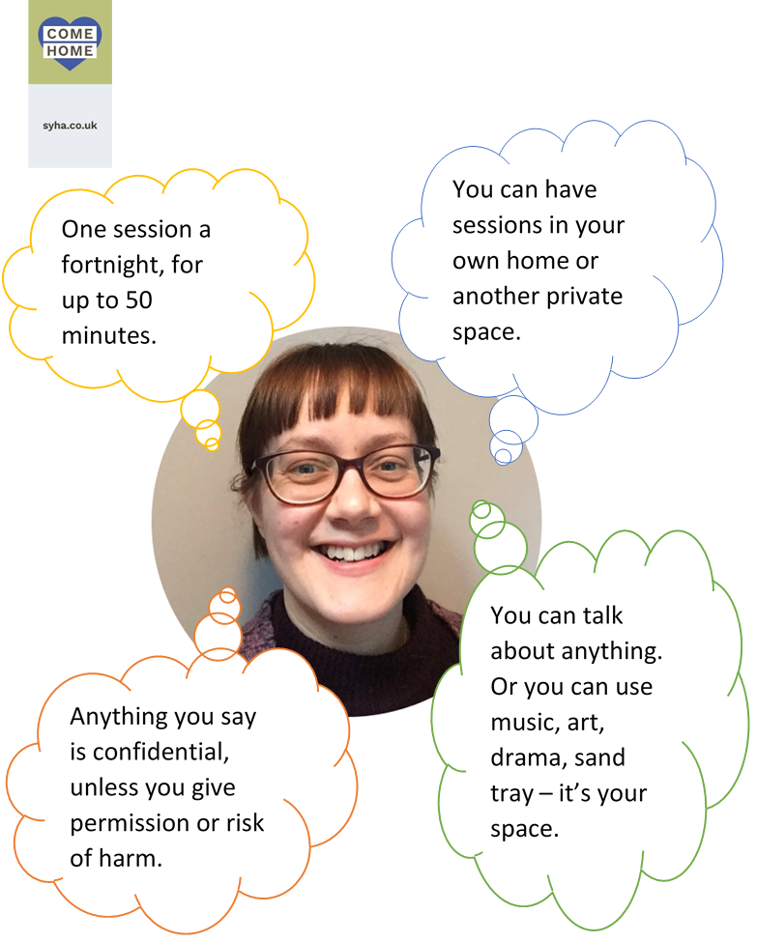
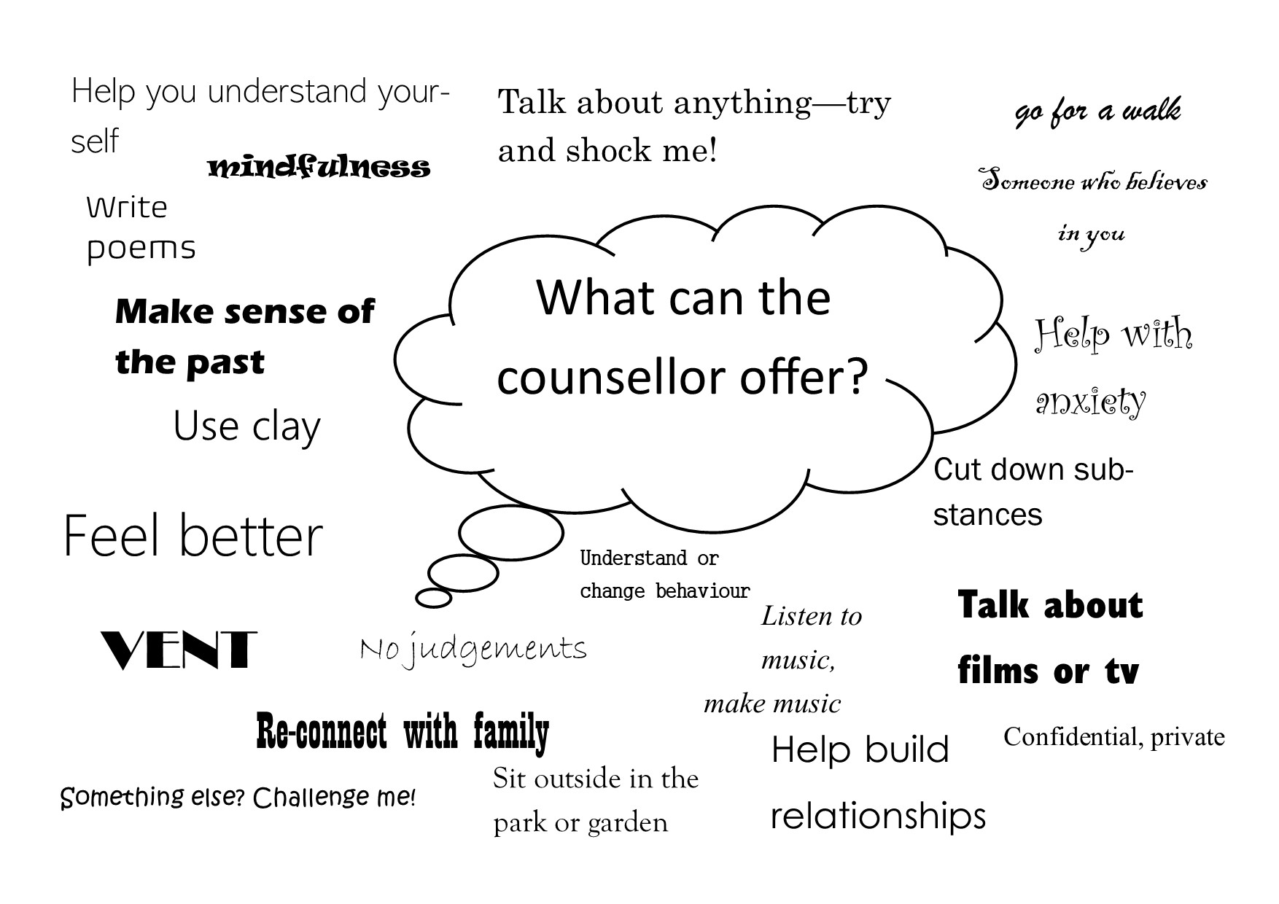
Individual counselling

Slide 10
“Reflective practice is not clinical supervision: it is a space within which the staff team can develop their thinking around what happens in the service.” Peter Cocksersell 2018
Reflective practice

Slide 11
Case dilemma
What do you want to happen?
What am I stuck with?
What happens when you…
How do you feel about…

Slide 12
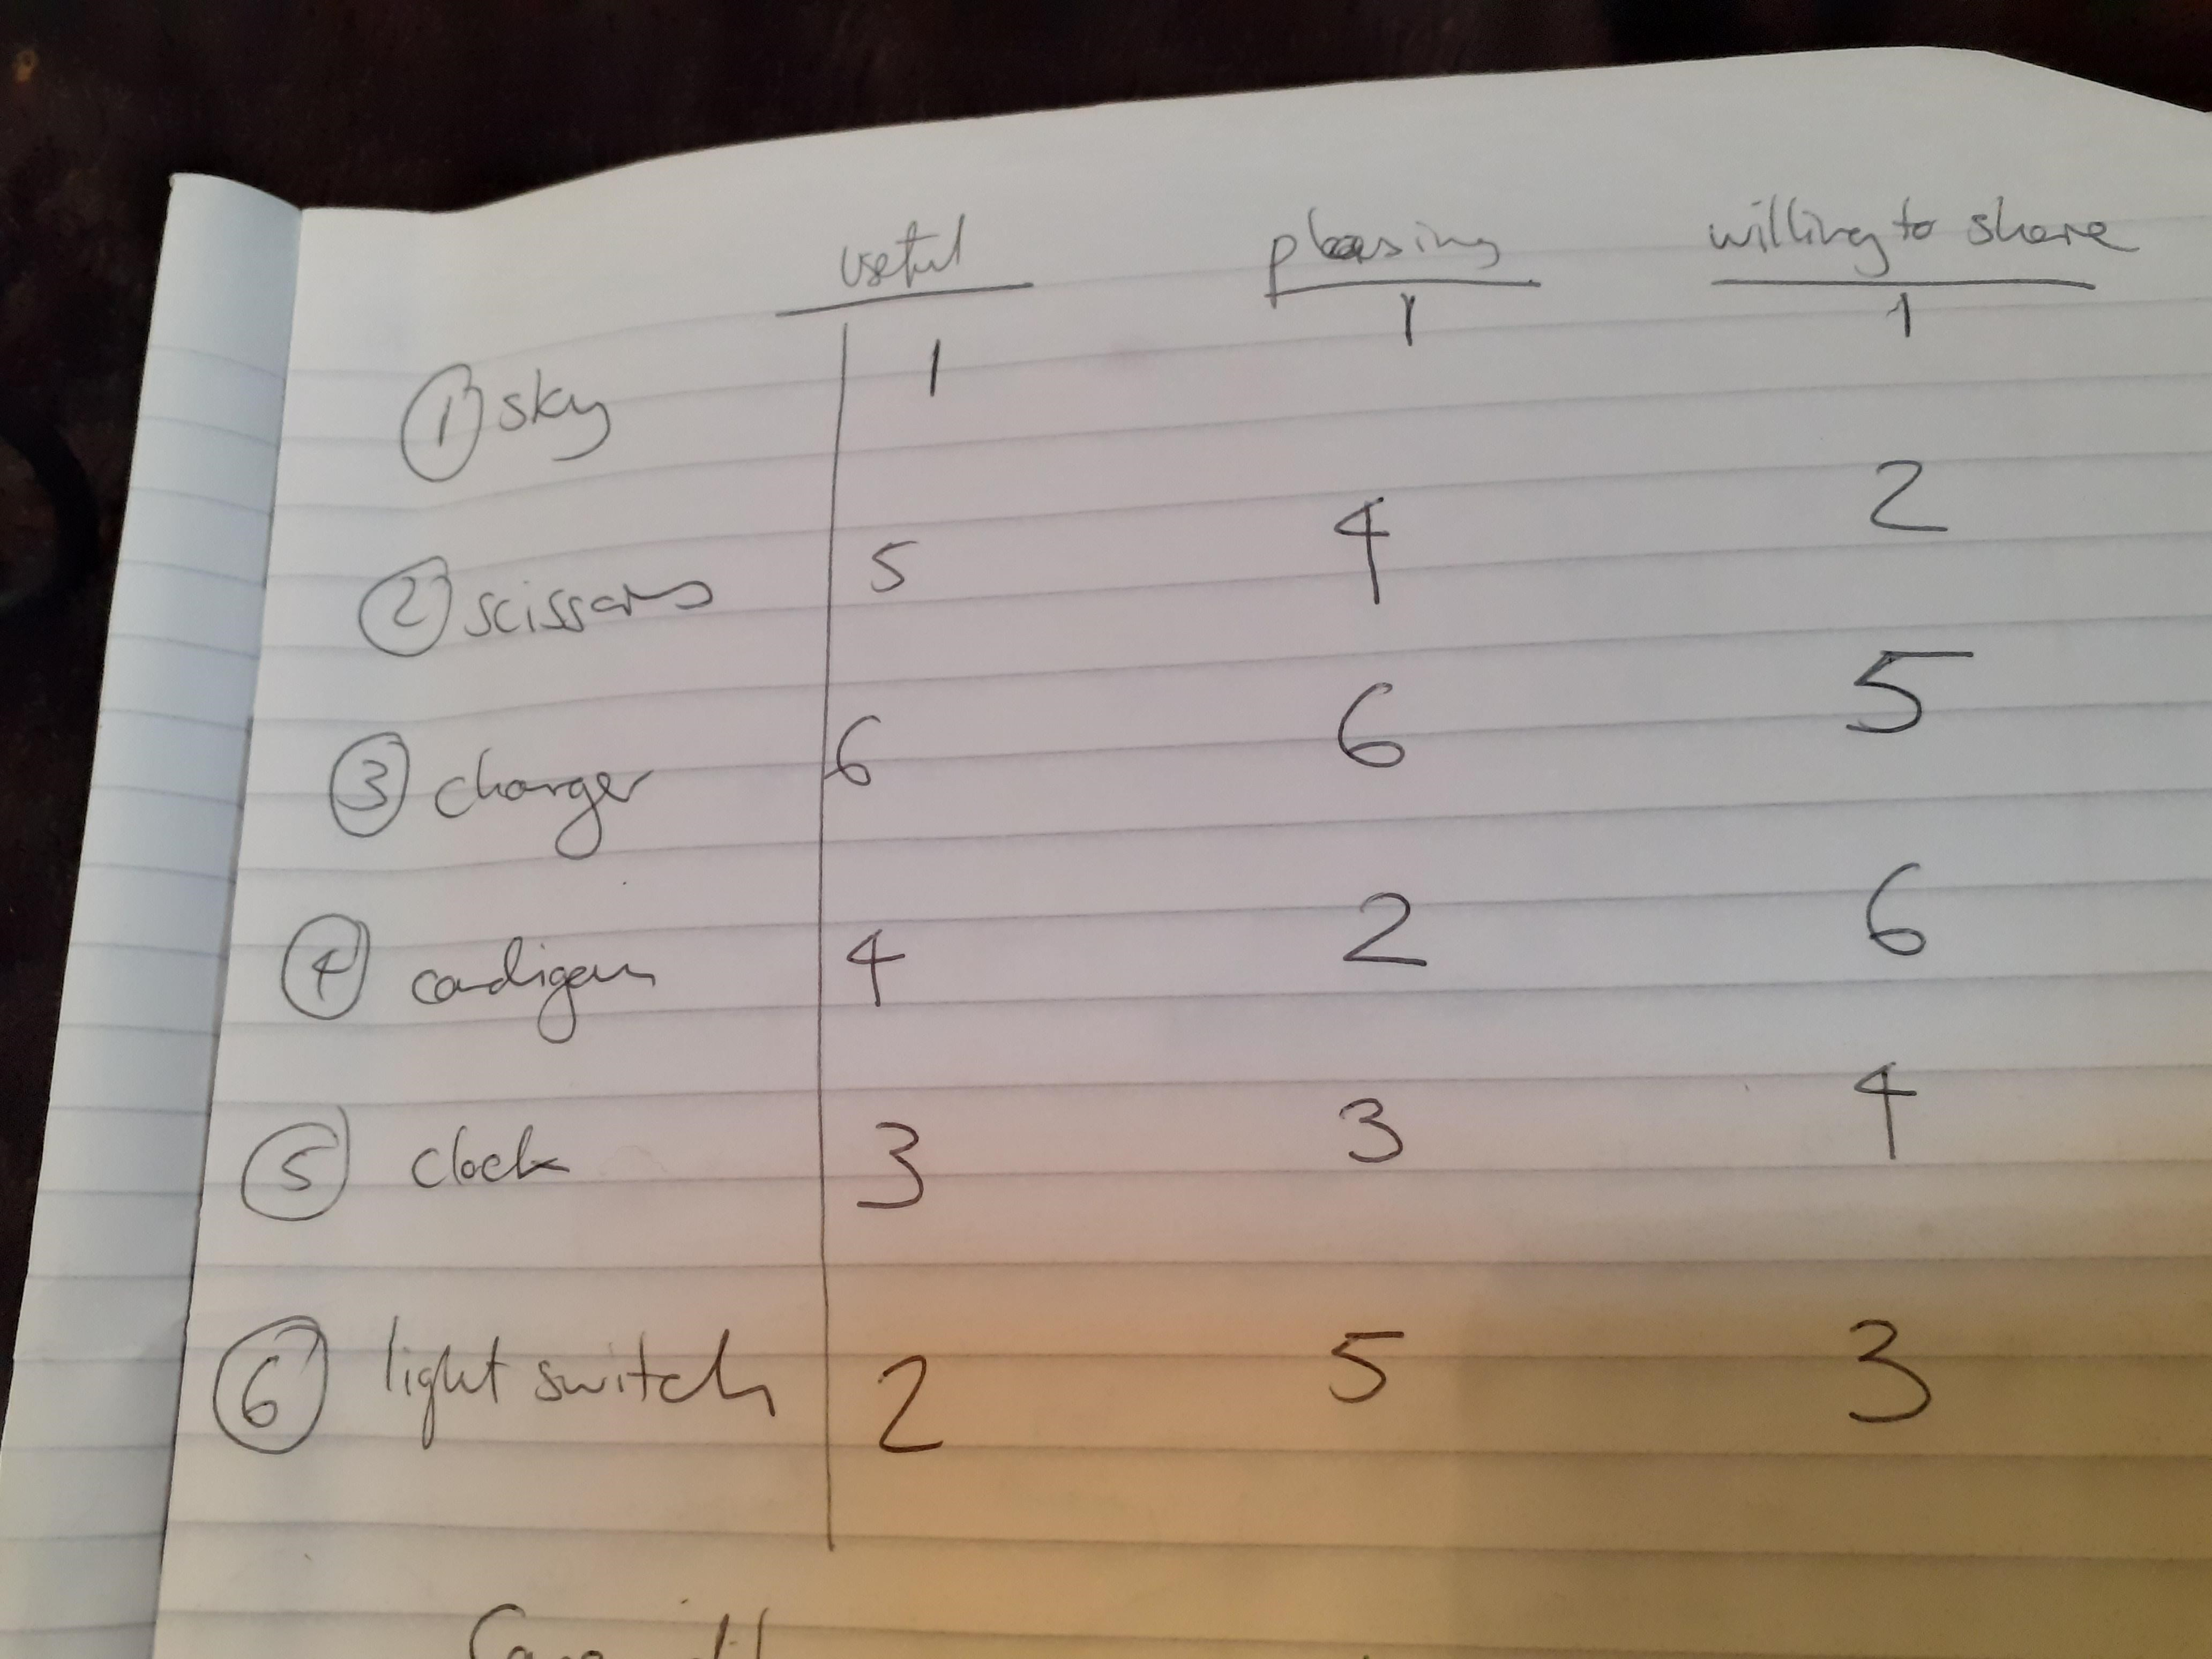
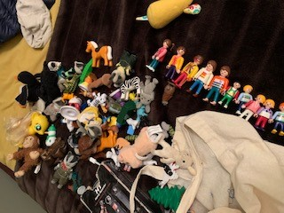
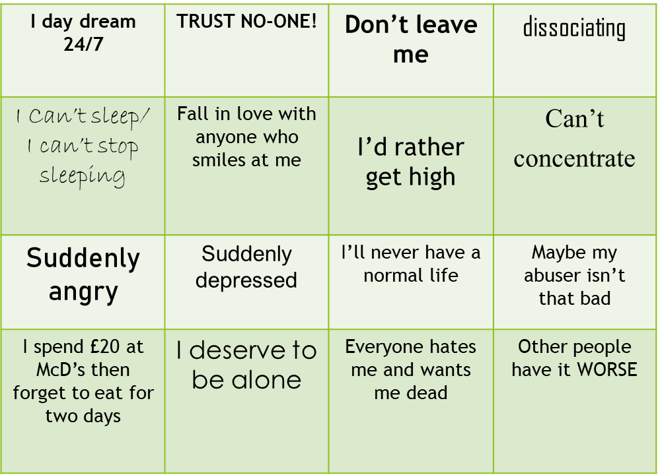
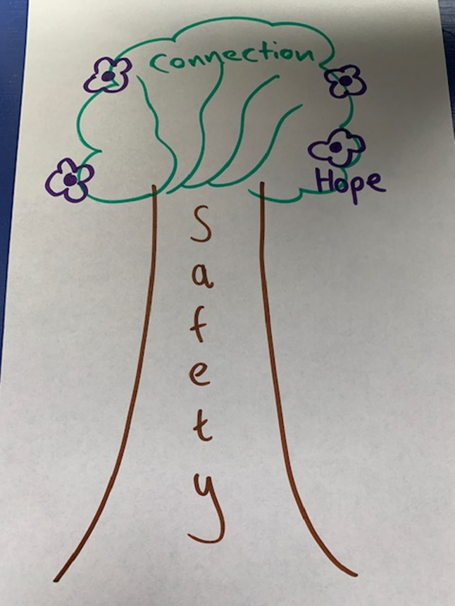
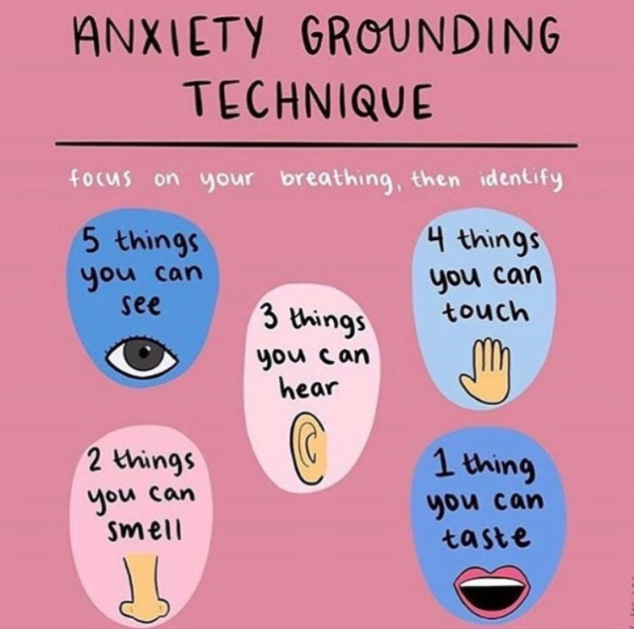
Reflective activity

Slide 13
Wider organisation
Training
Peer support groups
Listening ear during lockdown
Developing BLM workshops
Co-Creating a Mental Health First Aid Kit

Slide 15
How does a Trauma Informed Approach help?
Understanding the impact of trauma helps us recognise and respond to what our clients need.

Slide 16
Recognising the signs and symptoms helps us to respond
Behaviours may not make any sense, to you or the person. But they will be, in some way, about safety. About coping with what feels too much to deal with.
We are all trying our best. Behaviour is about trying to meet needs.

Slide 17
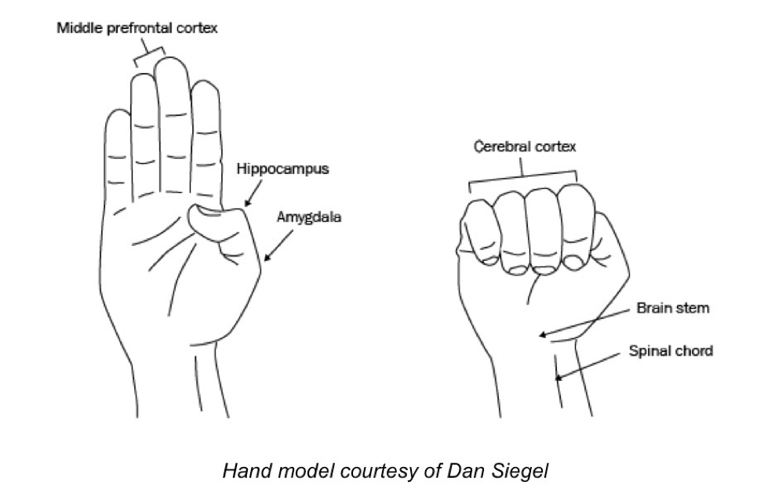
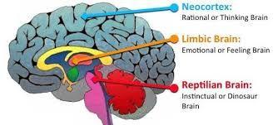
Realise the impact of trauma
TRAUMA
So how does trauma affect our brain?

Slide 18
Hyper arousal
How big is your window of tolerance?
dysregulation
dysregulation
Hypo arousal

Slide 19
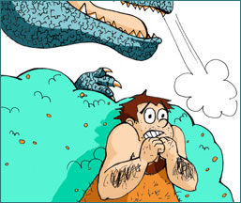
Hyper arousal
dysregulation
Freeze
dysregulation
Hypo arousal

Slide 20
Regulate
Relate
Reason/Reflect
Understanding the impact of trauma helps us resist re-traumatisation.
What helps you?

Slide 21
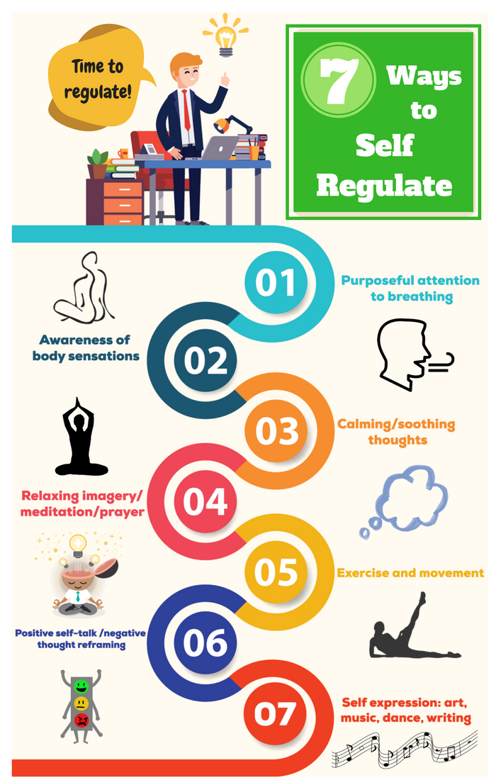

Slide 22
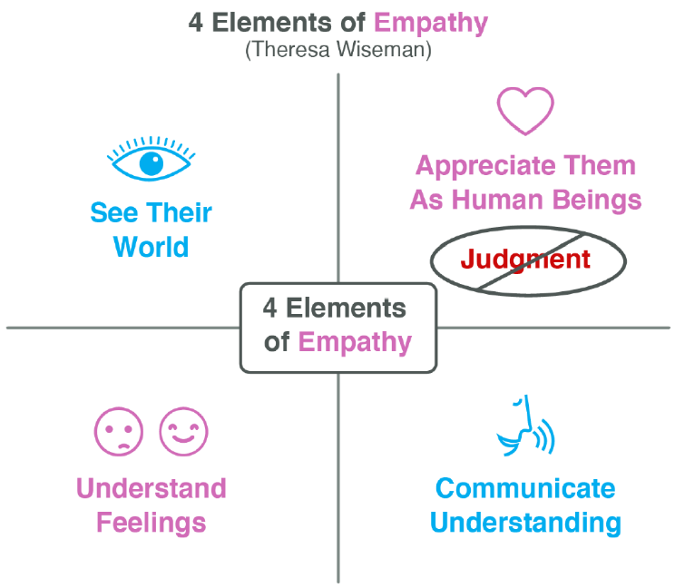
RELATE with empathy
How does a Trauma Informed Approach help?

Slide 23
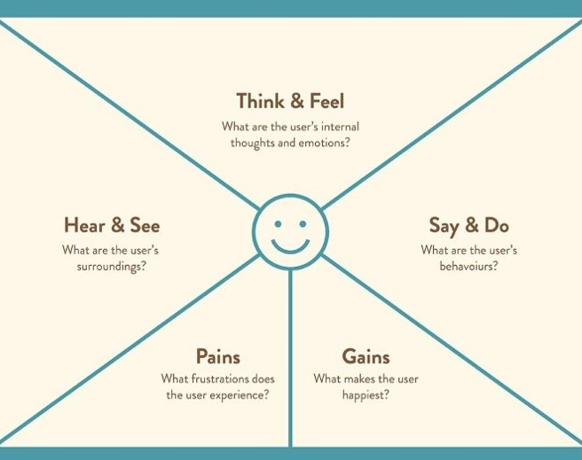
Empathy Mapping
Put yourselves in the shoes of the person by focusing on different aspects of their experience and internal dialogue. This exercise helps us understand the person and hopefully increase our empathy.

Slide 24
The importance of hope

Slide 25
Any questions?

