Slide 1
3rd October 2020

Slide 2
Who is Depaul?
Depaul is a dedicated cross-border charity helping people who are homeless or at risk of homelessness. We support some of the most marginalised of the homeless population.
Our Vision is of a society in which everyone has a place to call home and a stake in their community.
Our Mission is to end homelessness and change the lives of those affected by it.
Values
We celebrate the potential of people
We aim to take a wider role in civil society
We put our words into action
We believe in rights and responsibilities

Slide 3
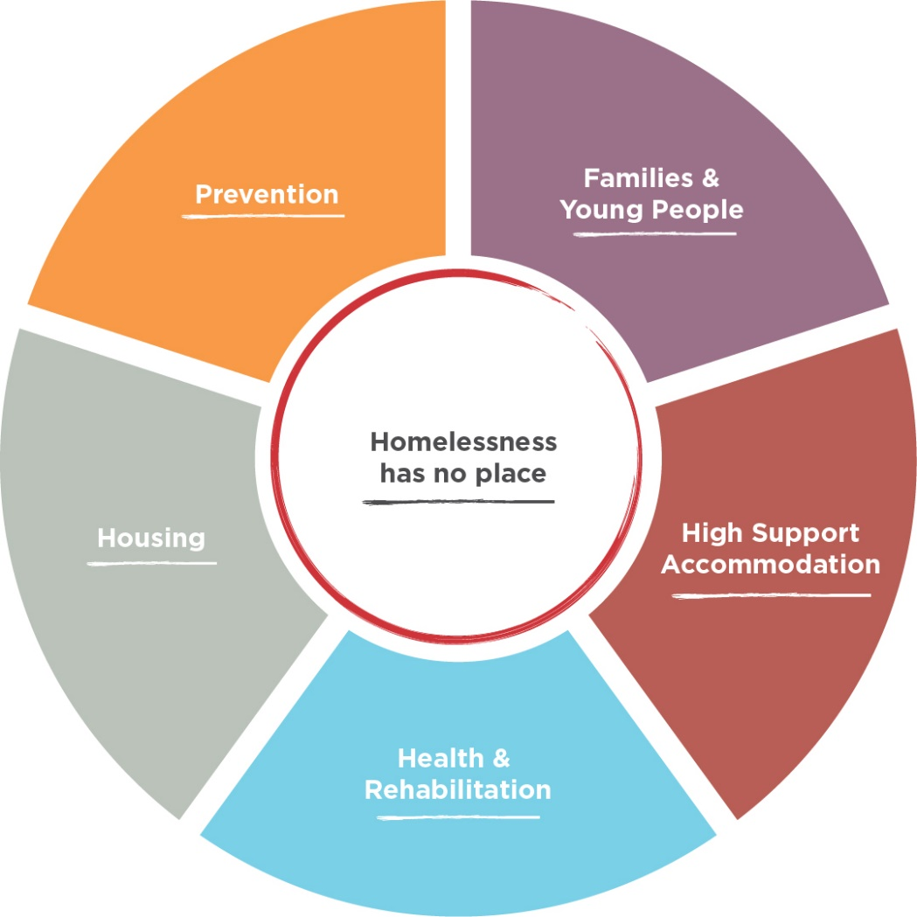
Who do we work with?
Last year, Depaul worked with 4,806 men, women and children across 5 main areas in our services…

Slide 4
History of the Service
Belfast Pilot 2013
2014 expansion of Belfast Service
2015 Findings published of the Belfast Pilot
2015 L/Derry service established
April 2018 –Fidelity Assessment
October 2020 – expanded service in response to the Pandemic

Slide 6
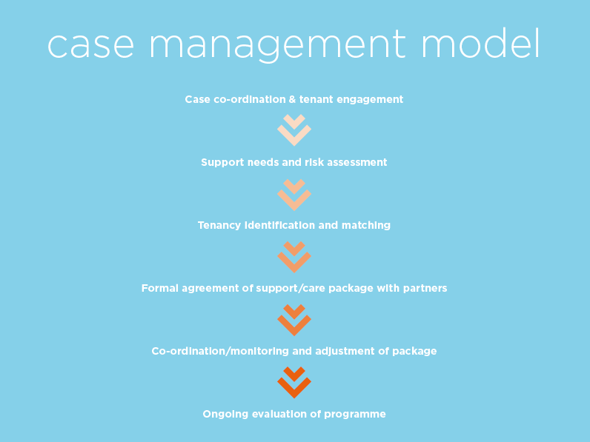

Slide 7
Referral Sources
Addiction Services
Prison Services & Probation
Housing Authorities
Internal – Depaul Services
Direct /Self Referrals
Hostel providers
GPs
Primary Care
Night Support Services
PSNI
Social Services including Mental Health Services
Housing Right

Slide 8
Depaul Case Management Toolkit
Depaul use an electronic client data management system to record all information in relation to the Service User Activity i.e –
Initial Needs Assessments
Support Planning
Keyworking/Case Management
Safety & Wellbeing Assessment/Management
Appointments
Referrals to other agencies/services

Slide 9
Fidelity Assessment
Housing Process and Structure
How Housing and Services are related
Service Philosophy
Service Array
Team Structure and HR

Slide 10
Methodology Used to Evaluate the Service
Pathways Housing First Programme
Internal assessment survey
Service user survey
External agency engagement

Slide 11
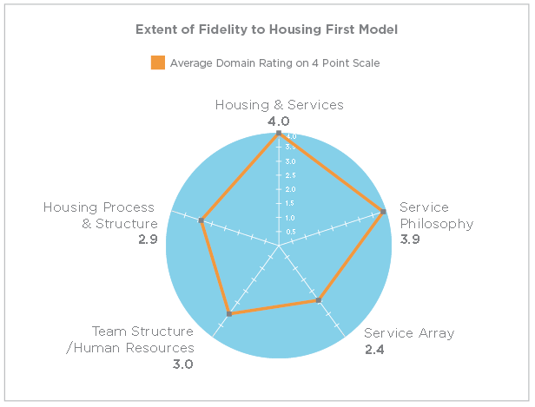
Fidelity Assessment

Slide 12
Key Findings
Depaul Housing First service operate with a high level of fidelity to the internationally recognised standards for Housing First. However, the lack of housing supply has a considerable impact on the capacity of each of the Housing First services.
There were 87 successful placements made by the 2 teams from 2015 to 2017. This equates to 74% of service users worked with in the same period of time.
Depaul Housing First teams have developed strong working relationships with statutory and community based services to support the work of wrap around services for service users in their tenancies, however the lack of formal agreements with these services is restrictive.
The social isolation and ability of service users to establish roots and to integrate within their new communities is a prevalent feature that affects the fidelity of the service delivery model.

Slide 13
Demographics
 | Belfast | Derry | Total
Total referrals accepted | 218 | 120 | 338
Age Range at referral date:
- 18 – 20 | 1 |  | 1
- 20+ | 50 | 33 | 83
- 30+ | 70 | 31 | 101
- 40+ | 54 | 41 | 95
- 50+ | 34 | 15 | 49
- 60+ | 6 | 3 | 9
MALE referrals accepted | 169 | 92 | 261
FEMALE referrals accepted | 46 | 31 | 77

Slide 14
Tenancy Sustainment
 | Total | %
Referrals accepted | 344
Placement into tenancies | 253 | 73.55%
Total remained in tenancy up to 1 year: | 81
Total remained in tenancy for 1-2 year: | 59
Total remained in tenancy for 2-3 years: | 25
Total remained in tenancy for 3+ years: | 27
Deaths between 2013 and 2020 | 31
Of the 253 individuals placed in tenancies 192 sustained a tenancy for 1 + years |  | 75.89%

Slide 15
CHALLENGES
Lack of social housing
Sourcing private rental accommodation
Tenants’ deposits having to be paid in advance
Housing Benefit not covering the full rent
Clients with no access to public funds
Clients potentially losing their Common Waiting List points if they engage with Housing First Service
Accommodating changes in the staffing complement
Formulating partnerships and devising interagency agreements
Getting the Housing First model understood

Slide 16
Service User Feedback
“Housing First helped me to facilitate and secure accommodation with Apex and work together as a team…Housing First helps provide support to me with my addiction and helps to facilitate me to appointments and remind me of these. I get to set my own goals, and decide where I want to go for help and support and Housing First helps and refers me.”
“If Housing First hadn’t helped me and sign post me to counselling and helped me out with housing and physical/mental health I would not be here today and I wouldn’t have been able to keep my father’s house. I’d be worse on the drugs and alcohol. I am happy that you have put me on to all the support that I am getting and I’ve never felt put under pressure to do it. Housing First referred me on to the Harm Reduction service which has been helping me with my anxiety, depression and a couple of physical health issues. I have felt involved in making decisions for my future and how best.”

Slide 17
Recommendations
^{1.}
A regional Housing First development strategy within the NIHE Homelessness Strategy 2017-2022 that assists in dealing specifically with chronic homelessness.
^{2.}
Further investment in Housing First as part of the solution to homelessness for a cohort of people with long-term homelessness and chronic health issues.
^{3.}
A regional strategy to be developed by the Department for Communities in partnership with NIHE to improve housing supply for Housing First tenancies.

Slide 18
Recommendations
^{4.}
A strategic and financial commitment towards Housing First Services by health and social services. This should be integrated with the NIHE homelessness strategy and action plan.
^{homelessness.}
^{5.}
Development of formal protocols for local health and community services in providing support to Housing First service users in the community, moving away from the successful but informal working arrangements that are in place at present.
^{6.}
Development of methods in which social isolation and community integration is addressed for the Housing First cohort. A development opportunity in this area is for peer involvement in the staffing model of Housing First services.

Slide 19
Impact of Covid
Social Isolation
Less Face to Face Engagement
Reliance on Technology
Remote Working
Housing Supply
Increasing Demand for HF Service
Demonstrated that Housing Led & Housing First is a more sustainable model

Slide 21
The principle of the manual
Developed primarily as an internal resource to guide our workers in the delivery of approach to the Housing First model. It is available on our E-Learning Platform
Future Partnerships - If we were to get into future partnerships this resource would be used to help support and inform the further development of Housing First Services

Slide 22
Contact Information
Organisational Email:
ie.depaulcharity.org
Deirdre Canavan
Senior Services Manager for Northern Ireland
Email: deirdre.canavan@depaulcharity.net
t. +442890647755 | m. +447966505607

