Slide 1

Housing First in England
An Introduction to the Principles
Alex Smith, Homeless Link

Slide 2

Homeless Link
Homeless Link is the national membership charity for organisations working directly with people who become homeless or who live with multiple and complex support needs. We work to improve services and campaign for policy change that will help end homelessness and secure a sustainable future for supported housing.

Slide 3
Housing First England
Ensure Housing First is available and viable to everyone that needs it in England, through:
Supporting service development and sharing good practice
Influencing policy and decision makers to overcome systemic barriers
Increasing understanding and evidence for the English context
www.hfe.homeless.org.uk
Let’s end homelessness together

Slide 4
Housing First in England
Number of services developed each year
Housing First England
Project began
Evaluation of nine
pilots published
Principles for HF in England published
MHCLG pilots funding announced
Housing First or Housing Led scoping
National HF conference
Camden HF pilot 2010
No. new services developed

Slide 5
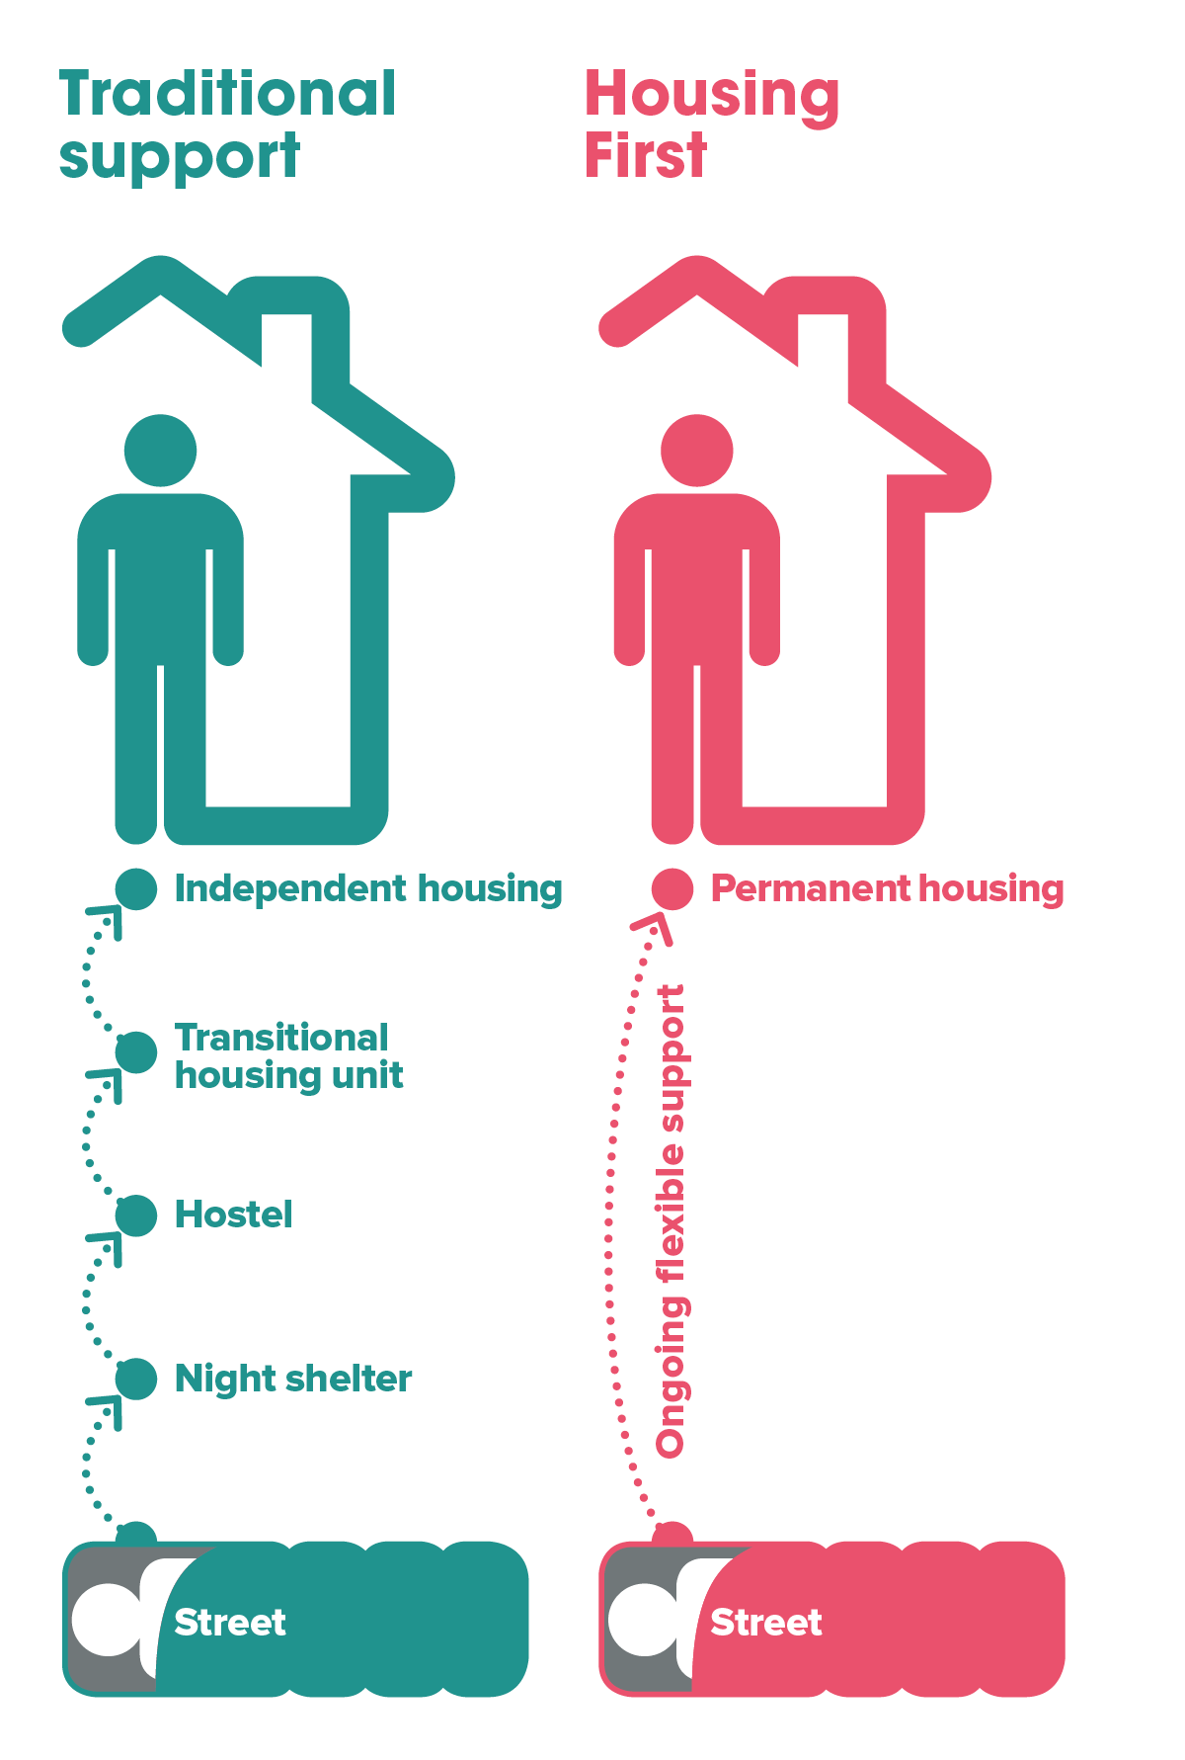
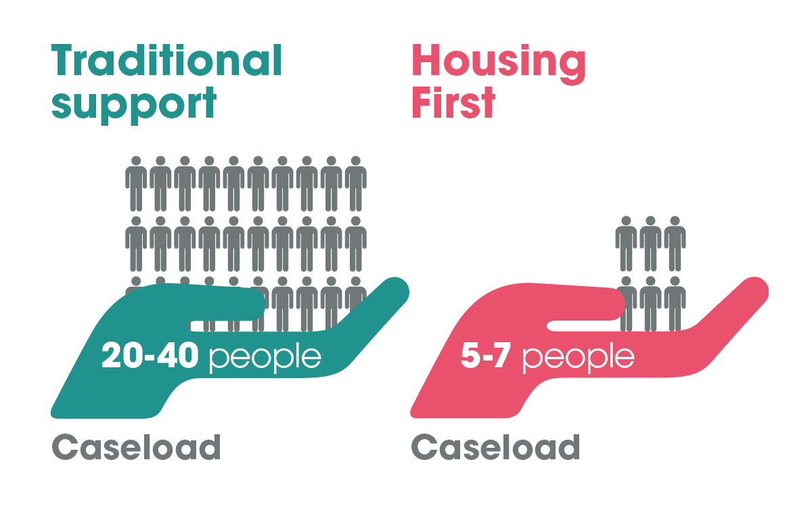
What is Housing First?
Long term housing and support
Complex needs
7 key principles
Solution for everyone
Expect people to cope alone
Immediate access

Slide 6

A consistent approach
Confusion over the Housing First model
Potential for low fidelity Housing First
Strong evidence for Housing First in the UK
Notes:
In 2015 we had done some scoping research into the use of HF in the sector and realised that knowledge was really mixed. People were using HF to describe different types of services - some very high fidelity, and others which were working with lower needs clients or providing less intensive support.

Slide 7

Developing the Principles
Consultation with Housing First services in England
Support from international experts
Launched in 2016
Notes:
In 2016, when HFE project started, we decided to launch the principles of HF to the sector - a key milestone for our project. At this point, we were aware of the Pathways and HF Europe principles. We worked with the University of York to understand more about the international context and use of HF, and decided to tweak the existing principles to make sure they were contextualised to our sector. This was essentially semantic; we changed the language to fit with the language used in our sector and we removed a principle about person-centred support as we felt this was inherent in other principles. The process involved HF services in England who fed back and helped us shape the document. Once that was done it was sent to international experts (e.g. Canada and Sam Tsemberis) for feedback. We launched them in Autumn 2016 at three events across the country. A couple of years later we developed the fidelity guidance and we are piloting the use of a fidelity assessment tool in the MHCLG pilot programme evaluation.

Slide 8

Housing First film

Slide 9

1
People have a right to a home
Prioritise access to housing asap
Eligibility is not contingent on any conditions other than willingness to maintain a tenancy
Housing provided is based on suitability rather than type of housing
Housing is not lost if they disengage or no longer require the support
Individual has their own tenancy agreement
www.hfe.homeless.org.uk
Let’s end homelessness together

Slide 10
2
Flexible support is provided for as long as is needed
Providers commit to long-term offers of support which do not have a fixed end date
Service designed for flexibility in amount of support provided, including dormant cases
Support provided for individual to transition away from service if a positive choice for them
The support links with relevant services across sectors that help to meet the full range of an individual’s needs
There are clear pathways into, and out of, the Housing First service
www.hfe.homeless.org.uk
Let’s end homelessness together

Slide 11
3
Housing and support are separated
Support is available to help people maintain a tenancy and to address any other needs they identify
An individual’s housing is not conditional on them engaging with support
The choices they make about their support do not affect their housing
The offer of support stays with the person – if the tenancy fails, the individual is supported to acquire and maintain a new home
www.hfe.homeless.org.uk
Let’s end homelessness together

Slide 12
4
Individuals have choice and control
Choose type of housing and where (defined by context, scattered and independent unless they want to live with others)
Have option not to engage with other services as long as there is regular contact with the Housing First team
Choose where, when and how support is provided by the Housing First team
Are supported through person-centred planning and are given the lead to shape the support they receive. Goals are not set by the service provider
www.hfe.homeless.org.uk
Let’s end homelessness together

Slide 13
5
An active engagement approach is used
Staff responsible for proactively engaging their clients
Making the service fit the individual instead of trying to make the individual fit the service
Caseloads are small allowing staff to be persistent and proactive in their approach, doing ‘whatever it takes’ and not giving up or closing the case when engagement is low
The team continues to engage and support the individual if they lose their home or leave their home temporarily
www.hfe.homeless.org.uk
Let’s end homelessness together

Slide 14
6
The service is based on people’s strengths
Philosophy that there is always a possibility for positive change and improved health and wellbeing, relationships and community and/or economic integration
Individuals supported to identify their strengths and goals and skills/knowledge to achieve these
Individuals are supported to develop increased self-esteem, self-worth and confidence, and to integrate into their local community
www.hfe.homeless.org.uk
Let’s end homelessness together

Slide 15
7
A harm reduction approach is used
People are supported holistically
Staff support individuals to reduce immediate and ongoing harm from substance misuse and self harm
Staff aim to support individuals to undertake practices that reduce harm and promote recovery in other areas of physical and mental health and wellbeing
www.hfe.homeless.org.uk
Let’s end homelessness together

Slide 16
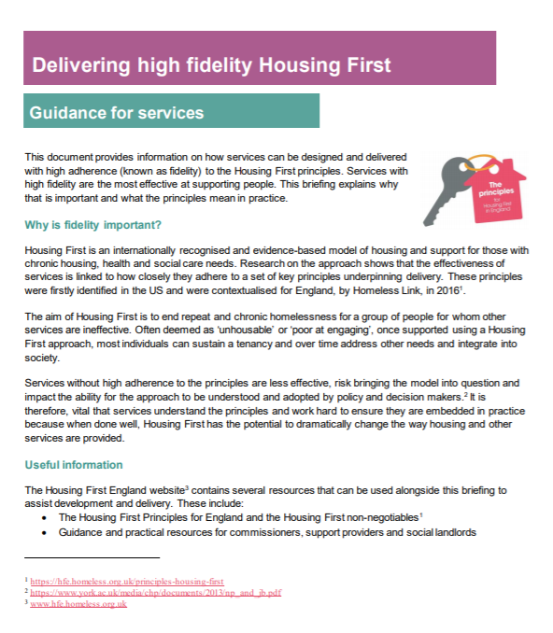
Fidelity Guidance
“The degree of exactness with which something is copied or reproduced”

Slide 17
Housing First England
More information:
Alex Smith
alex.smith@homelesslink.org.uk
@hf_england
Join the movement!
Visit www.hfe.homeless.org.uk

